Slide 1
HPC Computing with CUDA and Tesla Hardware
Timothy Lanfear, NVIDIA

Slide 2
What is GPU Computing?

Slide 3
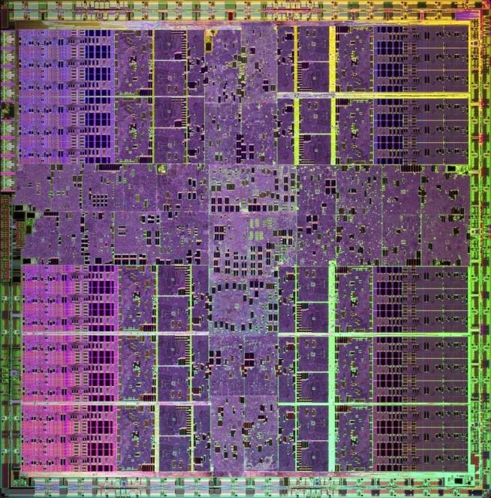
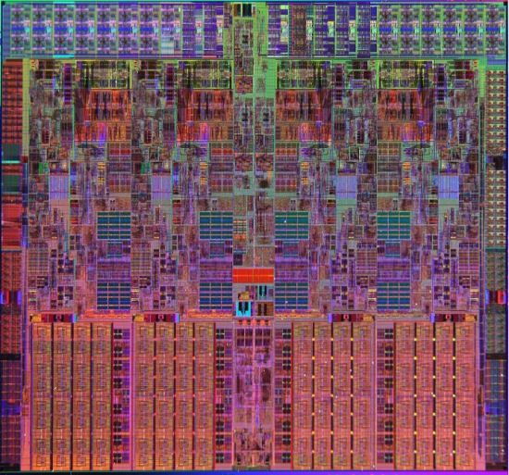
What is GPU Computing?
x86
PCIe bus
GPU
Computing with CPU + GPU
Heterogeneous Computing

Slide 4
Low Latency or High Throughput?
CPU
Optimised for low-latency access to cached data sets
Control logic for out-of-order and speculative execution
GPU
Optimised for data-parallel, throughput computation
Architecture tolerant of memory latency
More transistors dedicated to computation
Control
ALU
ALU
ALU
ALU
Cache
DRAM
DRAM

Slide 5
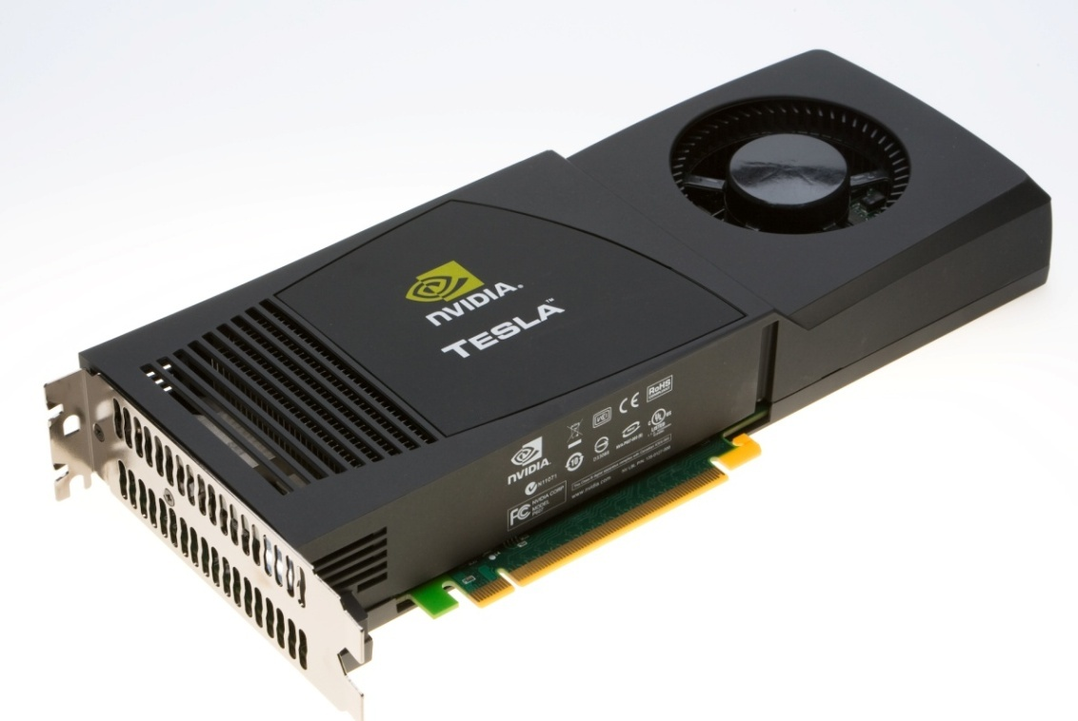
Tesla C1060 Computing Processor
Processor | 1 x Tesla T10
Number of cores | 240
Core Clock | 1.296 GHz
Floating Point Performance | 933 GFlops Single Precision
 | 78 GFlops Double Precision
On-board memory | 4.0 GB
Memory bandwidth | 102 GB/sec peak
Memory I/O | 512-bit, 800MHz GDDR3
Form factor | Full ATX: 4.736” x 10.5” Dual slot wide
System I/O | PCIe x16 Gen2
Typical power | 160 W

Slide 6
Tesla Streaming Multiprocessor (SM)
SM has 8 Thread Processors (SP)
IEEE 754 32-bit floating point
32-bit and 64-bit integer
16K 32-bit registers
SM has 2 Special Function Units (SFU)
SM has 1 Double Precision Unit (DP)
IEEE 754 64-bit floating point
Fused multiply-add
Multithreaded Instruction Unit
1024 threads, hardware multithreaded
32 single-instruction, multi-thread warps of 32 threads
Independent thread execution
Hardware thread scheduling
16KB Shared Memory
Concurrent threads share data
Low latency load/store
Notes:
6

Slide 7
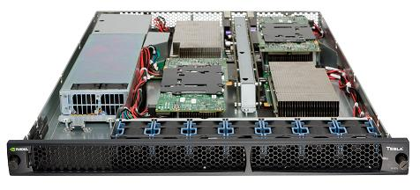
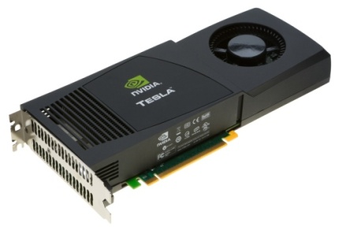
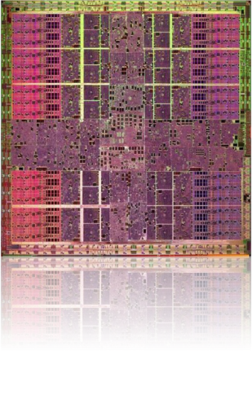
Computing with Tesla
240 SP processors at 1.5 GHz: 1 TFLOPS peak
128 threads per processor: 30,720 threads total
Tesla PCI-e board: C1060 (1 GPU)
1U Server: S1070 (4 GPUs)

Slide 8
CUDA Architecture

Slide 9
CUDA Parallel Computing Architecture
Parallel computing architecture and programming model
Includes a C compiler plus support for OpenCL and DirectCompute
Architected to natively support multiple computational interfaces (standard languages and APIs)
Application
C
OpenCL
Fortran
C++
Direct Compute
...
CUDA Architecture
Notes:
CUDA is an architecture with a number of entry points.
Today, developers are programming in C for CUDA. Using NVIDIA compilers. Programming language support for Fortran and other languages is coming soon.
Also, CUDA supports emerging API programming standards such as OpenCL. Because the OpenCL and CUDA constructs for parallelism are so similar, applications written in C can easily be ported to OpenCL if desired. OpenCL applications sit on top of the CUDA architecture.

Slide 10
NVIDIA CUDA C and OpenCL
CUDA C
Entry point for developers who prefer high-level C
Entry point for developers who want low-level API
OpenCL
Shared back-end compiler and optimization technology
PTX
GPU

Slide 11
CUDA Programming Model

Slide 12
GPU is a Multi-threaded Coprocessor
The GPU is a compute device that is:
A coprocessor to the CPU or host
Has its own memory space
Runs many threads in parallel
Data parallel portions of the application are executed on the device as multi-threaded kernels
GPU threads are very lightweight; thousands are needed for full efficiency

Slide 13
Heterogeneous Execution
Serial Code (CPU)
Parallel Kernel (GPU)
KernelA<<< nBlk, nTid >>>(args);
. . .
Serial Code (CPU)
Parallel Kernel (GPU)
KernelB<<< nBlk, nTid >>>(args);
. . .

Slide 14
Processing Flow
Work Distribution
GPU
Geometry Controller
Geometry Controller
SMC
SMC
CPU
I-Cache
I-Cache
I-Cache
I-Cache
Host CPU
PCI Bus
MT Issue
MT Issue
MT Issue
MT Issue
Bridge
C-Cache
C-Cache
C-Cache
C-Cache
SP
SP
SP
SP
SP
SP
SP
SP
CPU Memory
SP
SP
SP
SP
SP
SP
SP
SP
SP
SP
SP
SP
SP
SP
SP
SP
SP
SP
SP
SP
SP
SP
SP
SP
Copy input data from CPU memory to GPU memory
Load GPU program and execute, caching data on chip for performance
Copy results from GPU memory to CPU memory
SFU
SFU
SFU
SFU
SFU
SFU
SFU
SFU
Shared Memory
Shared Memory
Shared Memory
Shared Memory
Texture Unit
Texture Unit
Tex L1
Tex L1
Interconnection Network
ROP
L2
ROP
L2
DRAM
DRAM

Slide 15
Execution Model
A kernel is executed by a grid, which contain blocks
These blocks contain threads
Host
Device
Grid 1
Kernel 1
Block
(0, 0)
Block
(1, 0)
Block
(2, 0)
Block
(0, 1)
Block
(1, 1)
Block
(2, 1)
A thread block is a batch of threads that can cooperate
Sharing data through shared memory
Synchronizing their execution
Threads from different blocks operate independently
Grid 2
Kernel 2
Block (1, 1)
Thread
(0, 0)
Thread
(1, 0)
Thread
(2, 0)
Thread
(3, 0)
Thread
(4, 0)
Thread
(0, 1)
Thread
(1, 1)
Thread
(2, 1)
Thread
(3, 1)
Thread
(4, 1)
Thread
(0, 2)
Thread
(1, 2)
Thread
(2, 2)
Thread
(3, 2)
Thread
(4, 2)

Slide 16
Thread Blocks: Scalable Cooperation
Divide monolithic thread array into multiple blocks
Threads within a block cooperate via shared memory
Threads in different blocks cannot cooperate
Enables programs to transparently scale to any number of processors
Thread Block 0
Thread Block 1
Thread Block N - 1
threadID
0 | 1 | 2 | 3 | 4 | 5 | 6 | 7
0 | 1 | 2 | 3 | 4 | 5 | 6 | 7
0 | 1 | 2 | 3 | 4 | 5 | 6 | 7
…
float x = input[threadID];
float y = func(x);
output[threadID] = y;
…
…
float x = input[threadID];
float y = func(x);
output[threadID] = y;
…
…
float x = input[threadID];
float y = func(x);
output[threadID] = y;
…
…

Slide 17
Transparent Scalability
Hardware is free to schedule thread blocks on any processor
Kernel grid
Device
Block 0
Block 1
Device
Block 2
Block 3
Block 4
Block 5
Block 0
Block 1
Block 6
Block 7
Block 0
Block 1
Block 2
Block 3
Block 2
Block 3
Block 4
Block 5
Block 6
Block 7
Block 4
Block 5
Block 6
Block 7

Slide 18
Reason for blocks: GPU scalability
G80: 128 Cores
G84: 32 Cores
GT200: 240 SP Cores

Slide 19
Hierarchy of Threads
Thread
Computes result elements
Thread id number
Thread Block
Runs on one SM, shared mem
1 to 512 threads per block
Block id number
Grid of Blocks
Holds complete computation task
One to many blocks per Grid
Sequential Grids
Compute sequential problem steps
Thread
Block
t0 t1 t2 … tm
Grid
Bl. 0
Bl. 1
Bl. 2
Bl. n
. . .
Notes:
19

Slide 20
CUDA Memory
Block
Thread
Shared
Memory
Local Memory
Local barrier
Grid 0
Global barrier
Global
Memory
. . .
Sequential
Grids
in Time
Grid 1
. . .
Notes:
20

Slide 21
Memory Spaces
Memory | Location | Cached | Access | Scope | Lifetime
Register | On-chip | N/A | R/W | One thread | Thread
Local | Off-chip | No | R/W | One thread | Thread
Shared | On-chip | N/A | R/W | All threads in a block | Block
Global | Off-chip | No | R/W | All threads + host | Application
Constant | Off-chip | Yes | R | All threads + host | Application
Texture | Off-chip | Yes | R | All threads + host | Application

Slide 22
Compiling CUDA C
CUDA C
Application
Combined CPU-GPU Code
NVCC
CUDA C
Kernels
Rest of C
Application
CUDACC
CPU Compiler
CUDA object
files
CPU object
files
Linker
CPU-GPU
Executable

Slide 23
Compilation Commands
nvcc <filename>.cu [-o <executable>]
Builds release mode
nvcc –g <filename>.cu
Builds debug (device) mode
Can debug host code but not device code (runs on GPU)
nvcc –deviceemu <filename>.cu
Builds device emulation mode
All code runs on CPU, but no debug symbols
nvcc –deviceemu –g <filename>.cu
Builds debug device emulation mode
All code runs on CPU, with debug symbols
Debug using gdb or other linux debugger

Slide 24
Exercise 0: Run a Simple Program
CUDA Device Query (Runtime API) version (CUDART static linking)
There are 2 devices supporting CUDA
Device 0: "Tesla C1060"
CUDA Capability Major revision number: 1
CUDA Capability Minor revision number: 3
Total amount of global memory: 4294705152 bytes
Number of multiprocessors: 30
Number of cores: 240
Total amount of constant memory: 65536 bytes
Total amount of shared memory per block: 16384 bytes
Total number of registers available per block: 16384
Warp size: 32
Maximum number of threads per block: 512
Maximum sizes of each dimension of a block: 512 x 512 x 64
Maximum sizes of each dimension of a grid: 65535 x 65535 x 1
Maximum memory pitch: 262144 bytes
Texture alignment: 256 bytes
Clock rate: 1.44 GHz
Concurrent copy and execution: Yes
Run time limit on kernels: No
Integrated: No
Support host page-locked memory mapping: Yes
Compute mode: Exclusive (only one host thread at a time can use this device)
There is 1 device supporting CUDA
Device 0: "Quadro FX 570M"
Major revision number: 1
Minor revision number: 1
Total amount of global memory: 268107776 bytes
Number of multiprocessors: 4
Number of cores: 32
Total amount of constant memory: 65536 bytes
Total amount of shared memory per block: 16384 bytes
Total number of registers available per block: 8192
Warp size: 32
Maximum number of threads per block: 512
Maximum sizes of each dimension of a block: 512 x 512 x 64
Maximum sizes of each dimension of a grid: 65535 x 65535 x 1
Maximum memory pitch: 262144 bytes
Texture alignment: 256 bytes
Clock rate: 0.95 GHz
Concurrent copy and execution: Yes
Test PASSED
Press ENTER to exit...
Log on to test system
Compile and run pre-written CUDA program — deviceQuery

Slide 25
CUDA C Programming Language

Slide 26
CUDA C — C with Runtime Extensions
Device management:
cudaGetDeviceCount(), cudaGetDeviceProperties()
Device memory management:
cudaMalloc(), cudaFree(), cudaMemcpy()
Texture management:
cudaBindTexture(), cudaBindTextureToArray()
Graphics interoperability:
cudaGLMapBufferObject(), cudaD3D9MapVertexBuffer()

Slide 27
CUDA C — C with Language Extensions
Function qualifiers
__global__ void MyKernel() {} // call from host, execute on GPU
__device__ float MyDeviceFunc() {} // call from GPU, execute on GPU
__host__ int HostFunc() {} // call from host, execute on host
Variable qualifiers
__device__ float MyGPUArray[32]; // in GPU memory space
__constant__ float MyConstArray[32]; // write by host; read by GPU
__shared__ float MySharedArray[32]; // shared within thread block
Built-in vector types
int1, int2, int3, int4
float1, float2, float3, float4
double1, double2
etc.

Slide 28
CUDA C — C with Language Extensions
Execution configuration
dim3 dimGrid(100, 50); // 5000 thread blocks
dim3 dimBlock(4, 8, 8); // 256 threads per block
MyKernel <<< dimGrid, dimBlock >>> (...); // Launch kernel
Built-in variables and functions valid in device code:
dim3 gridDim; // Grid dimension
dim3 blockDim; // Block dimension
dim3 blockIdx; // Block index
dim3 threadIdx; // Thread index
void __syncthreads(); // Thread synchronization

Slide 29
SAXPY: Device Code
void saxpy_serial(int n, float a, float *x, float *y)
{
for (int i = 0; i < n; ++i)
y[i] = a*x[i] + y[i];
}
Standard C Code
__global__ void saxpy_parallel(int n, float a, float *x, float *y)
{
int i = blockIdx.x*blockDim.x + threadIdx.x;
if (i < n) y[i] = a*x[i] + y[i];
}
Parallel C Code

Slide 30
SAXPY: Host Code
// Allocate two N-vectors h_x and h_y
int size = N * sizeof(float);
float* h_x = (float*)malloc(size);
float* h_y = (float*)malloc(size);
// Initialize them...
// Allocate device memory
float* d_x; float* d_y;
cudaMalloc((void**)&d_x, size));
cudaMalloc((void**)&d_y, size));
// Copy host memory to device memory
cudaMemcpy(d_x, h_x, size, cudaMemcpyHostToDevice);
cudaMemcpy(d_y, h_y, size, cudaMemcpyHostToDevice);
// Invoke parallel SAXPY kernel with 256 threads/block
int nblocks = (N + 255) / 256;
saxpy_parallel<<<nblocks, 256>>>(N, 2.0, d_x, d_y);
// Copy result back from device memory to host memory
cudaMemcpy(h_y, d_y, size, cudaMemcpyDeviceToHost);

Slide 31
Exercise 1: Move Data between Host and GPU
Start from the “cudaMallocAndMemcpy” template.
Part 1: Allocate memory for pointers d_a and d_b on the device.
Part 2: Copy h_a on the host to d_a on the device.
Part 3: Do a device to device copy from d_a to d_b.
Part 4: Copy d_b on the device back to h_a on the host.
Part 5: Free d_a and d_b on the host.
Bonus: Experiment with cudaMallocHost in place of malloc for allocating h_a.

Slide 32
Launching a Kernel
Host
Device
Call a kernel with Func <<<Dg,Db,Ns,S>>> (params); dim3 Dg(mx,my,1); // grid spec dim3 Db(nx,ny,nz); // block spec size_t Ns; // shared memory cudaStream_t S; // CUDA stream
Execution configuration is passed to kernel with built-in variables dim3 gridDim, blockDim, blockIdx, threadIdx;
Extract components with threadIdx.x, threadIdx.y, threadIdx.z, etc.
Grid 1
Kernel
Block
(0, 0)
Block
(1, 0)
Block
(2, 0)
Block
(0, 1)
Block
(1, 1)
Block
(2, 1)
Block (1, 1)
Thread
(0, 0)
Thread
(1, 0)
Thread
(2, 0)
Thread
(3, 0)
Thread
(4, 0)
Thread
(0, 1)
Thread
(1, 1)
Thread
(2, 1)
Thread
(3, 1)
Thread
(4, 1)
Thread
(0, 2)
Thread
(1, 2)
Thread
(2, 2)
Thread
(3, 2)
Thread
(4, 2)

Slide 33
Exercise 2: Launching Kernels
Start from the “myFirstKernel” template.
Part1: Allocate device memory for the result of the kernel using pointer d_a.
Part2: Configure and launch the kernel using a 1-D grid of 1-D thread blocks.
Part3: Have each thread set an element of d_a as follows: idx = blockIdx.x*blockDim.x + threadIdx.x d_a[idx] = 1000*blockIdx.x + threadIdx.x
Part4: Copy the result in d_a back to the host pointer h_a.
Part5: Verify that the result is correct.

Slide 34
Exercise 3: Reverse Array, Single Block
Given an input array {a₀, a₁, …, a_{n-1}} in pointer d_a, store the reversed array {a_{n-1}, a_{n-2}, …, a₀} in pointer d_b
Start from the “reverseArray_singleblock” template
Only one thread block launched, to reverse an array of size N = numThreads = 256 elements
Part 1 (of 1): All you have to do is implement the body of the kernel “reverseArrayBlock()”
Each thread moves a single element to reversed position
Read input from d_a pointer
Store output in reversed location in d_b pointer

Slide 35
Exercise 4: Reverse Array, Multi-Block
Given an input array {a₀, a₁, …, a_{n-1}} in pointer d_a, store the reversed array {a_{n-1}, a_{n-2}, …, a₀} in pointer d_b
Start from the “reverseArray_multiblock” template
Multiple 256-thread blocks launched
To reverse an array of size N, N/256 blocks
Part 1: Compute the number of blocks to launch
Part 2: Implement the kernel reverseArrayBlock()
Note that now you must compute both
The reversed location within the block
The reversed offset to the start of the block

Slide 36
Performance Considerations

Slide 37
Single-Instruction, Multiple-Thread Execution
Warp: set of 32 parallel threads that execute together in single-instruction, multiple-thread mode (SIMT) on a streaming multiprocessor (SM)
SM hardware implements zero-overhead warp and thread scheduling
Threads can execute independently
SIMT warp diverges and converges when threads branch independently
Best efficiency and performance when threads of a warp execute together, so no penalty if all threads in a warp take same path of execution
Each SM executes up to 1024 concurrent threads, as 32 SIMT warps of 32 threads

Slide 38
Global Memory
Off-chip global memory is not cached

Slide 39
Efficient Access to Global Memory
Single memory transaction (coalescing) for some memory addressing patterns
128 bytes global memory
Linear pattern
Not all need participate
Anywhere in block OK
16 threads (half-warp)

Slide 40
Shared Memory
More than 1 Tbyte/sec aggregate memory bandwidth
Use it
As a cache
To reorganize global memory accesses into coalesced pattern
To share data between threads
16 kbytes per SM

Slide 41
Shared Memory Bank Conflicts
Successive 32-bit words assigned to different banks
Simultaneous access to the same bank by threads in a half-warp causes conflict and serializes access
Linear access pattern
Permutation
Broadcast (from one address)
Conflict, stride 8
Thread 0
Bank 0
Thread 1
Bank 1
Thread 2
Bank 2
Thread 3
Bank 3
Thread 4
Bank 4
Thread 5
Bank 5
Thread 6
Bank 6
Thread 7
Bank 7
Thread 15
Bank 15

Slide 42
Exercise 5: Optimize Reverse Array
Array reversal has a performance problem
Use the CUDA visual profiler to run the code
Look at
GLD_INCOHERENT
GST_INCOHERENT
WARP_SERIALIZE
Take a note of GPU Time
G80 Only

Slide 43
Exercise 5: Optimize Reverse Array
Goal: Get rid of incoherent loads/stores and improve performance
Use shared memory to reverse each block
Part 1: compute the number of bytes of shared mem
One element per thread
Part 2: implement the kernel
Comments should help
Don’t forget to compute the correct block offset!
Part 3: Profile the working code
Compare value of GLD/GST_INCOHERENT to previous
Compare GPU Time to previous
G80 Only

Slide 44
Reverse in Shared Memory
Global Memory
0
1
2
3
4
5
6
7
8
9
10
11
12
13
14
15
G80 Only
Coalesced Read
Local Variables (Registers)
0
1
2
3
4
5
6
7
8
9
10
11
12
13
14
15
Shared Memory
3
2
1
0
7
6
5
4
11
10
9
8
15
14
13
12
Coalesced Write
Global Memory
15
14
13
12
11
10
9
8
7
6
5
4
3
2
1
0

Slide 45
Matrix Transpose
Access columns of a tile in shared memory to write contiguous data to global memory
Requires __syncthreads() since threads write data read by other threads
Pad shared memory array to avoid bank conflicts
idata
odata
tile

Slide 46
Matrix Transpose
There are further optimisations: see the New Matrix Transpose SDK example.

Slide 47
Other GPU Memories

Slide 48
Texture Memory
Texture is an object for reading data
Data is cached
Host actions
Allocate memory on GPU
Create a texture memory reference object
Bind the texture object to memory
Clean up after use
GPU actions
Fetch using texture references text1Dfetch(), tex1D(), tex2D(), tex3D()

Slide 49
Constant Memory
Write by host, read by GPU
Data is cached
Useful for tables of constants

Slide 50
Execution Configuration

Slide 51
Execution Configuration
vectorAdd <<< BLOCKS, THREADS_PER_BLOCK >>> (N, 2.0, d_x, d_y);
How many blocks?
At least one block per SM to keep every SM occupied
At least two blocks per SM so something can run if block is waiting for a synchronization to complete
Many blocks for scalability to larger and future GPUs
How many threads?
At least 192 threads per SM to hide read after write latency of 11 cycles (not necessarily in same block)
Use many threads to hide global memory latency
Too many threads exhausts registers and shared memory
Thread count a multiple of warp size
Typically, between 64 and 256 threads per block
x = y + 5;
z = x + 3;

Slide 52
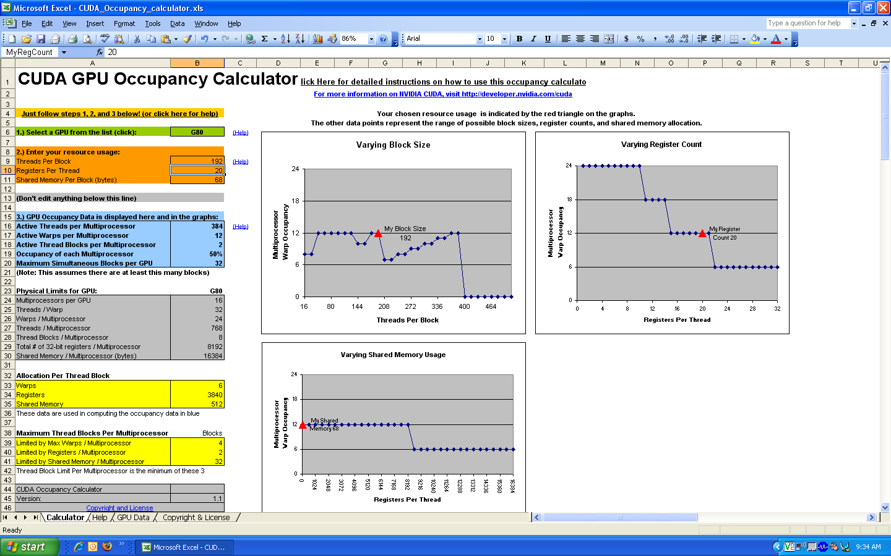
Occupancy Calculator
Occupancy calculator shows trade-offs between thread count, register use, shared memory use
Low occupancy is bad
Increasing occupancy doesn’t always help

Slide 53
Debugging and Profiling

Slide 54
Debugging
nvcc flags
–debug (-g) Generate debug information for host code
--device-debug <level> (-G <level>) Generate debug information for device code, plus also specify the optimisation level for the device code in order to control its ‘debuggability’. Allowed values for this option: 0,1,2,3
Debug with cuda-gdb a.out
Usual gdb commands available

Slide 55
Debugging
Additional commands in cuda-gdb
thread — Display the current host and CUDA thread of focus.
thread <<<(TX,TY,TZ)>>> — Switch to the CUDA thread at specified coordinates
thread <<<(BX,BY),(TX,TY,TZ)>>> — Switch to the CUDA block and thread at specified coordinates
info cuda threads — Display a summary of all CUDA threads that are currently resident on the GPU
info cuda threads all — Display a list of each CUDA thread that is currently resident on the GPU
info cuda state — Display information about the current CUDA state.
next and step advance all threads in a warp, except at _syncthreads() where all warps continue to an implicit barrier following sync

Slide 56
CUDA Visual Profiler
cudaprof
Documentation in $CUDA/cudaprof/doc/cudaprof.html

Slide 57
CUDA Visual Profiler
Open a new project
Select session settings through dialogue
Execute CUDA program by clicking Start button
Various views of collected data available
Results of different runs stored in sessions for easy comparison
Project can be saved

Slide 58
Miscellaneous Topics

Slide 59
Expensive Operations
32-bit multiply; __mul24() and __umul24() are fast 24-bit multiplies
sin(), exp() etc.; faster, less accurate versions are __sin(), __exp() etc.
Integer division and modulo; avoid if possible; replace with bit shift operations for powers of 2
Branching where threads of warp take differing paths of control flow

Slide 60
Host to GPU Data Transfers
PCI Express Gen2, 8 Gbytes/sec peak
Use page-locked (pinned) memory for maximum bandwidth between GPU and host
Data transfer host-GPU and GPU-host can overlap with computation both on host and GPU

Slide 61
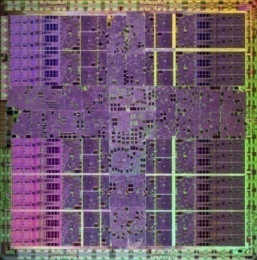
Application Software
(written in C)
CUDA Libraries
cuFFT
cuBLAS
cuDPP
CPU Hardware
CUDA Compiler
CUDA Tools
1U
PCI-E Switch
C
Fortran
Debugger Profiler
4 cores
240 cores

Slide 62
On-line Course
Programming Massively Parallel Processors, Wen-Mei Hwu, University of Illinois at Urbana-Champaign http://courses.ece.illinois.edu/ece498/al/
PowerPoint slides, MP3 recordings of lectures, draft of textbook by Wen-Mei Hwu and David Kirk (NVIDIA)

Slide 63
CUDA Zone: www.nvidia.com/CUDA
CUDA Toolkit
Compiler
Libraries
CUDA SDK
Code samples
CUDA Profiler
Forums
Resources for CUDA developers

