Slide 1
High-Performance Computing with NVIDIA Tesla GPUs
Timothy Lanfear, NVIDIA

Slide 2
Why GPU Computing?

Slide 3

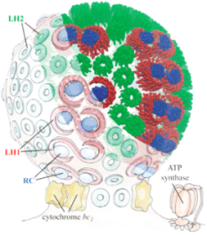
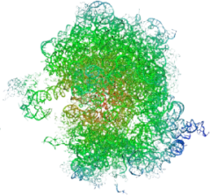
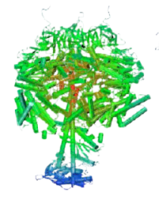
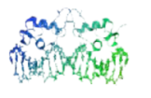

Science is Desperate for Throughput
Gigaflops
1,000,000,000
1 Exaflop
1,000,000
1 Petaflop
Bacteria
100s of
Chromatophores
Chromatophore
50M atoms
1,000
Ribosome
2.7M atoms
F1-ATPase
327K atoms
Ran for 8 months to simulate 2 nanoseconds
1
Estrogen Receptor
36K atoms
BPTI
3K atoms
1982
1997
2003
2006
2010
2012

Slide 4
Power Crisis in Supercomputing
Household Power
Equivalent
Exaflop
City
25,000,000 Watts
7,000,000 Watts
Petaflop
Town
Jaguar
Los Alamos
850,000 Watts
Teraflop
Neighborhood
60,000 Watts
Gigaflop
Block
1982
1996
2008
2020

Slide 5

“Oak Ridge National Lab (ORNL) has already announced it will be using Fermi technology in an upcoming super that is ‘expected to be 10-times more powerful than today’s fastest supercomputer.’
Since ORNL’s Jaguar supercomputer, for all intents and purposes, holds that title, and is in the process of being upgraded to 2.3 Petaflops …
… we can surmise that the upcoming Fermi-equipped super is going to be in the 20 Petaflops range.”
September 30 2009
Notes:
1 Peta Flops = 10¹² = one thousand billion floating point operations / sec
http://www.hpcwire.com/blogs/NVIDIA-Changes-the-Calculation-with-Fermi-GPU-63016337.html
Mega Flops = 10 6 = million
Tera Flops = 10 9 = billion
Peta Flops = 10 12 = thousand billion = 1 000 000 000 000 000

Slide 6
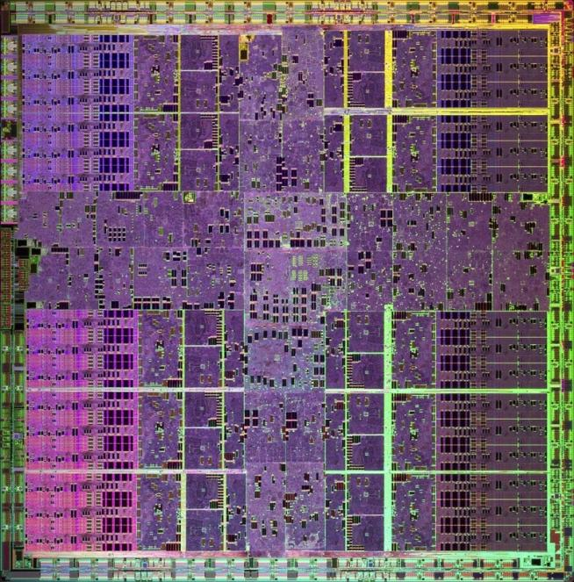
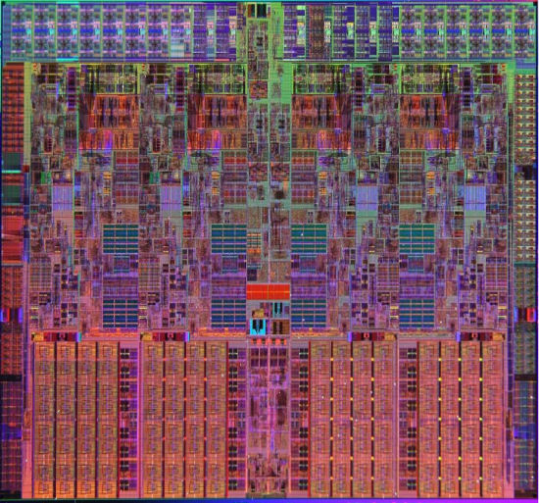

What is GPU Computing?
x86
PCIe bus
GPU
Computing with CPU + GPU
Heterogeneous Computing

Slide 7
Low Latency or High Throughput?
CPU
  Optimised for low-latency access to cached data sets
  Control logic for out-of-order and speculative execution
GPU
  Optimised for data-parallel, throughput computation
  Architecture tolerant of memory latency
  More transistors dedicated to computation
Control
ALU
ALU
ALU
ALU
Cache
DRAM
DRAM

Slide 8
Why Didn’t GPU Computing Take Off Sooner?
GPU Architecture
  Gaming oriented, process pixel for display
  Single threaded operations
  No shared memory
Development Tools
  Graphics oriented (OpenGL, GLSL)
  University research (Brook)
  Assembly language
Deployment
  Gaming solutions with limited lifetime
  Expensive OpenGL professional graphics boards
  No HPC compatible products

Slide 9
NVIDIA Invested in GPU Computing in 2004
Strategic move for the company
  Expand GPU architecture beyond pixel processing
  Future platforms will be hybrid, multi/many cores based
Hired key industry experts
  x86 architecture
  x86 compiler
  HPC hardware specialist
  Create a GPU based Compute Ecosystem by 2008

Slide 10


NVIDIA GPU Computing Ecosystem
ISV
NVIDIA Hardware Solutions
CUDA SDK & Tools
GPU Architecture
TPP / OEM
CUDA Training Company
CUDA Development Specialist
Hardware
Architect
VAR
Customer Application
Deployment
Customer
Requirements
Hardware Architecture

Slide 11

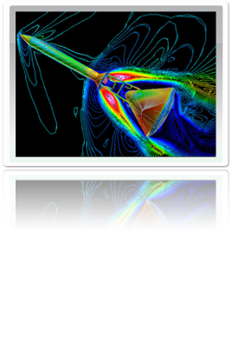
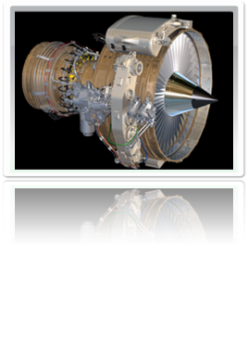


NVIDIA GPU Product Families
GeForce®
Entertainment
TeslaTM
High-Performance Computing
Quadro®
Design & Creation

Slide 12

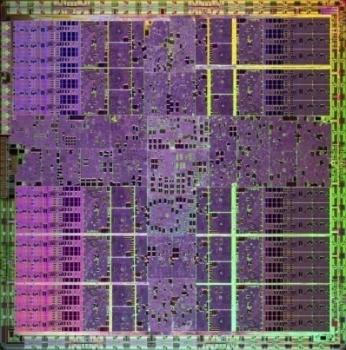

Many-Core High Performance Computing
NVIDIA’s 10-series GPU has 240 cores
Each core has a
  Floating point / integer unit
  Logic unit
  Move, compare unit
  Branch unit
Cores managed by thread manager
  Thread manager can spawn
  and manage 30,000+ threads
  Zero overhead thread switching
NVIDIA 10-Series GPU
1.4 billion transistors
1 Teraflop of processing power
240 processing cores
NVIDIA’s 2nd Generation
CUDA Processor

Slide 13
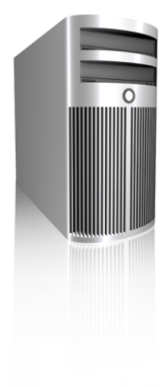
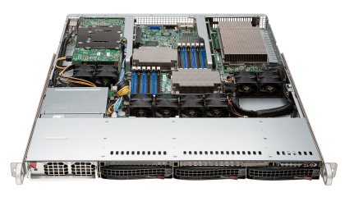
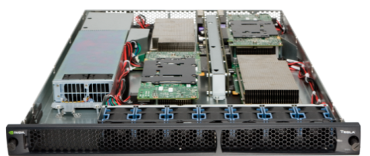
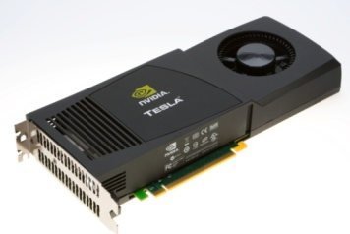
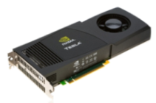
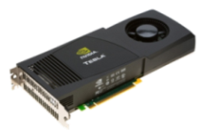
Tesla GPU Computing Products
SuperMicro 1U
GPU SuperServer
Tesla S1070
1U System
Tesla C1060
Computing Board
Tesla Personal Supercomputer
GPUs | 2 Tesla GPUs | 4 Tesla GPUs | 1 Tesla GPU | 4 Tesla GPUs
Single Precision Performance | 1.87 Teraflops | 4.14 Teraflops | 933 Gigaflops | 3.7 Teraflops
Double Precision Performance | 156 Gigaflops | 346 Gigaflops | 78 Gigaflops | 312 Gigaflops
Memory | 8 GB (4 GB / GPU) | 16 GB (4 GB / GPU) | 4 GB | 16 GB (4 GB / GPU)

Slide 14

Tesla C1060 Computing Processor
Processor | 1 × Tesla T10
Number of cores | 240
Core Clock | 1.296 GHz
Floating Point Performance | 933 Gflops Single Precision
 | 78 Gflops Double Precision
On-board memory | 4.0 GB
Memory bandwidth | 102 GB/sec peak
Memory I/O | 512-bit, 800MHz GDDR3
Form factor | Full ATX: 4.736″ x 10.5″ Dual slot wide
System I/O | PCIe ×16 Gen2
Typical power | 160 W

Slide 15
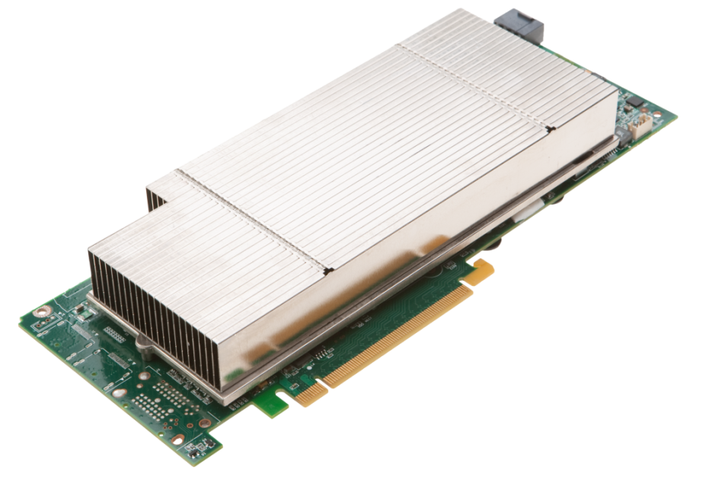
Tesla M1060 Embedded Module
Processor | 1 × Tesla T10
Number of cores | 240
Core Clock | 1.296 GHz
Floating Point Performance | 933 Gflops Single Precision
 | 78 Gflops Double Precision
On-board memory | 4.0 GB
Memory bandwidth | 102 GB/sec peak
Memory I/O | 512-bit, 800MHz GDDR3
Form factor | Full ATX: 4.736″ x 10.5″ Dual slot wide
System I/O | PCIe ×16 Gen2
Typical power | 160 W
OEM-only product
Available as integrated product in OEM systems

Slide 16
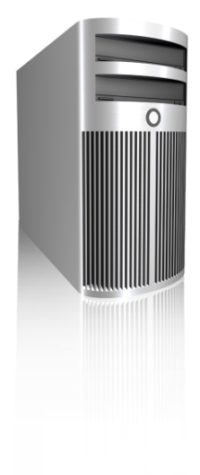
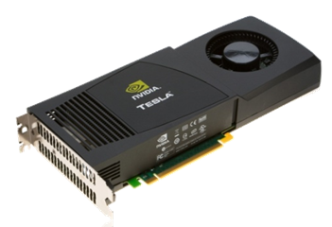
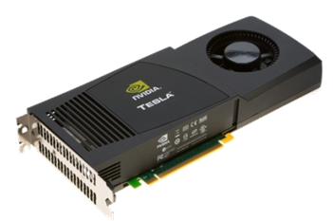
Tesla Personal Supercomputer
Supercomputing Performance
Massively parallel CUDA Architecture
960 cores. 4 Teraflops
250× the performance of a desktop
Personal
One researcher, one supercomputer
Plugs into standard power strip
Accessible
Program in C for Windows, Linux
Available now worldwide under $10,000

Slide 17
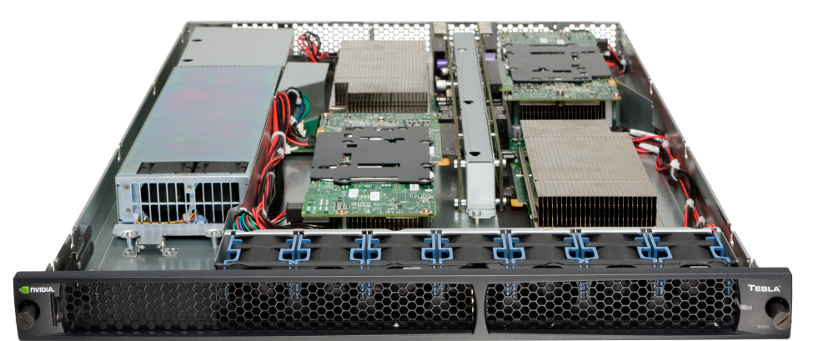
Tesla S1070 1U System
Processors | 4 × Tesla T10
Number of cores | 960
Core Clock | 1.44 GHz
Performance | 4 Teraflops
Total system memory | 16.0 GB (4.0 GB per T10)
Memory bandwidth | 408 GB/sec peak (102 GB/sec per T10)
Memory I/O | 2048-bit, 800MHz GDDR3 (512-bit per T10)
Form factor | 1U (EIA 19″ rack)
System I/O | 2 PCIe ×16 Gen2
Typical power | 700 W

Slide 18
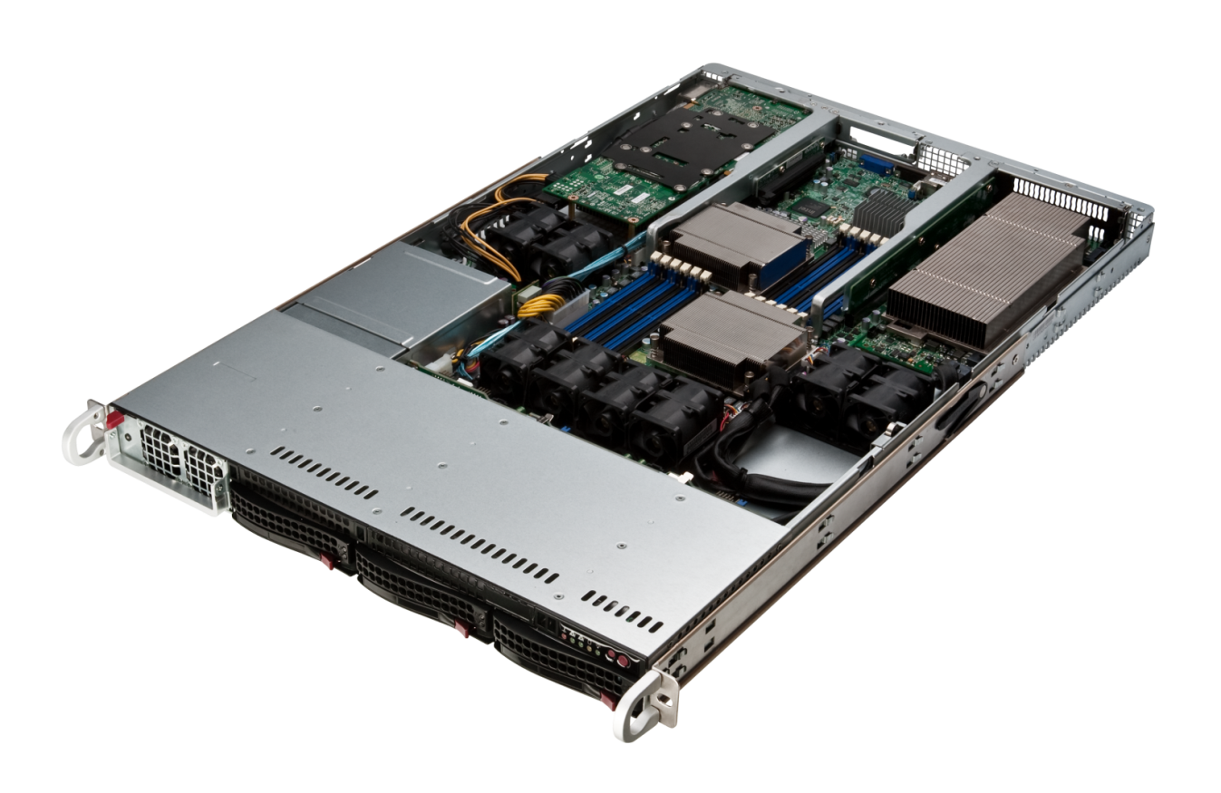
SuperMicro GPU 1U SuperServer
M1060 GPUs
Two M1060 GPUs in a 1U
Dual Nehalem-EP Xeon CPUs
Up to 96 GB DDR3 ECC
Onboard Infiniband (QDR)
3× hot-swap 3.5″ SATA HDD
1200 W power supply

Slide 19
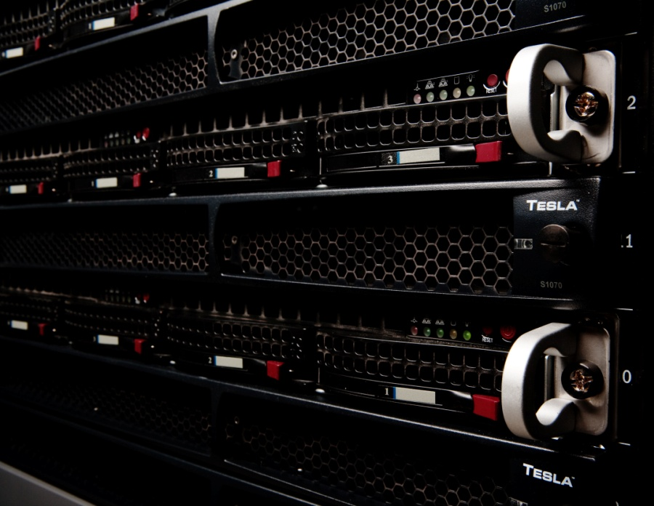

Tesla Cluster Configurations
Modular 2U compute node
Tesla S1070 + Host Server
4 Teraflops
Integrated 1U compute node
GPU SuperServer
2 Teraflops

Slide 20
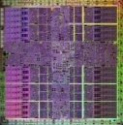

CUDA Parallel Computing Architecture
GPU Computing Applications
CUDA C
OpenCL™
DirectCompute
CUDA Fortran
Java and Python
NVIDIA GPU
with the CUDA Parallel Computing Architecture
OpenCL is trademark of Apple Inc. used under license to the Khronos Group Inc.

Slide 21
NVIDIA CUDA C and OpenCL
CUDA C
Entry point for developers who prefer high-level C
Entry point for developers who want low-level API
OpenCL
Shared back-end compiler and optimization technology
PTX
GPU

Slide 22






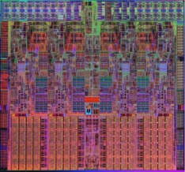

Application Software
(written in C)
CUDA Libraries
cuFFT
cuBLAS
cuDPP
CPU Hardware
CUDA Compiler
CUDA Tools
1U
PCI-E Switch
C
Fortran
Debugger Profiler
4 cores
240 cores

Slide 23
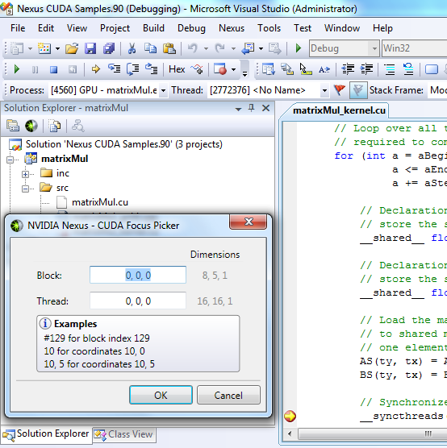
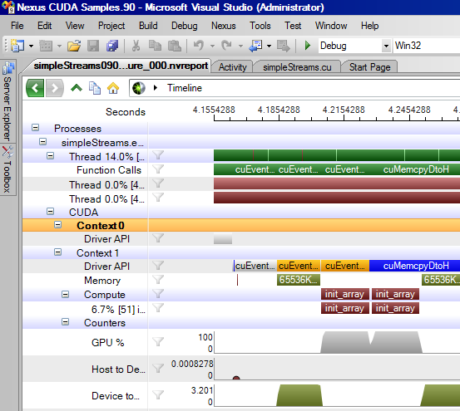
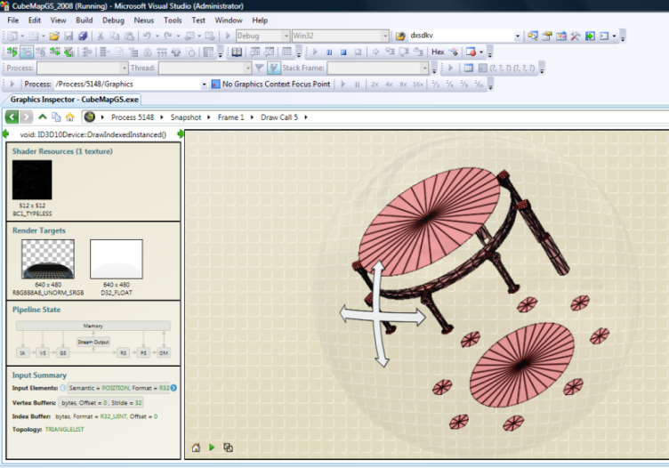
NVIDIA Nexus
The first development environment for massively parallel applications.
Hardware GPU Source Debugging
Platform-wide Analysis
Complete Visual Studio integration
Parallel Source Debugging
Platform Trace
Register for the Beta here at GTC!
http://developer.nvidia.com/object/nexus.html
Beta available October 2009
Releasing in Q1 2010
Graphics Inspector

Slide 24
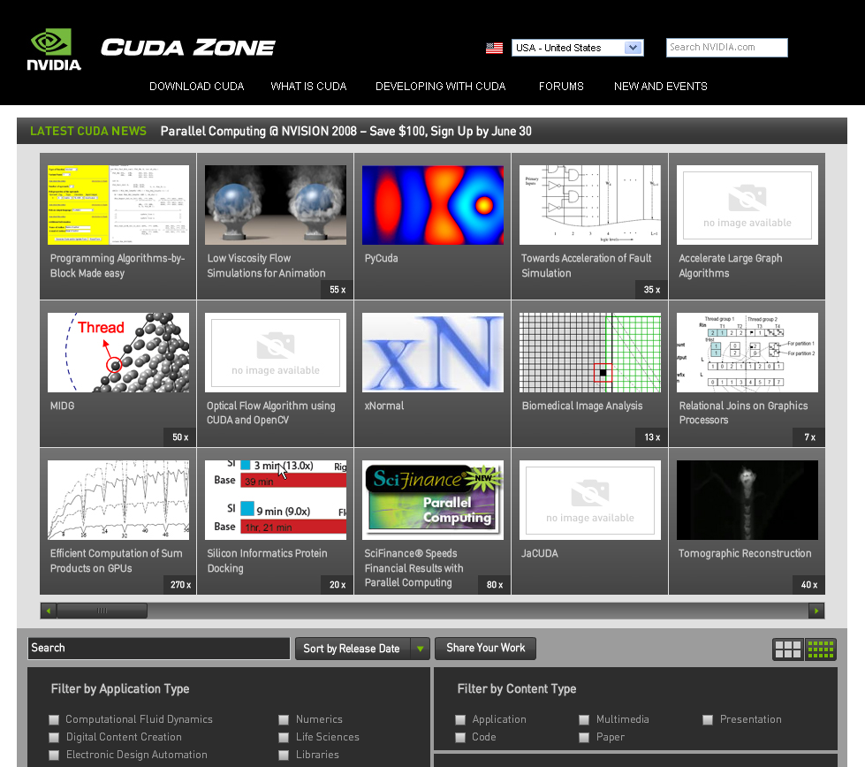
CUDA Zone: www.nvidia.com/CUDA
CUDA Toolkit
  Compiler
  Libraries
CUDA SDK
  Code samples
CUDA Profiler
Forums
Resources for CUDA developers

Slide 25



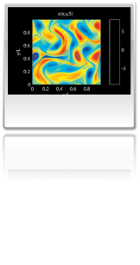

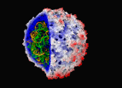
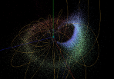

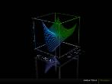



Wide Developer Acceptance and Success
146X
36X
19X
17X
100X
Interactive visualization of volumetric white matter connectivity
Ion placement for molecular dynamics simulation
Transcoding HD video stream to
H.264
Simulation in Matlab using .mex file CUDA function
Astrophysics N-body simulation
149X
47X
20X
24X
30X
Financial simulation of LIBOR model with swaptions
GLAME@lab: An M-script API for linear Algebra operations on GPU
Ultrasound medical imaging for cancer diagnostics
Highly optimized object oriented molecular dynamics
Cmatch exact string matching to find similar proteins and gene sequences

Slide 26
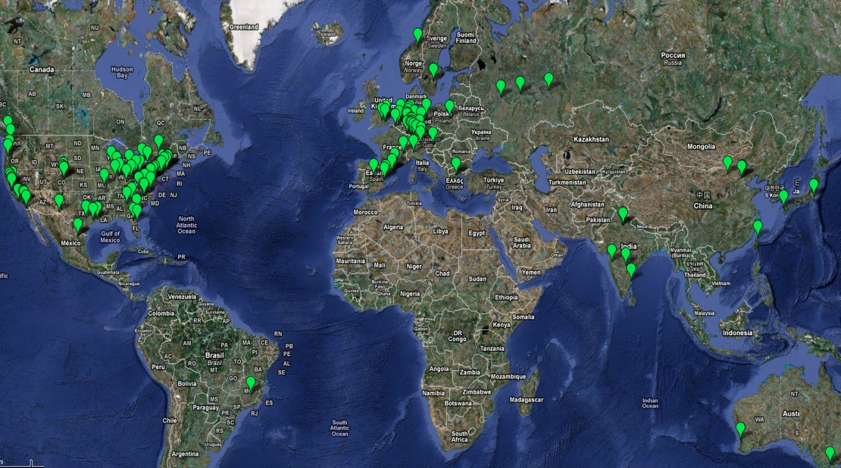






























CUDA Co-Processing Ecosystem
Over 200 Universities Teaching CUDA
Languages
C, C++
DirectX
Fortran
Java
OpenCL
Python
Compilers
PGI Fortran
CAPs HMPP
MCUDA
MPI
NOAA Fortran2C
OpenMP
UIUC
MIT
Harvard
Berkeley
Cambridge
Oxford
…
IIT Delhi
Tsinghua
Dortmundt
ETH Zurich
Moscow
NTU
…
Applications
Libraries
FFT
BLAS
LAPACK
Image processing
Video processing
Signal processing
Vision
Consultants
OEMs
Oil & Gas
Finance
CFD
ANEO
Medical
Biophysics
Imaging
Numerics
DSP
EDA
GPU Tech

Slide 27
What We Did in the Past Three Years
2006
  G80, first GPU with built-in compute features, 128 core multi-threaded, scalable architecture
  CUDA SDK Beta
2007
  Tesla HPC product line
  CUDA SDK 1.0, 1.1
2008
  GT200, second GPU generation, 240 core, 64-bit
  Tesla HPC second generation
  CUDA SDK 2.0
2009 …

Slide 28
Next-Generation GPU Architecture — ‘Fermi’

Slide 29
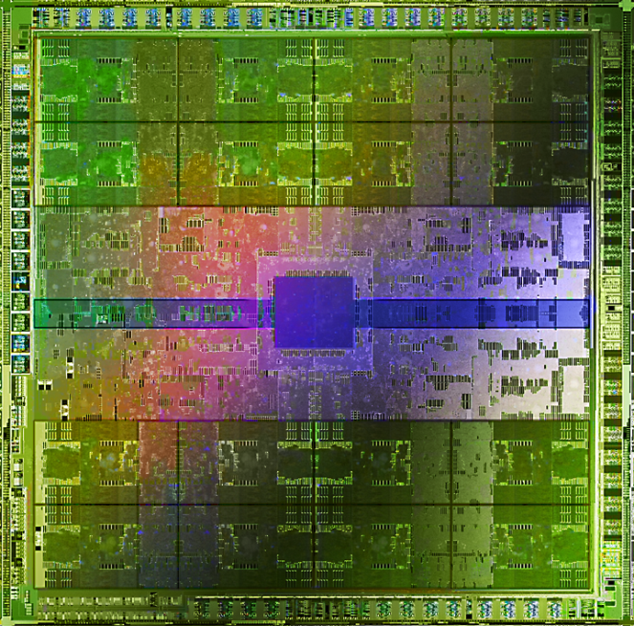




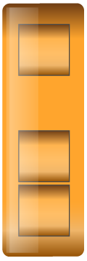
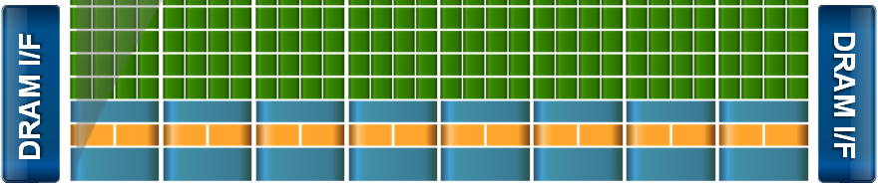
Introducing the ‘Fermi’ Architecture
The Soul of a Supercomputer in the body of a GPU
3 billion transistors
Over 2× the cores (512 total)
8× the peak DP performance
ECC
L1 and L2 caches
~2× memory bandwidth (GDDR5)
Up to 1 Terabyte of GPU memory
Concurrent kernels
Hardware support for C++
DRAM I/F
DRAM I/F
HOST I/F
DRAM I/F
L2
Giga Thread
DRAM I/F
DRAM I/F
DRAM I/F

Slide 30
Design Goal of Fermi
Expand performance sweet spot of the GPU
Bring more users, more applications to the GPU
Data
Parallel
GPU
Instruction
Parallel
CPU
Many Decisions
Large Data Sets
Notes:
Expand performance sweet spot of the GPU
Caching
Concurrent Kernels
FP64
Bring more users, more applications to the GPU
C++
Visual Studio Integration
ECC

Slide 31
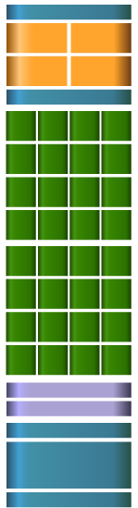
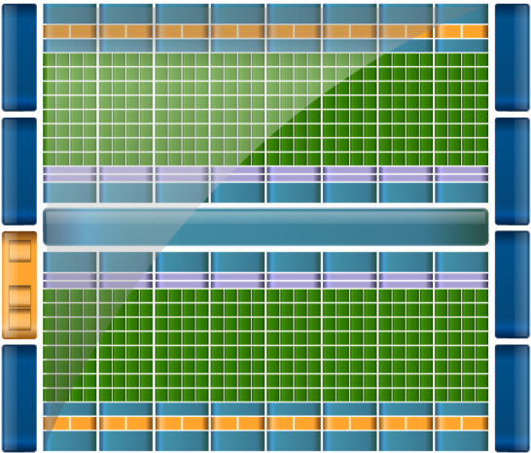

Streaming Multiprocessor Architecture
Instruction Cache
Scheduler
Scheduler
Dispatch
Dispatch
  32 CUDA cores per SM (512 total)
  8× peak double precision floating point performance
    50% of peak single precision
  Dual Thread Scheduler
  64 KB of RAM for shared memory and L1 cache (configurable)
Register File
Core
Core
Core
Core
Core
Core
Core
Core
Core
Core
Core
Core
Core
Core
Core
Core
Core
Core
Core
Core
Core
Core
Core
Core
Core
Core
Core
Core
Core
Core
Core
Core
Load/Store Units x 16
Special Func Units x 4
Interconnect Network
64K Configurable
Cache/Shared Mem
Uniform Cache

Slide 32

CUDA Core Architecture
Instruction Cache
Scheduler
Scheduler
Dispatch
Dispatch
New IEEE 754-2008 floating-point standard, surpassing even the most advanced CPUs
Fused multiply-add (FMA) instruction
for both single and double precision
Newly designed integer ALU
optimized for 64-bit and extended
precision operations
Register File
Core
Core
Core
Core
Core
Core
Core
Core
Core
Core
Core
Core
CUDA Core
Core
Core
Core
Core
Dispatch Port
Core
Core
Core
Core
Operand Collector
Core
Core
Core
Core
Core
Core
Core
Core
FP Unit
INT Unit
Core
Core
Core
Core
Load/Store Units x 16
Result Queue
Special Func Units x 4
Interconnect Network
64K Configurable
Cache/Shared Mem
Uniform Cache
Notes:
Each CUDA processor has a fully pipelined integer arithmetic logic unit (ALU) and floating point unit (FPU). Prior GPUs used IEEE 754-1985 floating point arithmetic. The Fermi architecture implements the new IEEE 754-2008 floating-point standard, surpassing even the most advanced CPUs.
It supports fused multiply-add (FMA) instructions for both single and double precision arithmetic. FMA improves over a multiply-add (MAD) instruction by doing the multiplication and addition with a single final rounding step, with no loss of precision in the addition. FMA is more accurate than performing the operations separately.

Slide 33



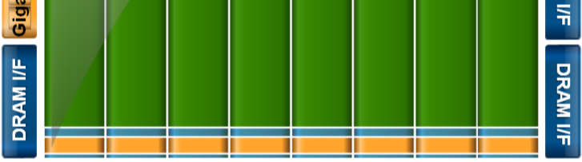
Cached Memory Hierarchy
First GPU architecture to support a true cache hierarchy in combination with on-chip shared memory
L1 Cache per SM (32 cores)
  Improves bandwidth and reduces latency
Unified L2 Cache (768 KB)
  Fast, coherent data sharing across all cores in the GPU
DRAM I/F
DRAM I/F
HOST I/F
DRAM I/F
Parallel DataCache™
Memory Hierarchy
L2
Giga Thread
DRAM I/F
DRAM I/F
DRAM I/F

Slide 34
Larger, Faster Memory Interface
GDDR5 memory interface
  2× speed of GDDR3
Up to 1 Terabyte of memory attached to GPU
  Operate on large data sets
DRAM I/F
DRAM I/F
HOST I/F
DRAM I/F
L2
Giga Thread
DRAM I/F
DRAM I/F
DRAM I/F

Slide 35
Error Correcting Code
ECC protection for
  DRAM
    ECC supported for GDDR5 memory
  All major internal memories are ECC protected
    Register file, L1 cache, L2 cache

Slide 36

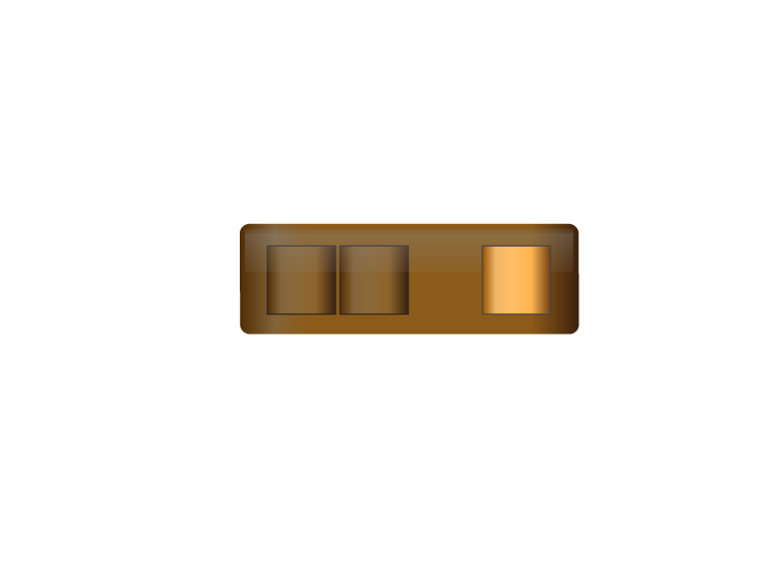

GigaThreadTM Hardware Thread Scheduler
Hierarchically manages thousands of simultaneously active threads
10× faster application context switching
Concurrent kernel execution
HTS
Notes:
One of the most important technologies of the Fermi architecture is its two-level, distributed thread scheduler. At the chip level, a global work distribution engine schedules thread blocks to various SMs, while at the SM level, each warp scheduler distributes warps of 32 threads to its execution units. The first generation GigaThread engine introduced in G80 managed up to 12,288 threads in realtime. The Fermi architecture improves on this foundation by providing not only greater thread throughput (24,576), but dramatically faster context switching, concurrent kernel execution, and improved thread block scheduling.

Slide 37
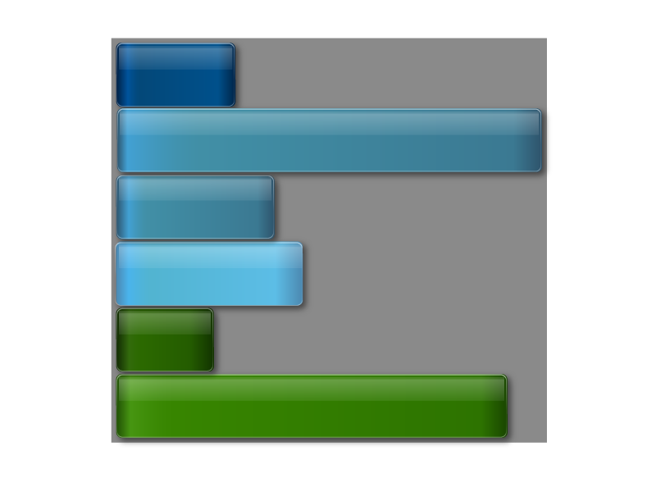
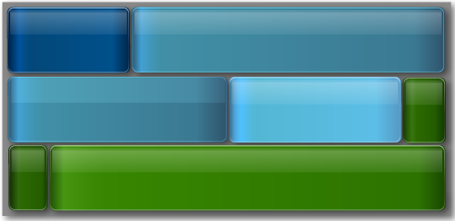
GigaThread Hardware Thread Scheduler
Concurrent Kernel Execution + Faster Context Switch
Kernel 1
Kernel 1
Kernel 2
Kernel 2
Kernel 2
Kernel 3
Ker
4
Kernel 2
nel
Kernel 5
Time
Kernel 3
Kernel 4
Kernel 5
Serial Kernel Execution
Parallel Kernel Execution
Notes:
Fermi supports concurrent kernel execution, where different kernels of the same application context can execute on the GPU at the same time. Concurrent kernel execution allows programs that execute a number of small kernels to utilize the whole GPU. For example, a PhysX program may invoke a fluids solver and a rigid body solver which, if executed sequentially, would use only half of the available thread processors. On the Fermi architecture, different kernels of the same CUDA context can execute concurrently, allowing maximum utilization of GPU resources. Kernels from different application contexts (e.g. a game with graphics + PhysX) can still run sequentially with great efficiency thanks to the improved context switching performance.

Slide 38

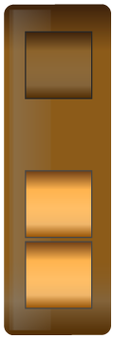




GigaThread Streaming Data Transfer Engine
Dual DMA engines
  Simultaneous CPU→GPU and GPU→CPU data transfer
  Fully overlapped with CPU and GPU processing time
Activity Snapshot:
SDT
Kernel 0
CPU
SDT0
GPU
SDT1
Kernel 1
CPU
SDT0
GPU
SDT1
Kernel 2
CPU
SDT0
GPU
SDT1
Kernel 3
CPU
SDT0
GPU
SDT1

Slide 39
Enhanced Software Support
Full C++ Support
  Virtual functions
  Try/Catch hardware support
System call support
  Support for pipes, semaphores, printf, etc
Unified 64-bit memory addressing

Slide 40
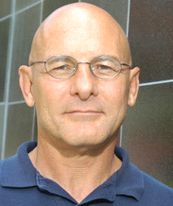
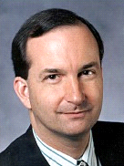
“
I believe history will record Fermi as a significant milestone.
”
Dave Patterson
Director Parallel Computing Research Laboratory, U.C. Berkeley
Co-Author of Computer Architecture: A Quantitative Approach
“
Fermi surpasses anything announced by NVIDIA's leading GPU competitor (AMD).
”
Tom Halfhill
Senior Editor
Microprocessor Report
Notes:
What the Experts Are Saying About ‘Fermi’…

Slide 41
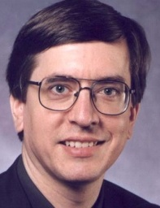
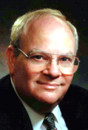
“
Fermi is the world’s first complete GPU computing architecture.
”
Peter Glaskowsky
Technology Analyst
The Envisioneering Group
“
The convergence of new, fast GPUs optimized for computation as well as 3-D graphics acceleration and industry-standard software development tools marks the real beginning of the GPU computing era. Gentlemen, start your GPU computing engines.
”
Nathan Brookwood
Principle Analyst & Founder
Insight 64
Notes:
What the Experts Are Saying About ‘Fermi’…

Slide 42
GPU Revolutionizing Computing
A 2015 GPU *
~20× the performance of today’s GPU
~5,000 cores at ~3 GHz (50 mW each)
~20 TFLOPS
~1.2 TB/s of memory bandwidth
GFlops
GPU
Fermi
512 core
T10
240 core
T8
128 core
2006
2008
2010
2012
2015
* This is a sketch of a what a GPU in 2015 might look like; it does not reflect any actual product plans.
Notes:
This is a sketch of a what a GPU in 2015 might look like, it does not reflect any actual product plans
42

Slide 43
