Slide 1
Introduction to GPU hardware and Vulkan compute
Torbjörn Nilsson & Aksel Hjerpbakk
2023-11-01

Slide 2
Agenda
Arm introduction
Hardware
  "Recap" of CPU architecture
  GPU shader core architecture
  System architecture
Software – Vulkan Compute

Slide 3




Building the Future of Computing
The global leader
in the development
of licensable
compute technology
2000+
Active licenses, growing by
100+ every year
- R&D outsourcing for
semiconductor companies
600+
licensees
Focused on freedom
and flexibility to
innovate
Industry leaders and high-growth start-ups; chip companies and OEMs
- Technology reused across
multiple applications
250bn+
Arm-based chips shipped to-date
With a partnership
based culture
& business model
31bn
Semiconductor IP Business
- Licensees take advantage
of learnings from a uniquely
collaborative ecosystem
Arm-based chips shipped in 2023
Notes:
"Building the Future of Computing" is Arm's new corporate motto – replacing the kind of weird "Invisibly enabling the future of computing" that came before. I personally like the idea that people actually know where all these chips come from.
The motto is not just some words, let’s spend a minute looking at the data….1000’s license our technology…every major technology provider and startup. The ecosystem has shipped >225B chips…that’s equivalent to the number of stars in the milky way galaxy. Last year alone, ~30B arm-based chips were deployed!
More interesting for you guys, that we are trying to recruit: every quarter, Arm ships about 1 million chips per employee! This means that since I started almost 2.5 years ago, 10 million chips were shipped "in my name" alone!
Please don't ask me what the world is supposed to do with 4 chips per human per year, it hurts my brain too.

Slide 4

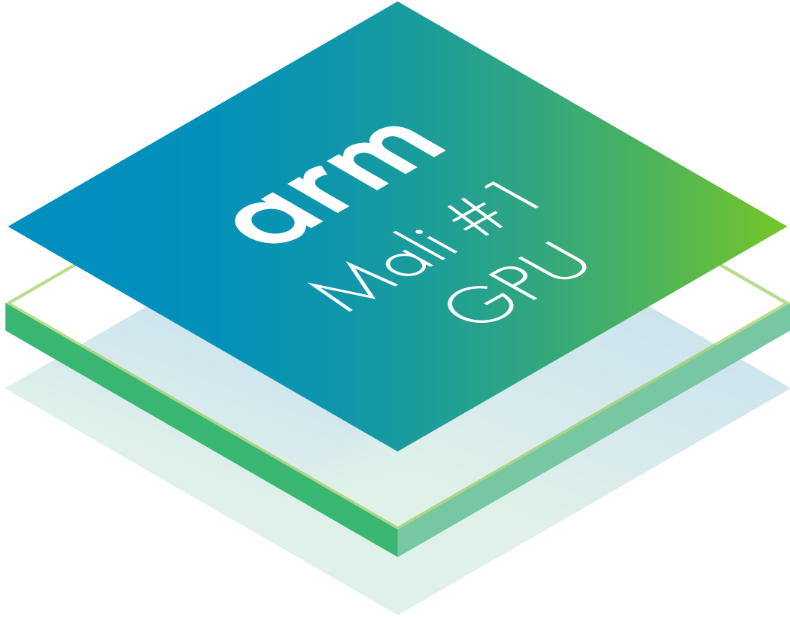



Arm Mali GPUs: The World’s #1 Shipping Graphics Processor
>9Bn
Mali GPUs shipped to date*
1 Mali GPU for every person on Earth
PERFORMANCE
FOR THE DEVELOPERS
PERVASIVENESS
* Cumulative shipments reported by Arm
Notes:
Our line of GPUs is called Mali, and we shipped around 8 billion of them to date. That is around one GPU per living human!
Fun fact: during the nvidia acquisition period, Jensen Huang (Nvidia CEO...) liked to joke that we were the more successful GPU company.

Slide 5

No.1
Arm Norway (Trondheim)
Established as a start-up in 2001 by 5 students from NTNU
Falanx Microsystem was acquired by Arm in 2006
16 years of growth; 24 to 200 employees in Trondheim
1 customer in 2006; Today – Marked leader with more than 1 billion GPU’s shipped each year
shipped GPU in the world
36
95% GPU team
Nationalities
16
Working close with NTNU, Næringsforeningen, and Techno Port
Summer students in 2023
5
Notes:
So why are we in Trondheim of all places?

Slide 6
CPU core architecture
Notes:
We will first do a quick runthrough of the CPU architecture that you have learned about this semester, as it is a good reference point for going into the GPU architecture.

Slide 7

CPUs
Low thread count
Latency sensitive
Performance gained by
single thread acceleration
Notes:
CPUs generally solve low thread count problems, typically around 4-8 threads in a phone/laptop, certainly not in the hundreds
Latency sensitive workloads, control flow, interoperation between threads, if you want to make your browser faster you need to make the threads run faster
Add more logic to make the few threads run faster

Slide 8
Processor essentials
Instruction
fetch
Register
read
Useful
processing
Multiple cycles
Register
write
Notes:
The must-haves of the processor: instruction fetch, registers for storing values. Read at start of pipeline, do some processing, write back
Problem: Getting from read to write takes multiple cycles, depends on hardware, 5-10 cycles not uncommon

Slide 9
Processor essentials
Instruction
fetch
Branch prediction
Register
read
Useful
processing
Register
write
Notes:
First optimization: Don't want to wait for write and read, add register forwarding. Faster but more wiring
Second: Software is "branchy", don't want to wait for the actual check so instead try to predict, might have to undo though

Slide 10
Processor essentials
Instruction
fetch
Branch prediction
Register
read
Useful
ALU 1
Useful
ALU 2
Register
write
Notes:
Might go super-scalar: Not enough with one pipeline, add more. However ISA is single-threaded, need hardware to figure out how to parallelize

Slide 11
Processor essentials
Instruction
fetch
Branch prediction
Super-scalar
issue
Out-of-order
execution
Essential
Register
read
Speculative
execution
Useful
Useful
ALU 1
Useful
ALU 2
Speculative
data fetch
Overhead
Big caches
Register
write
Notes:
Add out-of-order execution: more hardware but we can look at a window of ~128 (or 1000) instructions and run out of order based on data dependencies
Speculative execution: if something is idle, chuck something at it and hope it is useful later
Pre-fetch: DRAM is slow, fetch pre-emptively
Big caches: DRAM super slow, maybe 100 cycles for a load
Orange is overhead, only exist to keep green bits busy. If we can find another way to keep the green bits busy, we save on hardware and have built a better system. However for single-threaded CPU type workloads you need this stuff to get the performance

Slide 12
Processor essentials
Single
Instruction
Multiple
Data
Instruction
fetch
A0
A1
A2
A3
+
B0
B1
B2
B3
=
A0 + B0
A1 + B1
A2 + B2
A3 + B3
Notes:
Another optimization for CPUs is SIMD. Fetch a single instruction, execute on n lanes of data simultaneously
Nice because all the orange stuff run on one instruction, but we get 4 green bits in return
Question: Why would we want the processing to go even faster, didn’t we just complain it was hard to feed the ALUs? This is a question of workloads – this makes us better at very linear processing of long arrays of data. All the orange makes us good at generic, unpredictable, branchy code.

Slide 13
CPU architecture summary
We know how to make very fast processors
  … but additional hardware is not really “processor”
Extra hardware inevitably costs something
  Reduces energy efficiency
  Reduces area efficiency
Heterogeneous multi-core helps
  Fast big cores for high-intensity workloads
  Energy efficient little cores for low-intensity workloads
… but cannot be fast and efficient at the same time
Notes:
Big cores: a lot faster but more silicon, higher power consumption etc.
Little cores: much smaller, maybe 1/4 of the size of big one, but slower
Tradeoff between energy efficiency and performance
Addendum: big.LITTLE called into question by recent products.

Slide 14
GPU core architecture
Notes:
GPU: We want performance, but we need efficiency. On mobile, the power budget is around 3W for the GPU

Slide 15


GPUs
Why were they created?
  Speed up graphics by parallelizing
Graphics is easily parallelizable
  Process geometry vertices individually
  Process pixels individually
Today used for various purposes
  Graphics
  Machine Learning
  Bitcoin mining
  ...
Notes:
Historically just for graphics, but their ability to speed up «generic compute» has become more and more of a factor.

Slide 16

GPUs
Very parallelizable domain
with high thread count
Performance gained by overall
computational throughput
Computational throughput
achieved via energy efficiency
The cake is a lie!
Notes:
So for GPUs the main difference is the problem domain, we have thousands of threads instead
Not much interop between threads
Gain performance through overall throughput, do not care about each pixel, only final image
Tune for energy efficient hardware, scale by adding more cores

Slide 17
GPU design principles
Design API for scalability
  Design-out Amdahl’s law scaling problems
  Stream processing of independent work items
  Limit opportunities for cross-thread sharing
Optimize for throughput not latency
  Only complete final image is useful
  Individual thread latency not important
Build high efficiency cores for this domain
  Exploit parallelism to build the core
  Exploit parallelism to scale core count
Notes:
How to enable extreme threadcount designs?
CPUs can't do it, the problems don't parallelize well, see Amdahl's law
For GPU, with thousands of threads, even if we have .1% serial the whole thing implodes
This is why APIs are designed using stream processing, do not share data

Slide 18
Shader core essentials
Instruction
fetch
Branch predictor
Super-scalar
issue
Out-of-order
execution
Register
read
Speculative
execution
ALU
ALU
ALU
ALU
Speculative
data fetch
Big caches
Register
write
Notes:
Don't need super-scalar or out of order -> we already have parallelism
Don't need branch prediction, after 10 cycles I have the result
Don't need speculative execution, just pick another thread
Data fetch and caches might be a problem, we'll get back to it
Basically, we can always just find another thread to run to keep the green parts busy
By removing the orange stuff, we have a much more energy efficient piece of hardware

Slide 19
Shader core essentials
Thread pool
(10 threads)
Instruction
fetch
Register
read
Execute one instruction from each thread every 10 cycles
ALU
ALU
ALU
ALU
10 cycles
Register
write
Notes:
Here is our nice CPU again, now with 4 ALUs for SIMD. Still 10 cycles, so we're gonna have problems without the orange stuff
So what if we exploit the thread count? Let's have a thread pool of 10 independent threads. Each clock cycle, 1 instruction from each thread

Slide 20
Shader core essentials
Thread pool
(10 threads)
Massive thread pool
(1000 threads)
Instruction
fetch
Register
read
Execute one instruction from
any thread
every 10 cycles
ALU
ALU
ALU
ALU
Register
write
Notes:
This is all good, but DRAM is still a problem, takes maybe a few hundred cycles. But we have thousands of threads!
Let's add 1000 threads, big number
Need more registers
We need 10 threads that have actual processing to do at any given time and 1 thread ready to run. The other 989 can be blocked on memory
This means we don't lose any cycles of green processing.
Could a GPU run Windows? Yes but very poorly

Slide 21
Shader core essentials
Instruction
fetch
Branch predictor
Super-scalar
issue
Out-of-order
execution
Register
read
Speculative
execution
ALU
ALU
ALU
ALU
Speculative
data fetch
Big caches
Register
write
Notes:
We now have got rid of all the orange blocks
Probably want a cache, but not to the degree of a CPU

Slide 22
Shader core essentials
Single
Instruction
Multiple
Thread
Instruction
fetch
Warp
Wave
Subgroup
T0.A0
T1.A0
T2.A0
T3.A0
+
T0.B0
T1.B0
T2.B0
T3.B0
=
T0.(A0 + B0)
T1.(A0 + B0)
T2.(A0 + B0)
T3.(A0 + B0)
Notes:
We don't like SIMD, it says that the compiler sees vector instructions and needs special hardware to handle those.
SIMT is used in GPUs on the other hand, have multiple threads run the same program in lock-step (same PC). Don't need special instructions.
Take it to the extreme, 16 wide design amortize 1 instruction fetch amongst many threads

Slide 23
Shader core essentials

Slide 24
SPMT branch divergence
C.x = A.x + B.x
vec2 C;
if (cond) {
C = A + B;
} else {
C = A – B;
}
C.y = A.y + B.y
C.x = A.x - B.x
C.y = A.y - B.y
Notes:
However, what about divergense between threads?
Have to run both, 50% efficiency penalty

Slide 25
Shader core essentials
Thread pool
Vertex
interpolation
Instruction
fetch
Texture
decompression
Register
read
Texture
filtering
Fixed-function
accelerators
Fragment
blending
Register
write
Notes:
Throw fixed function hardware at it.
Many things do not need instruction based processing
Half of our GPU is yellow stuff

Slide 26
More cores!
Shared L2 cache
1K of threads, 10K of threads, 100K threads ...
Notes:
Finally, add performance by adding more cores!

Slide 27
GPU and system architecture
More than just a shader core…
Notes:
As you may or may not know, a GPU is not just a collection of shader cores!
To render fast, we can actually do more than just make fatter cores. I will give an illustration of this by comparing immediate and tile based architectures.

Slide 28



“big” CPUs
Best performance
… but less efficient
“LITTLE” CPUs
Most efficient
… but slower
CPU
GPU
CPU
Shared L3 cache
System cache
DPU may not
handle everything
Can fall back to GPU
DPU
DRAM accesses
are expensive
~80mW/GB/s
Memory
Controller
To DRAM
To Display
Notes:
Note: Game engines will often actively target the LITTLE cpus for game logic (as applications are *usually* GPU bound). This leaves more power budget for the GPU and DRAM access.
Back-of-envelope
Images is 2MP
4B of color data per pixel
8MB of data per frame
100 frames a second
800MB/s
Total budget is 3W = 40GB/s
5% is spent just on DRAM for frame buffer

Slide 29
Frequency matters ...
Power consumption
Underclock
Overclock
Frequency
Notes:
Switching speed in HW is roughly linear in the voltage, while power consumption is ~V^2, so there are diminishing returns involved in driving up the clock of a given system. In desktop it is more an issue of "how much heat can I get out of the CPU with unlimited wattage for cooling?", while in the mobile world we just want to maximize what we can get out of a ~3W envelope.

Slide 30
Bandwidth matters ...
DRAM
Energy cost of an operation
Logic
2013
Now
Time
Notes:
You've all heard of Moore's law. Well it doesn't apply to memory system speed, and we're seeing some pain here. Modern CPUs even on desktop have been shipping with larger and larger caches with more levels of hierarchy for a reason.

Slide 31
Immediate mode architecture

Slide 32
Immediate mode architecture
Coherent
On-chip
Incoherent
Geometry
processing
Fragment
processing
FIFO
DRAM
Notes:
So – DRAM access is <<expensive>>. At least on mobile where power budgets and heatsinking capabilites are limited.
In an immediate mode renderer, vertices are streamed into the GPU and picked up as they enter. The output of vertex shading is then sent to an on-chip-FIFO memory and quickly picked up by a fragment processor. At the end of the fragment processing we write out the result to RAM.
A real problem here is that the accesses at the fragment end are not read-only, we need to read previous depth values for occlusion culling, and we need to read previous colors for blending. This can get very expensive if there is any overshading.
One option is to have the entire framebuffer in a fast on-chip SRAM, but this costs a lot of area and is not an option on mobile. In addition, it will never make memory quite as cheap as in a tile based architecture (to come in a later slide :) ).

Slide 33
Immediate mode architecture
Notes:
Enjoy video

Slide 34
Immediate mode architecture
Pros
Cons
Simple hardware architecture
  Good scaling
  Easy to use
Geometry bandwidth stays on-chip
  FIFO inside the GPU hardware
Fragment bandwidth goes off-chip
  Whole framebuffer working set
  ZS testing increases bandwidth
  Blending increases bandwidth
Anti-aliasing is expensive
  Framebuffer storage increases
  Framebuffer bandwidth increases
  Resolve pass needed to resolve samples
Low screen-space locality
  Bad cache access patterns to framebuffer

Slide 35
Basic tile-based architecture

Slide 36
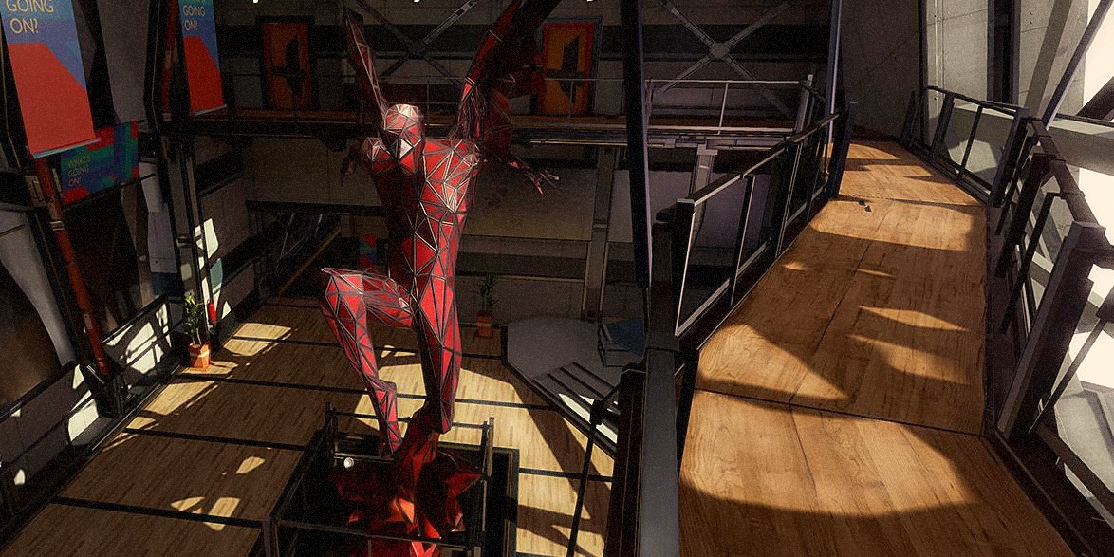
Basic tile-based architecture
Notes:
We split a frame into tiles

Slide 37
Basic tile-based architecture
Coherent
Off-chip
Coherent
Geometry
processing
Fragment
processing
Tile RAM
DRAM
Notes:
The main feature of tile based is that we finish all of the geometry processing in a single block. We then write out vertex information to DRAM in a special data structure that sorts it into tiles based on what tiles a triangle ends up in.
Then we shade fragments in units of tiles, storing all intermediate frame buffer accesses in a local tile RAM. Finally, at the end of a tile we do a single write to DRAM to get out just the frame information.
Note: Modern "Immediate" GPUs actually implement some kind of greedy/speculative tiling where they will let the primitive stream buffer for a while and the ship triangles with good spatial coherency as well as they can. I can't speak on the details of that since I didn't work for any other GPU vendors, and even if I did I might be in sticky legal territory.
Note: Modern mobile games are more or less direct ports of desktop content, and the amount of geometry is growing rapidly. For example, Nanite shoots for a LOD where there is roughly one triangle per pixel. This means that tiling GPUs really need some kind of strategy to deal with vertex data. One such thing that Mali does is separating Vertex and Position shading – we shade positions first, then we cull triangles that are not going to be visible anyways, then we go back and shade the rest of the vertex before we start rasterization and fragment shading.

Slide 38
Basic tile-based architecture
Notes:
Enjoy the video

Slide 39
Basic tile-based architecture
Pros
Cons
Fragment bandwidth stays on-chip
  Zero bandwidth ZS testing
  Zero bandwidth blending
  Zero bandwidth anti-aliasing
  Zero bandwidth transient data
Final framebuffer state is known
  Unchanged tile elimination
Enables new algorithms
  Shaders directly using tile storage
Geometry output bandwidth goes off-chip
  Verts and triangles are expensive
  Geometry shaders are a bad fit
  Tessellation shaders are a bad fit
  Additional memory storage needed
Stricter API rules for good performance
  Render pass overlap for best performance

Slide 40
Tile-based with deferred vertex shading

Slide 41
Tile-based architecture and DVS
Dense triangles are small and mostly exist in one tile
  Defer vertex shading until fragment shading time!
Coherent
Off-chip
Coherent
Fragment
processing
Vertex shading
Position
processing
Tile RAM
DRAM
Notes:
Let's talk modern GPUs!
Just this week, Mediatek announced the Dimensity 9300 which is currently topping the benchmark charts. It has a new piece of technology called Deferred vertex shading. The idea is that actually, vertices in modern games are really small. In the game engine Unreal, the Nanite geometry engine tries to generate about one triangle per pixel. This means that most triangles only ever cover one tile, and we can actually do the whole vertex->fragment pipeline on tile! (With some duplication of work for the triangles that hit two tiles). This saves us huuuge amounts of vertex data bandwidth as we only need to write tell the tile which primitives to shade (and *maybe* their vertex locations).

Slide 42
Tile-based architecture with DVS
Pros
Cons
All the benefits of basic tile-based
  Fragment bandwidth stays on-chip
  Final framebuffer state is known
  Exploit layer locality
  Enables new algorithms
… and …
  Remove a lot of geometry bandwidth
  Remove nearly all geometry storage
Still some extra geometry bandwidth
  Vertex shading writes the tile-list
  Vertex positions read multiple times
Some extra vertex processing needed
  Vertex positions shaded at least twice
  Reshading if primitives in multiple tiles
Even stricter API rules for good performance
  Vertex data dependencies released later

Slide 43
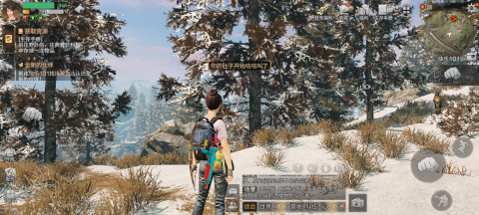
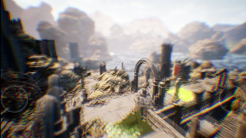
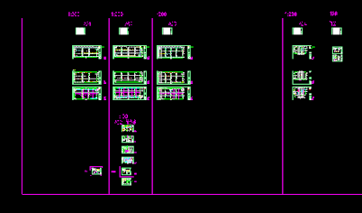


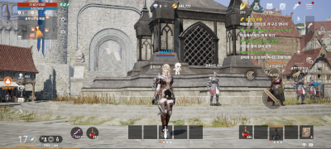

Deferred Vertex Shading uplift (DVS)
Life After
Elven Ruins
AutoCAD
Genshin Impact
58% less bandwidth
41% less bandwidth
37% less bandwidth
33% less bandwidth
Fortnite
Lineage2 Mobile
Antutu Terracotta
26% less bandwidth
26% less bandwidth
20% less bandwidth

Slide 44
Other (publicly known) tricks
Stop vertex shading early if we find out it's going outside the viewport anyways
Compress image data in hardware before it has to cross the memory bus to DRAM
Skip writing out tiles that didn't change between frames (CRC)
Teach applications to write good code...

Slide 45
Final remarks

Slide 46
Key takeaways
CPUs find performance by using lots of silicon to find instruction level paralellism.
  M1 has an OOO window as much as 1000 instructions
  Power and silicon hungry
GPUs find performance by having huge thread banks that can be switched out to hide memory system latency
  Long latencies
  Needs large, homogenous workloads
The system matters
  Beyond just the paralellism, GPUs can make domain specific optimizations with specialized hardware
  Having the right memory layout for the problem makes a huge difference

Slide 47

Vulkan Compute

Slide 48
Structure
Some background
  Compute
  Cuda
  Vulkan
Shaders and SPIR-V
Compute pipelines
Command buffers
Barriers
Queues
Vulkan memory
Summary

Slide 49
What is compute?
In this context we are talking about GPGPU.
It's useful for large data sets.
Must be a parallelizable problem.

Slide 50

Cuda
You already have been introduced to the API.
A compute API made by Nvidia.
Extend C++ to allow executing functions on the device.
Comparably simple device API.

Slide 51


Vulkan
A cross vendor graphics and compute API made by all major vendors through Khronos.
Can be used for compute and rendering (traditional rasterization, ray tracing, mesh shading … ).
Supported by all major GPU vendors.
… A lot more complex than Cuda.

Slide 52
Vulkan device execution
Running some piece of code (program) on the device.
In Cuda this is done with kernel functions.
There is no compiler integration in Vulkan.
Can be done by loading SPIR-V blobs .
Notes:
So lets go straight to "how do I do the one thing I want to do with any compute API". This is of course "running some piece of code on the device to do parallel computation"
Just so we are on the same page I am talking about what you would achieve by writing a kernel function in Cuda.
In vulkan there is no compiler integration for the API. What I mean by this is that Cuda is an extension of C++ that requires the Cuda compiler to work. Vulkan is a system library exposed by a simple header file.
This means it is language agnostic (you can write vulkan code in any language that can communicate with C). It also means that we can expect there to be some more work and less "magic".
So what a kernel function equivalent is a vulkan pipeline constructed based on some loaded spirv. That might not mean much to you yet so I will try to go into what that means.

Slide 53
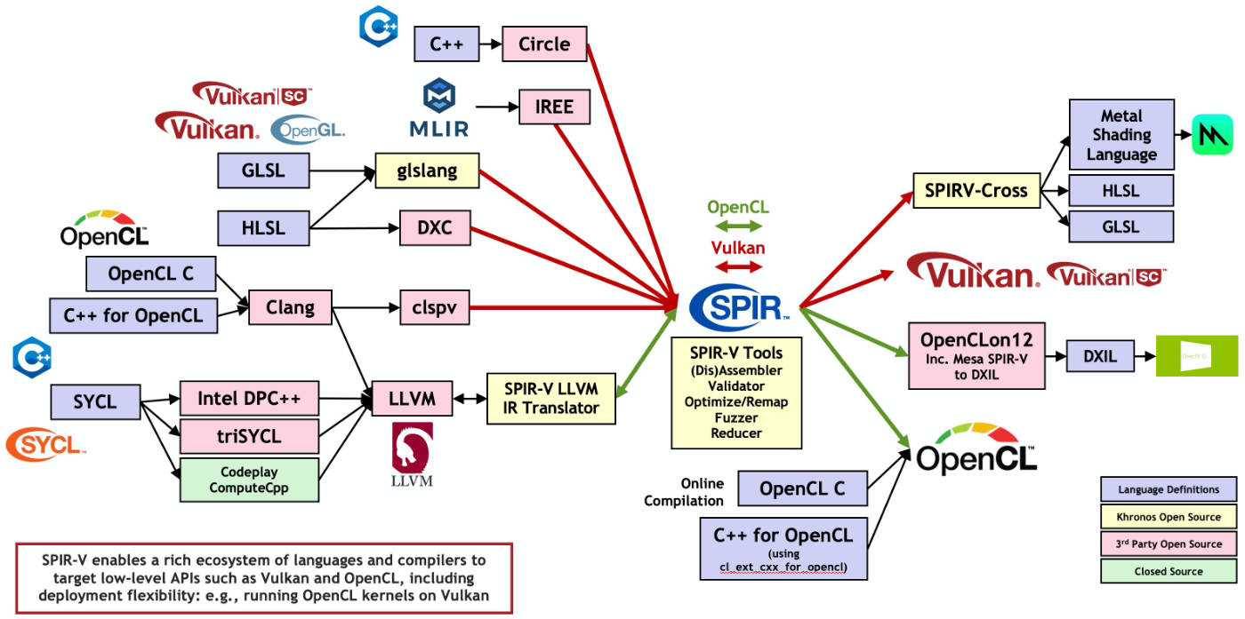
What is SPIR-V?
Standard Portable Intermediate Representation.
Many ways to produce SPIRV.
Notes:
SPIRV stands for standard portable intermediate representation.
You can think of it as a common language to express device programs or "shaders" on across vendors.
It’s a binary format and as you can see on the diagram there are many ways of producing spriv binaries.
Since vulkan just loads this intermediate representation the actual device programs can be written in any language that has a compiler that supports SPIRV as a target. This includes, but are not limited to c++, c, glsl, hlsl and rust.
So to make it clear. You need to write a program for the GPU (usually called shader). You then should probably set up in your build system something that will compiler your program or programs and move then to a predefined folder that your host binary can access and load it from

Slide 54
Case study: Writing a simple "kernel"
Let's write a simple kernel in Vulkan that consumes rays from a buffer and draws these rays to an image.
  Note: For simplicity, how the rays are produced is omitted. This is only the "drawing of rays" stage.

Slide 55
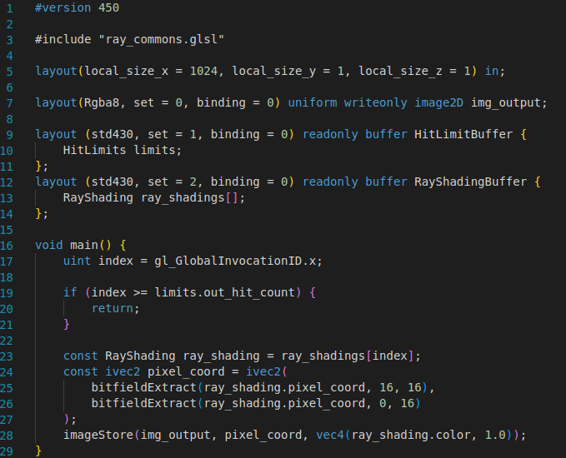
Writing a shader and compiling to SPIRV
Like mentioned, shaders can be written in different languages. Here is an example in glsl.

Slide 56
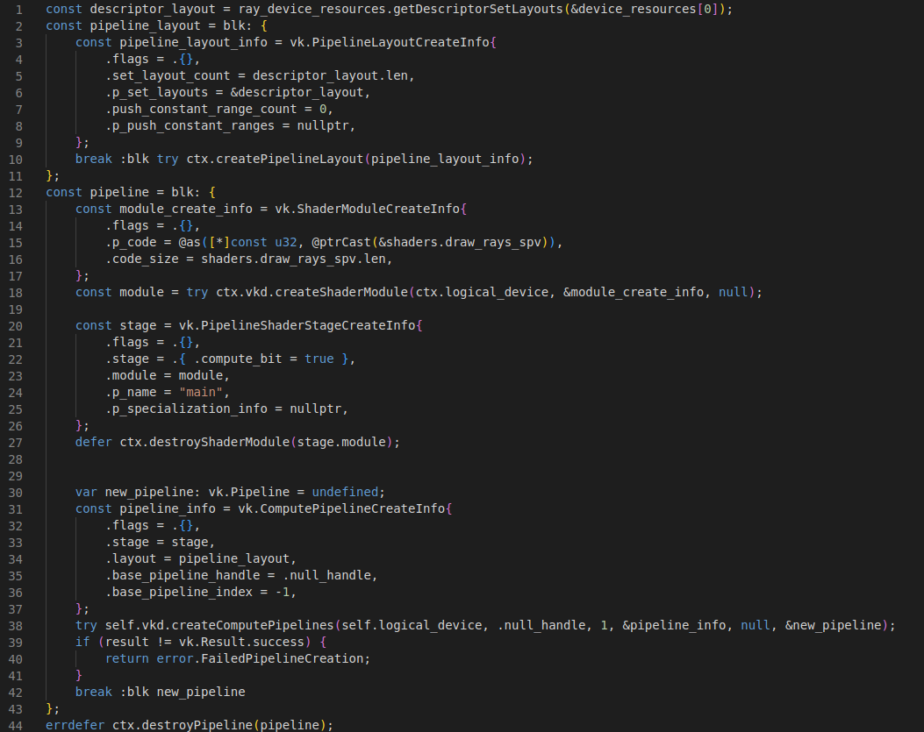
Ok I have my SPIRV blob … now what?
To run the SPIRV code, we must construct a pipeline with the loaded blob.
Notes:
To execute the spirv code we must first construct a vulkan pipeline.
*Go through the pseudo code*

Slide 57
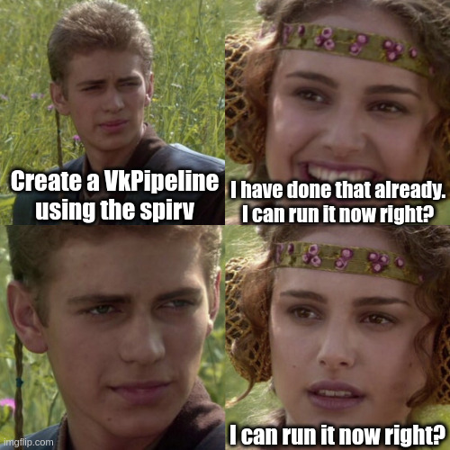
Ok I have my pipeline … can I run it?

Slide 58
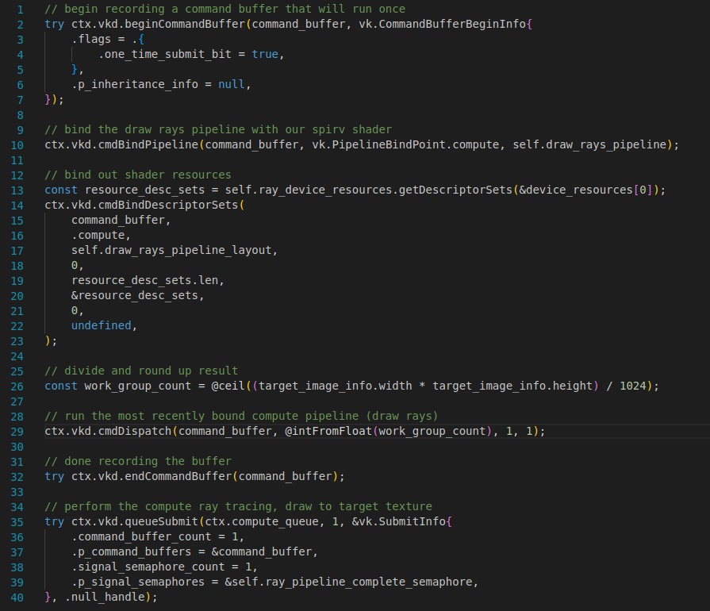
Recording our "draw rays" command buffer
We describe what we want the device to do on the host.
The commands are submitted to the device.
A lot of async.
We can wait for completion on device and/or host.
Notes:
Note the similarity between the cmd dispatch and calling a kernel function in cuda

Slide 59
Vulkan Command buffers
A device can be asked to do certain operations through "command buffers" in Vulkan.
A stream of instructions that are performed on some magic global hardware.
Different from the shaders.
Shaders run on each invocation/thread.
  Commands run globally on the device.
We can use commands buffers to dispatch our new pipeline.
Vulkan apps "record" command that the GPU should do.
  Execution order is guaranteed to happen in record order.
  Many commands are async and does not finish in order.
  Dependencies between commands can be expressed with pipeline barriers.

Slide 60
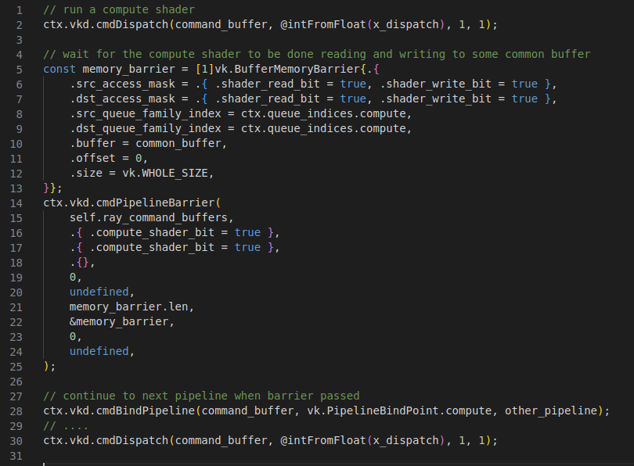
Pipeline barrier example
Notes:
3 types of barriers. In this example we use a buffer memory barrier.
There is also normal memory barrier which specify global memory usage, and image memory barrier which specify image barriers.

Slide 61
Vulkan Synchronization
Most things in Vulkan are explicitly synchronized.
The app has the knowledge about dependencies so the app should synchronize.
Good for performance, no guessing needed by the driver.
Bad for app complexity.
Enables the development multithreaded rendering code
  Not properly supported by previous graphics APIs like OpenGL

Slide 62
4 Vulkan synchronization primitives
Fences – device (queue) -> host
Semaphores – device to device (across queues)
  Extended in recent Vulkan to also replace fences (timeline semaphores)
  Timeline semaphore is bidirectional as well (host -> device, device -> host)
Pipeline barriers – device to device
  Must be in the same queue
  Express memory dependencies
Events – device to device & host to device
  Must be in the same queue

Slide 63
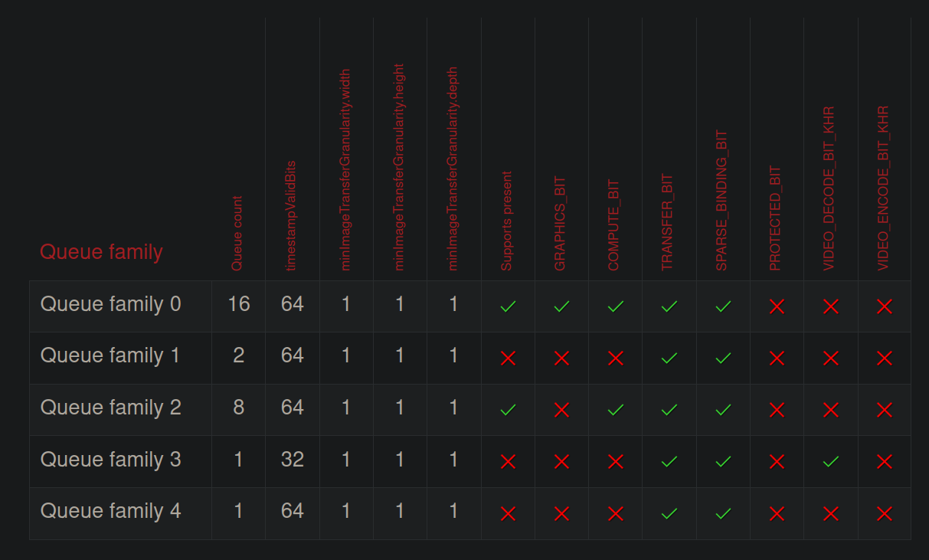
Vulkan queues
The app needs to schedule work on queues. Using multiple queues can lead to improved performance
We don’t have time to cover this in detail, but it's good to know about them
RTX 4090 queue families
https://vulkan.gpuinfo.org/displayreport.php?id=25395#queuefamilies

Slide 64
Vulkan Memory Model
Memory allocations are explicit like in Cuda
Unlike Cuda there is no magic allocator behind the scenes to save you from inefficient sparse allocations.
  You can use third party libraries to simplify allocations like Amd's VulkanMemoryAllocator: https://github.com/GPUOpen-LibrariesAndSDKs/VulkanMemoryAllocator
You need to specify how you will use the requested memory
  Hints to the driver which memory can be returned from the request
Memory can be bound to different types of Vulkan memory like buffers or images.

Slide 65
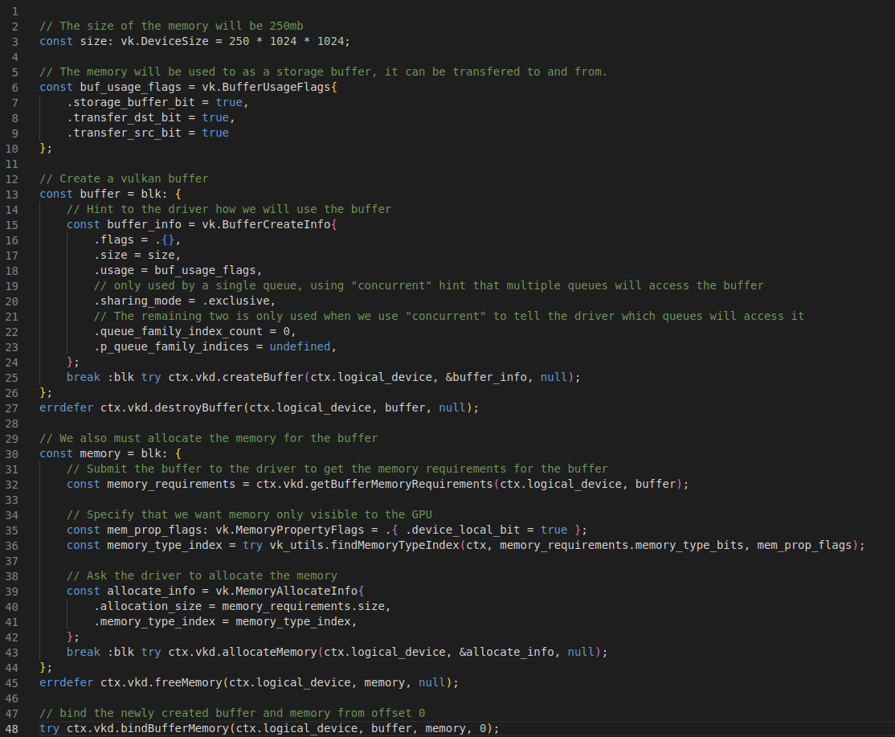
Vulkan memory allocation example
Just like everything else we have seen so far we need to express all our intentions for this memory in order to allocate
Notes:
Remember to discuss the implication of device only memory

Slide 66
Why is using Vulkan so explicit?
The Vulkan driver does no guessing (relative to other APIs)
  You have told the driver exactly what you intend
  No performance surprises for the developer
It must work for multiple vendors which increases complexity

Slide 67
In summary: Cuda vs Vulkan
Cuda
Vulkan
Nvidia only
  Your code can only run on host machines with Nvidia devices
Compute only
  If you need rendering, then you need an additional API
Higher level
  A lot simpler than Vulkan
Usually, the first to see any fancy Nvidia compute features
Cross vendors
  Works on all major GPU vendor!
  "Write once, run anywhere"
Compute and Graphics
Low level API
  Very verbose
  Gives the application lots of control
  More control over the hardware means it can be faster than Cuda
  Access to vendor specific features through extensions
Notes:
Cuda is a AP

Slide 68
Is Vulkan worth it?
Keep in mind the reality of Vulkan is a bit more complex
  Skipped all Vulkan setup code (~600loc)
  Real code need to deal with proper synchronization
    Example code omits all synchronization
  Descriptors are not covered in these slides
  Utilizing queues properly can be hard
    This is a big topic for performance (async compute …) along with correct memory usage
If you want to make anything cross vendor
If you want graphics with your compute (i.e rendering the results)
If you want to close to theoretical throughput
Handle multiple device systems explicitly (good for HPC)

