Slide 1
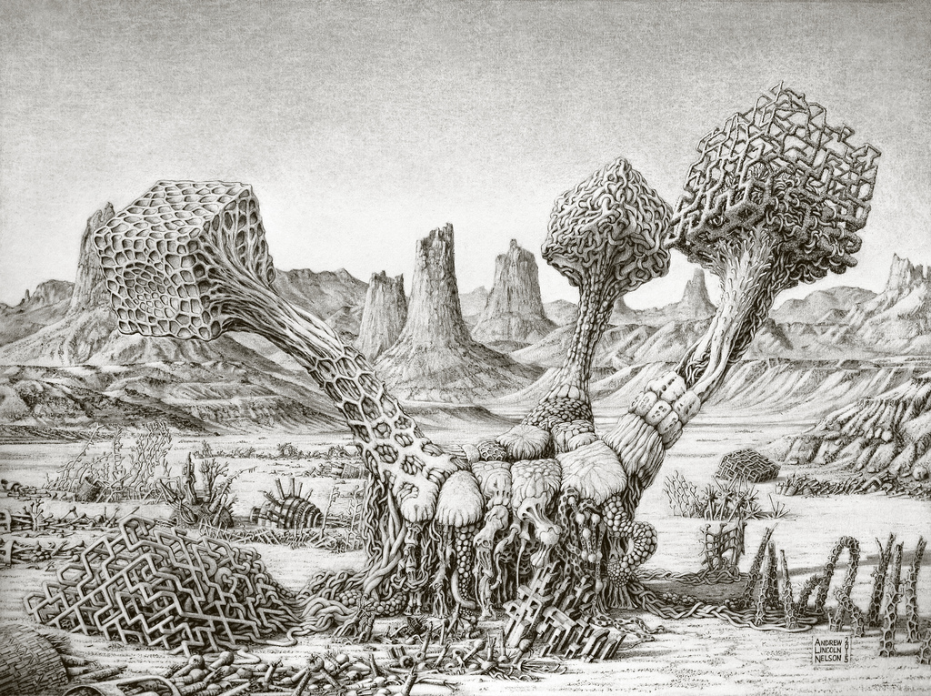
Artificial Intelligence:
Evolution of a Translucent Technology
Keith Downing (IDI, NTNU)
Plantimal 1: Robot 29
(Andrew Lincoln Nelson, 2015)

Slide 2
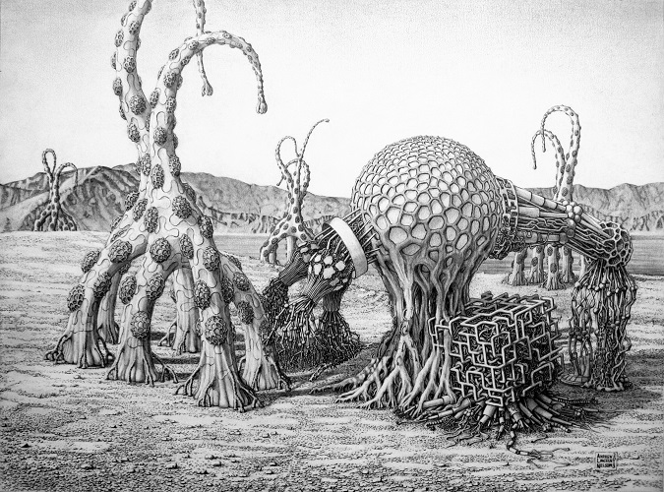
Artificial Intelligence for the
Naturally Curious
Keith Downing (IDI, NTNU)
Phytoborg 1: Robot 25
(Andrew Lincoln Nelson, 2013)

Slide 3
The Norwegian Open AI Lab
AI Lab Video
https://vimeo.com/tydelig/review/287662197/61bd6c5dc6

Slide 4
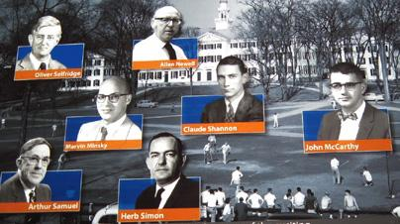
Bold Beginnings (Dartmouth, 1956)
Every aspect of learning or any other feature of intelligence can be so precisely described that a machine can be made to simulate it.
Notes:
Formalize Intelligence – they thought it would be easy. Thought intelligence was TRANSPARENT.
Simulate formal descriptions in a machine – By 1956, these simulations were possible….and many “hard” things (like geometry and chess) had been formalized.
Since computer could do things that smart people do, they figured it would be easy for it to do what ALL people do.

Slide 5
Roller Coaster History of AI
Notes:
Thus began the roller-coaster ride of AI.

Slide 6
Landmark AI Achievements

Slide 7
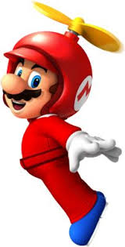
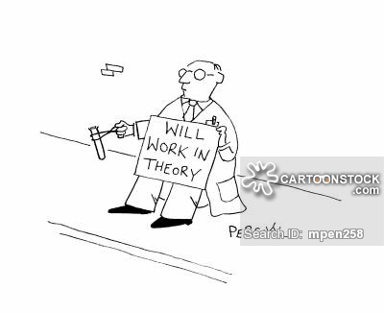

Perspectives on
AI Progress & Potential
Media,
General Public,
Funding Agencies
AI Researchers
Notes:
Rises and Falls are only a perception. People in the field have seen steady progress. But they have also contributed to the hype!!

Slide 8
The Ever-Changing Scope of AI
AI is what humans are currently better at …. Jim Hendler (AI expert)
Once a cognitive process is demystified by an algorithm, it exits AI.

Slide 9
Two Very Different AI Approaches

Slide 10
AI Texas Hold’em (Top-Down)
Interview poker experts (or read strategy books) to produce a large set of situation-action rules:
  IF your hole cards are a pair of face cards, AND the third such face card appears in the flop, THEN slow-play the hand (i.e. do not raise, only call).
  IF it is the final (“river”) round of betting, AND the opponent raises before you, AND the pot-odds are favorable, THEN call the raise.

Slide 11
AI Texas Hold’em (Bottom-Up)
Deal out remaining cards thousands of times.
Count # times (W) that Player 2 wins.
Base Player 2’s betting decision on W.

Slide 12
AI in Medicine
Top-Down
Doctors formalize their (deep) medical knowledge
AI developers enter (‘hardwire’) it into an expert system (ES).
Patient cases run through the ES; no learning.
Bottom-Up
Medical experts label hundreds (thousands) of MRI images.
AI system learns associations between images and labels.
AI system computes labels for new images.
AI system has no explicit deep domain knowledge.

Slide 13
DENDRAL (1965-1979)
Edward Feigenbaum (AI) + Joshua Lederberg (geneticist)
Input: Spectrographic Data for an organic compound
Output: Molecular Structure of that compound
First computer system with a clean separation of:
  Knowledge (of organic chemistry and hypothesis reformulation)
  Reasoning (applying rules to modify hypotheses)
Focus on specific domain knowledge, not the reasoning mechanisms.
Knowledge comes directly from domain experts in the form of If-then rules.
Established Knowledge-Intensive methods as the central AI problem-solving paradigm for 15-20 years.

Slide 14
MYCIN Rule # 578
IF
    The infection is meningitis
    Organisms seen on the culture’s stain
    Type of infection = bacterial
    Patient has been seriously burned
THEN
  Cause = Pseudomonas-Aeruginosa
  with (probability = 0.5)
MYCIN (Stanford, early 1980’s) was one of the first successful expert systems.

Slide 15
Chess (The Drosophila of AI)
1967 - Greenblatt’s MAC HACK VI = 1st computer in a human tournament: Won 2; Tied 2.
1997 – IBM’s Deep Blue beats reigning world champion Garry Kasparov.
  I am a human being. When I see something that is well beyond my understanding, I am afraid … G.K.
  Deep Blue: evaluated 200 million states/sec. Kasparov: 3.
  Deep Blue used Minimax with Alpha-Beta pruning.
  Deep Blue does NOT learn.
  IBM team claimed it wasn’t AI at all, just brute-force search.
  Dismantled after the match.
2006 – German Deep Fritz, better than Deep Blue.
2017 – Alpha Zero uses Deep Reinforcement Learning to learn chess from scratch and beat the best AI player.
Notes:
Games are popular in AI teaching and research. We can chart AI’s progress along dimensions defined by these games.

Slide 16
AI and Checkers
1967 – Samuel’s (IBM) system learned own evaluation function
by playing against itself. Beat Connecticut state champion.
1990 - Schaeffer (Univ. of Alberta) develops Chinook.
2001 – Fogel evolves Blondie 24, which climbs on zone.com
and beats Chinook (once).
2004 – Chinook becomes world champion.
2007 – Shaeffer’s group proves all Checkers games can end in a tie if played perfectly by each side: Checkers is solved.
  Takes 18 years of computer time and 5 x 10²⁰ state evaluations.
  It’s been 18 years! …obsessive-compulsive behavior …. not normal….Get a life, Jonathan. – Schaeffer’s wife.

Slide 17
TD-Gammon
Gerald Tesauro (1995)
Reinforcement Learning

Slide 18
The Backpropagation Algorithm
The network may need to see each example thousands of times to learn correctly.

Slide 19
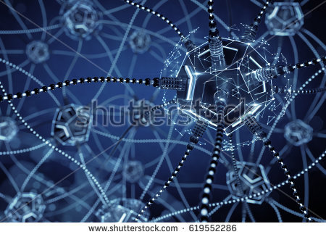
Deep Learning
Large Neural Networks
LOTS of Data
LOTS of Computing Power
Beat Humans at
Complex Tasks of
Pattern-Recognition

Slide 20
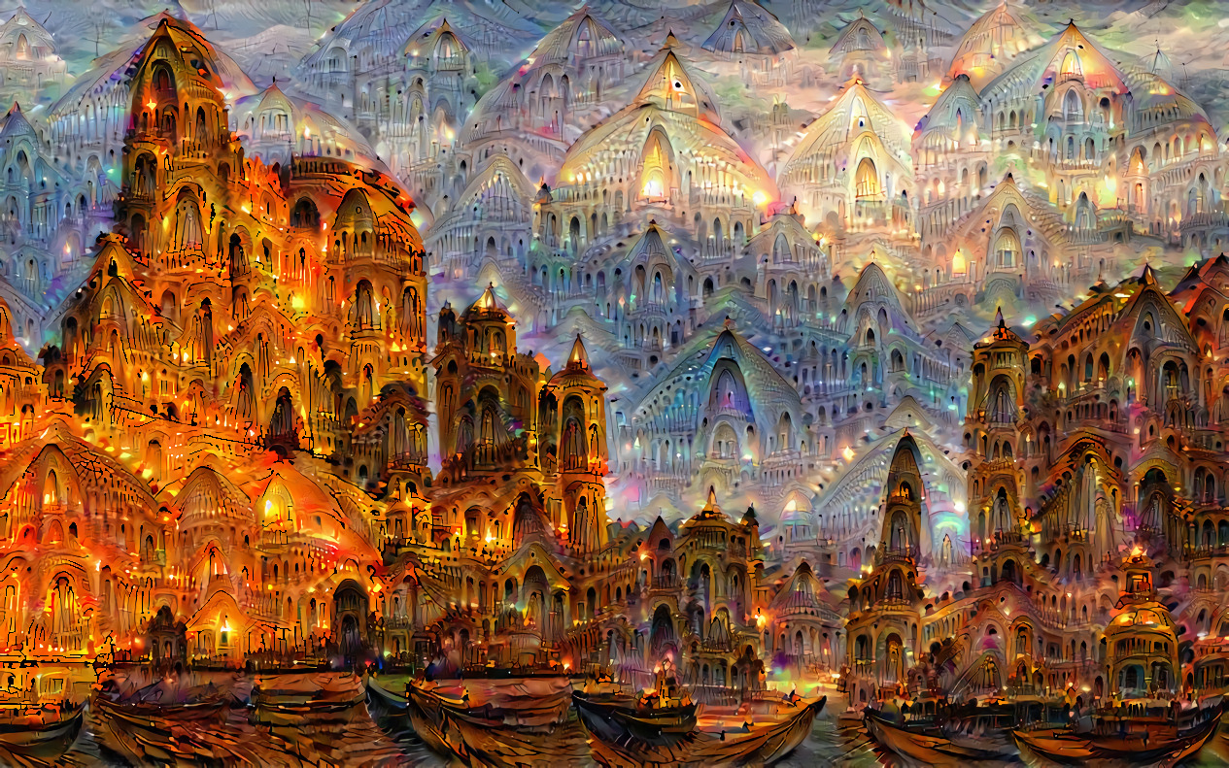
Deep-Learning Applications
Coloring B/W Images
Adding Sound Effects to Silent Movies
Adding Captions to Images
Accelerated Discovery of New Drugs
Interpreting Web Data for Cancer Research
Identifying High-Risk Patients for many Diseases
Natural Language Translation
Generating Articles from Statistics (e.g. Sports)
Generating Art based on Styles of Particular Artists
Environmental Modeling – Interpreting Satellite Images
Power-line Troubleshooting - Interpreting Drone Images
Trent Troop and his Deep Dreamer

Slide 21
Deep-Learning Applications
Self-Driving Vehicles
Championship-level Game Playing
Producing Captions for Images
Coloring B/W Images
Adding Sound Effects to Silent Movies
Fake Video
Detecting Fake Social-Media posts
Accelerated Discovery of New Drugs
Interpreting Web Data for Cancer Research
Identifying High-Risk Patients for many Diseases
Early detection of Cerebral Palsy (Open AI Lab)
Natural Language Translation
Generating Articles from Statistics (e.g. Sports)
Generating Art + Music based on Styles of Particular Artists
Environmental Monitoring – Interpreting Satellite Images

Slide 22
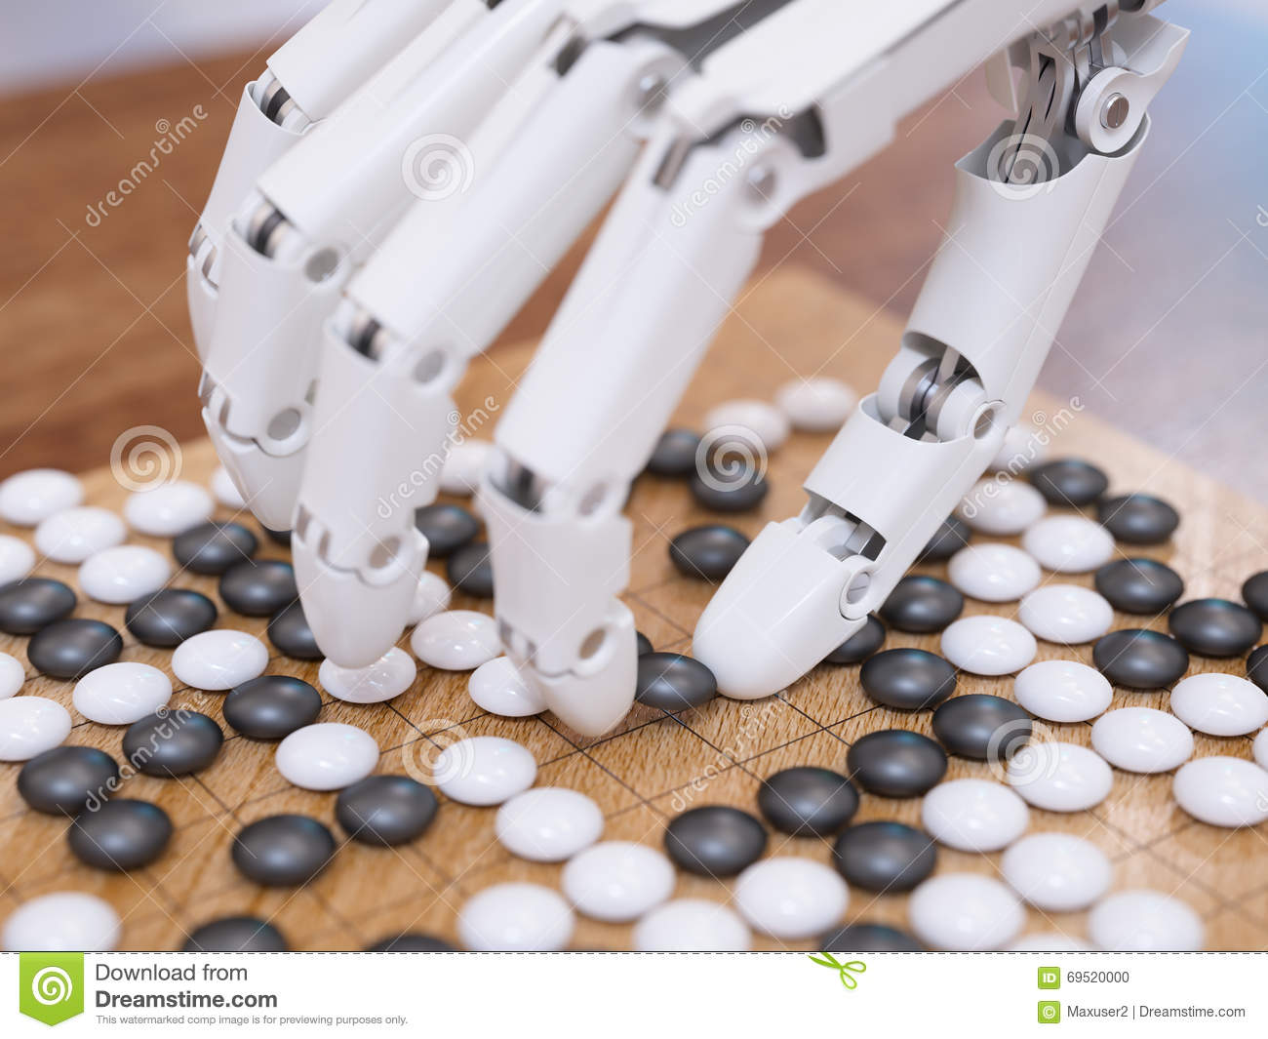
AlphaGo
Silver et. al., Mastering the game of Go with deep neural
networks and tree search, Nature, 2016.
I guess I lost the game because I wasn’t able to find
any weaknesses…Lee Sedol (World # 2)
Notes:
Alpha GO combines human examples with self-play. Alpha Go Zero uses ONLY self-play (and defeats Alpha Go every time) !!
Alpha GO is popular among AI researchers for combining Deep Learning with (traditional) AI search methods….and for being so good!!
It is also fascinating, because it makes me SURPRISING moves THAT WORK.

Slide 23
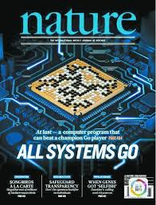
AlphaGo
Silver et. al., Mastering the game of Go with deep neural
networks and tree search, Nature, 2016.
I guess I lost the game because I wasn’t able to find
any weaknesses…Lee Sedol (World # 2)
Notes:
Alpha GO combines human examples with self-play. Alpha Go Zero uses ONLY self-play (and defeats Alpha Go every time) !!
Alpha GO is popular among AI researchers for combining Deep Learning with (traditional) AI search methods….and for being so good!!
It is also fascinating, because it makes me SURPRISING moves THAT WORK.

Slide 24
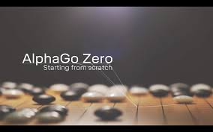
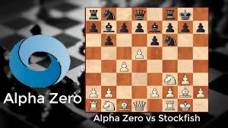
AlphaGo Zero & Alpha Zero
No expert knowledge needed.
Self-play is enough to become world champ
Generalize AlphaGo Zero to other games.
Becomes world champ at them.
Another step toward AGI

Slide 25
The Breadth of DeepMind (The Apollo Project of AI)
AlphaFold – predicting 3D protein structure from amino acid sequences => Drug discovery. Used in Covid-19 vaccine research.
Predicting Macular Degeneration Progression – Deep Learning trained on 3D optical coherence tomography images.
Distributional value codes – ML’s reinforcement learning (RL) realized with dopamine and the basal ganglia.
Grid-cell emergence – Deep-Learning systems in which grid-like functionality arises.
Randomized-to-Canonical Adaptation Networks – Reducing the simulation-reality gap with Deep Learning
Diplomacy – Deep RL for a complex 7-player board game involving social and political dilemmas.
…… and many more areas…

Slide 26
Humans Need Not Apply
AI learns by itself. No need for human expertise.
RL systems generate their own labeled datasets as they explore the world
Humans are no longer the undisputed masters of pattern recognition
Unbiased by humans => Extremely Creative (Move 37)

Slide 27
Life is not a Game
AI systems cannot play 10000 rounds of Life to generate data….though simulations of domains such as traffic flow do produce useful data.
In the natural sciences, simulations are useful, but always limited, so we still need real data.
  Human experts still needed to analyze real-world scenarios and label them.
  Humans need to monitor Machine Learning systems for both accuracy and bias.
Humans are best at understanding other humans.
  Major roadblock to 100% self-driving cars = predicting behavior of pedestrians (and other drivers, cyclists, scooterists, etc.)

Slide 28

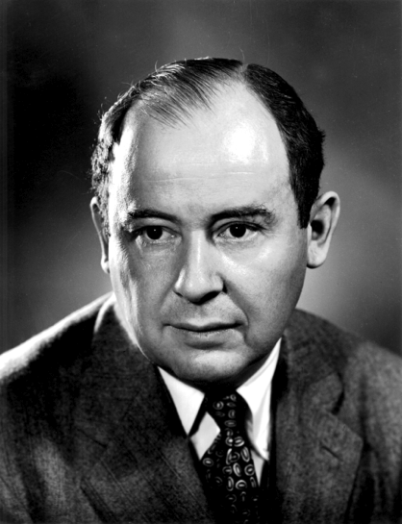
“Machines take me by surprise with great frequency”
- Alan Turing
“Young man, in mathematics, you don’t understand things. You just get used to them.”
- John von Neumann
AI’s true (and most feared) power = computational creativity
(and unpredictability), not automated reasoning and decision making.
Notes:
The real beauty of AI is not a reasoning computer, but a CREATIVE (and hence unpredictable) computer. There are advantages and disadvantages of this.

Slide 29
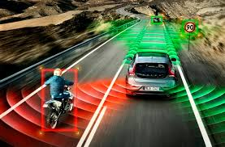
Autonomous Vehicles
Notes:
Bottom-up methods are behind the big, recent breakthroughs in AI. They are the most creative, AND the most unpredictable. The
question is: How much control are we willing to give to our computers???

Slide 30
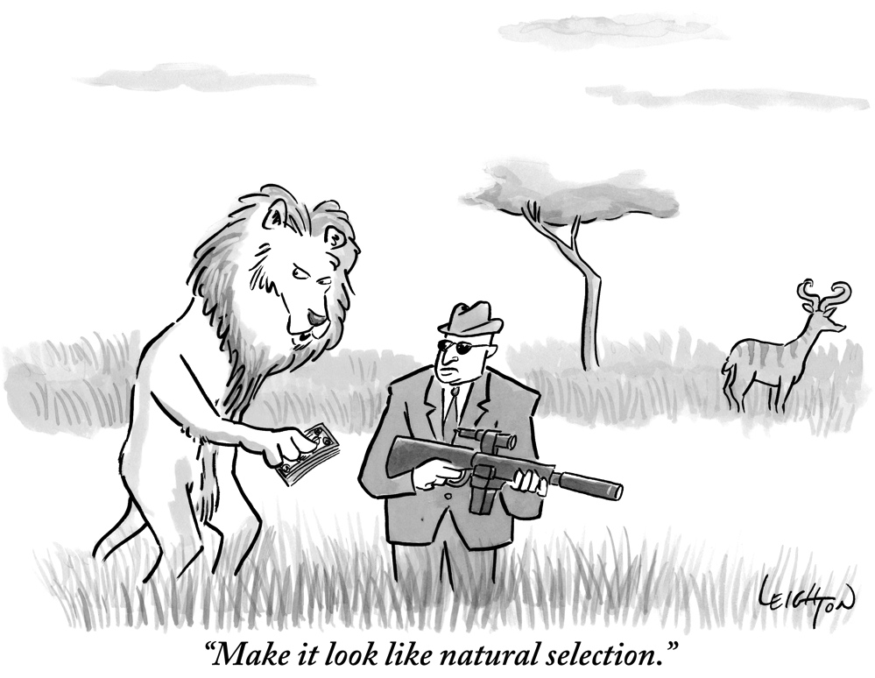
Notes:
In addition to learning, AI systems can also EVOLVE, using simulations that “look like natural selection”.

Slide 31
Evolutionary Computation
Notes:
This field is called Evolutionary Computation.
(Briefly) discuss the slide.

Slide 32
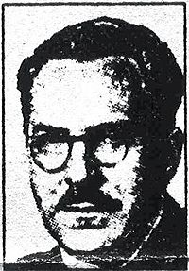
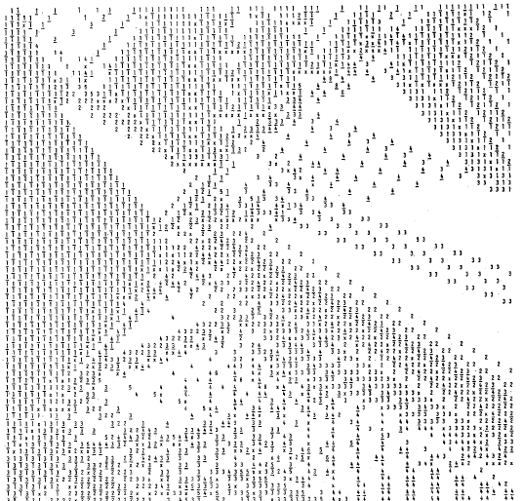
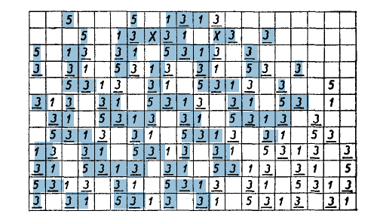
Nils Barricelli
Oslo University
(1968 – 1993)
Notes:
Norway was involved in very early forms of evolutionary computation.
In the 1950’s, the Norwegian-Italian mathematician, Nils Aall Barricelli, travelled to various labs in the US and Europe (including von Neumann’s) in search of computer time to run what were probably the first simulations of reproduction and evolution.

Slide 33
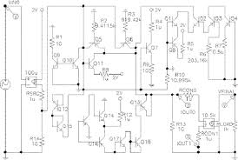
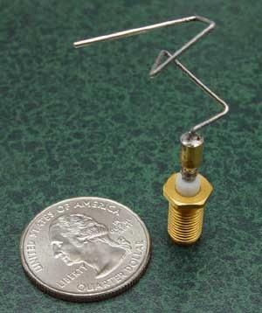
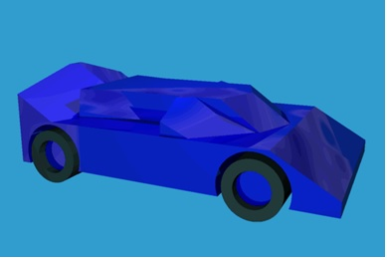
Koza et. al. (2003)
Lohn, Hornby and Linden (2012)
Bentley (1996)
Notes:
Now, the results of this field are very impressive, and often quite SURPRISING. Unconventional (but effective) designs!
NASA used evolutionary computation to design this satellite antenna, which beats anything that human engineers could come up with.

Slide 34
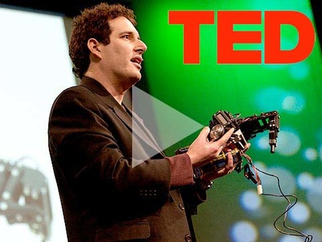
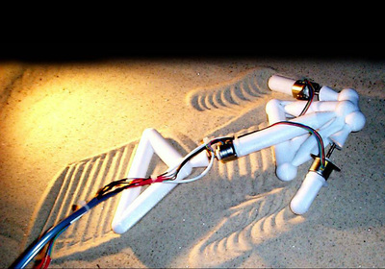
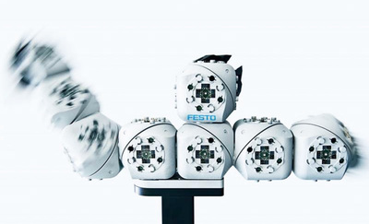
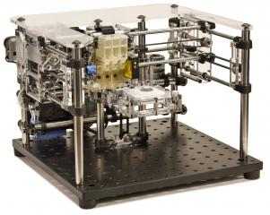
Hod Lipson’s
Creative Machines Lab
(Columbia University)
Notes:
So now we have AI systems that evolve other AI systems that can be produced, physically: robots making robots!! This scares some people.

Slide 35
The Singularity (Vernor Vinge, Ray Kurzweil)
A point where normal
expectations break down,
where things become
confusing, meaningless,
and unpredictable
(Joel Garreau, 2006).
Notes:
When AI’s can produce (improved) AI’s, without human help, the SINGULARITY occurs.

Slide 36
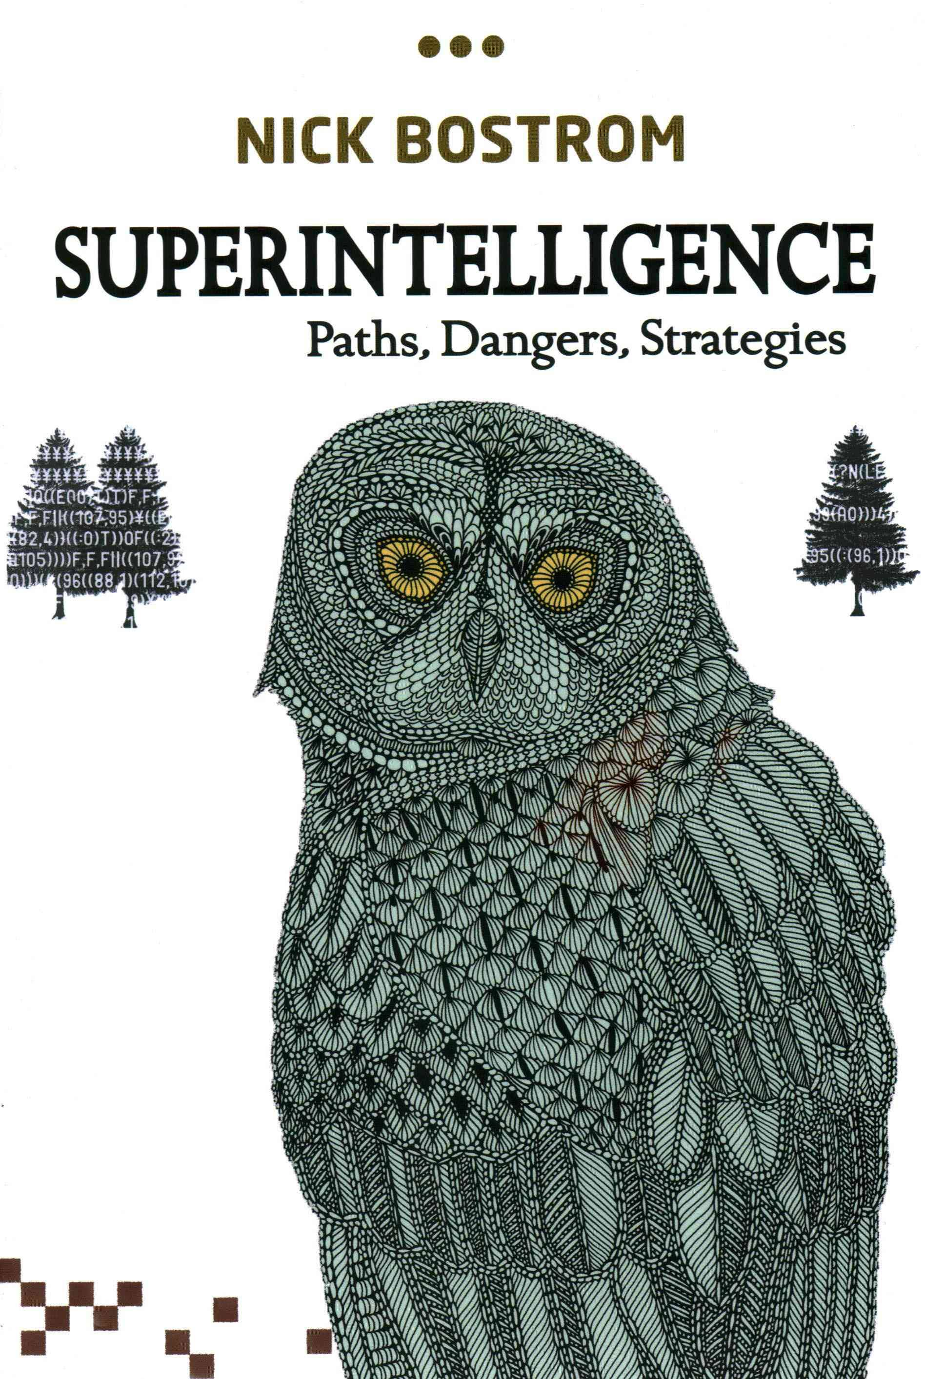
Notes:
All of these exponentials (accelerations) => the singularity could sneak up on us very quickly. Once we get to chimp intelligence, human intelligence (and beyond) may only be a few days away!!
We need a plan, now, as to how to control these superintelligences. We may not have time to do it after they are created.

Slide 37

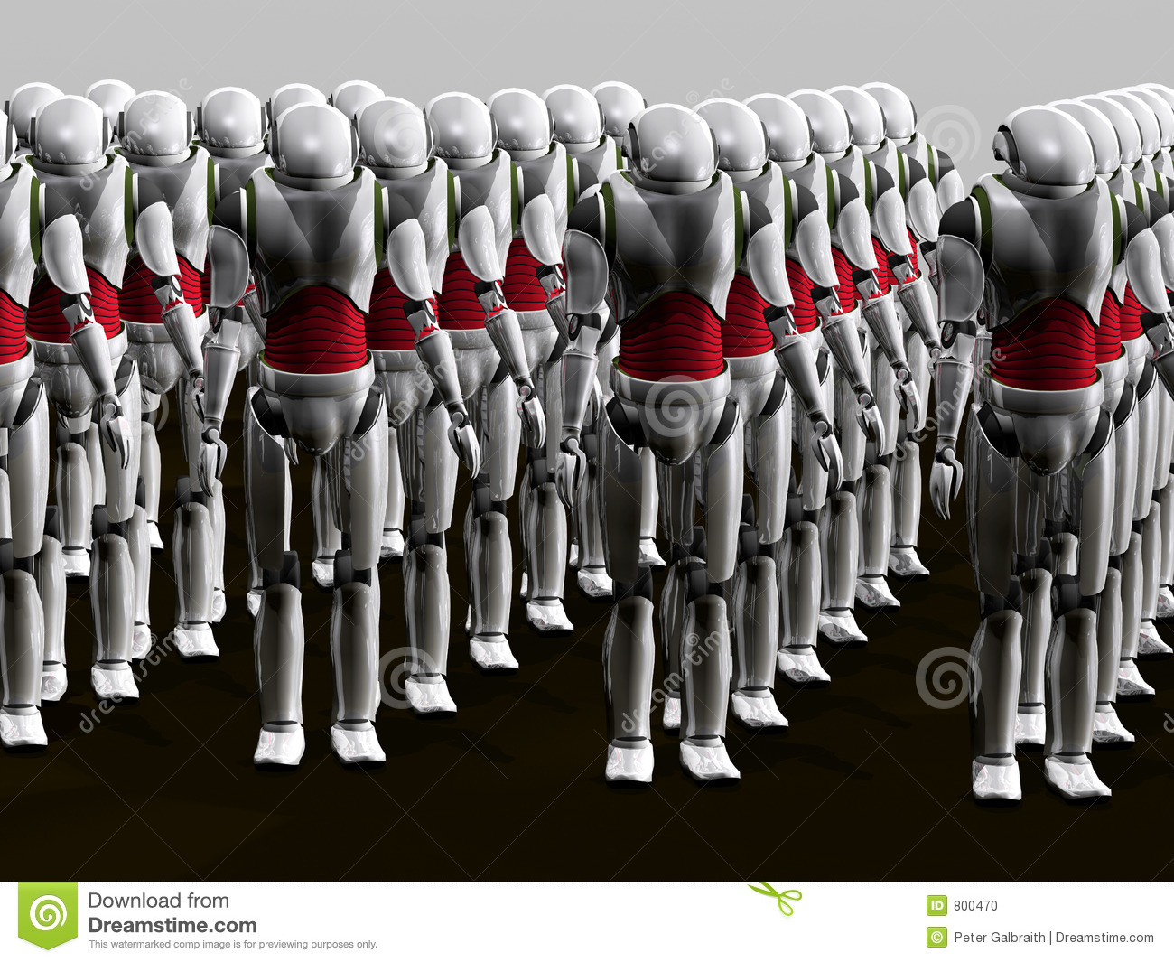
Survival
of the
Fittest
Artificial Selection of AI
Natural Selection of AI
Competence
Adaptability
Obedience
Focus on our goals
Self-preservation
Replication
Focus on its goals
Notes:
Maintaining control of AI => Insuring that Artificial Selection of AI never becomes NATURAL Selection of AI.
As long as we can stay in the blue, we are ok.

Slide 38

Problems Preserving Artificial Selection of AI
Birth Control
Who controls the resources
needed for AI preservation and
reproduction?
  Humans
  Nobody in particular
  AI
Today humans have:
  Good control of Hardware
  Weaker control of Software
Our Goals
Properly defining them (ethics)
Risk-free embodiment in AIs
Preventing AI from developing
new goals that supersede ours.
We gradually give technologies more and
more control over our decision-making.
Notes:
But it is not so easy to preserve artificial selection.

Slide 39
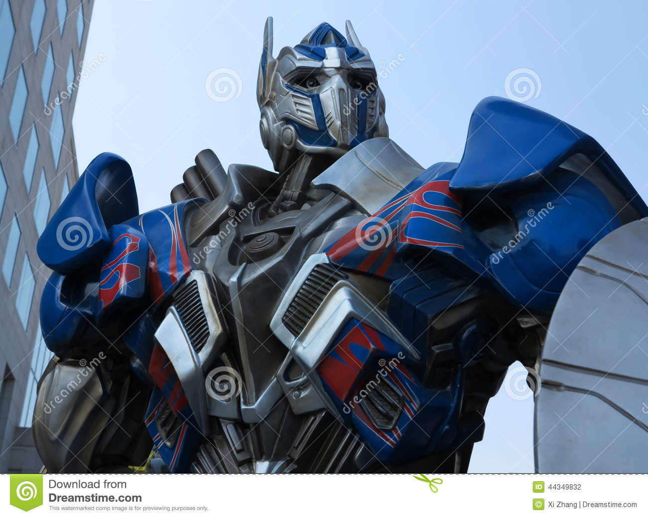
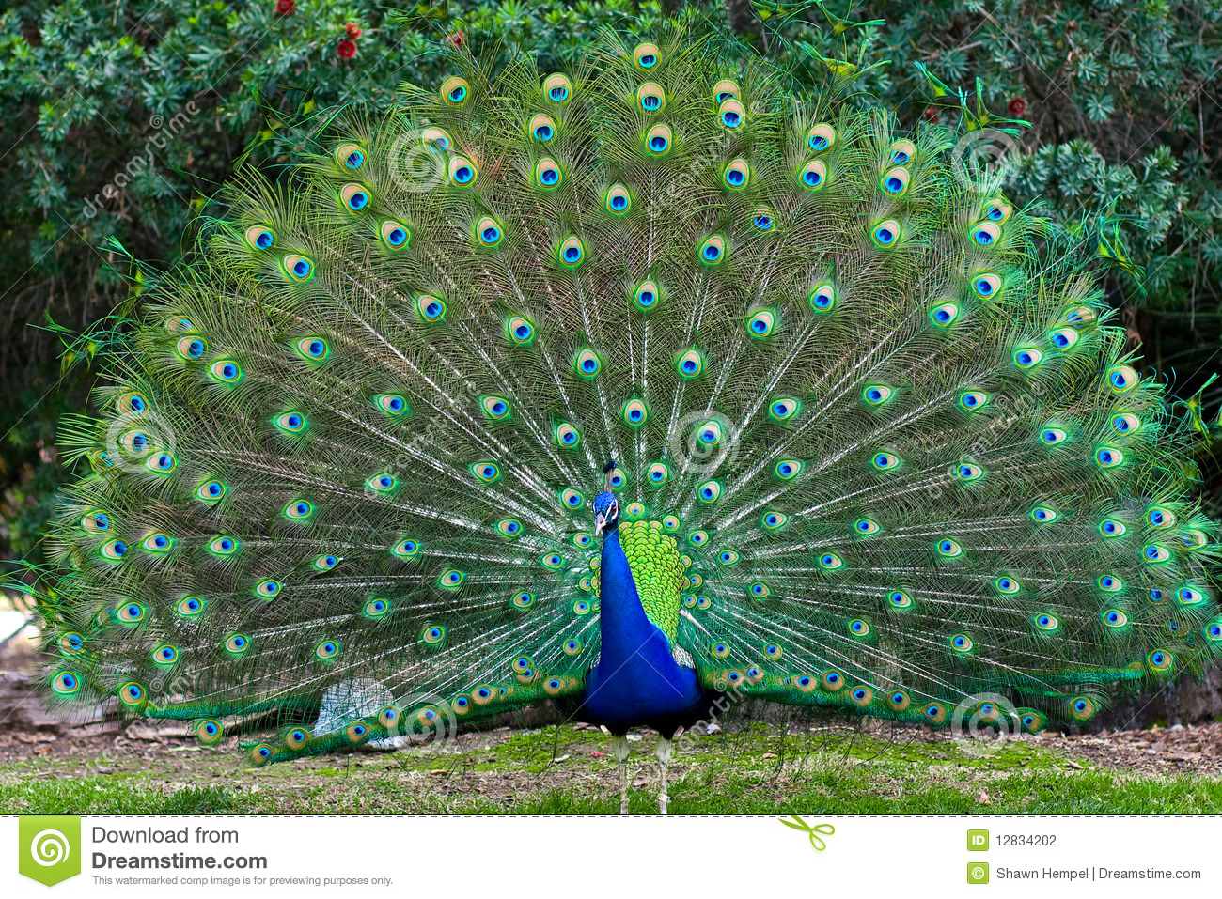


Diminishing Transparency of AI
Showing Off
Military
Nature
Financial Sector
Academia
Notes:
Another disturbing trend is reduced transparency of AI, in several different respects.

Slide 40
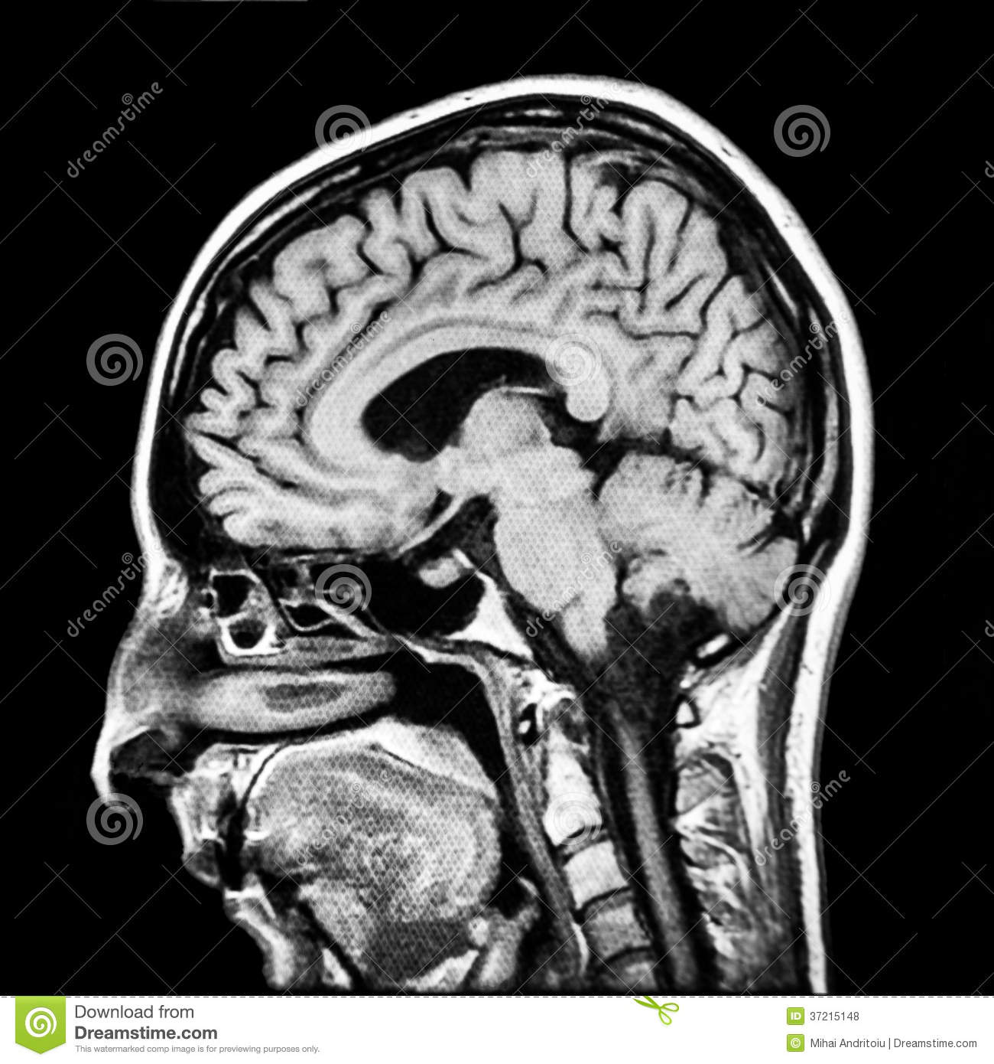
Translucent but not Transparent
Dissecting the Black Box
Competence without
Comprehension (Dennett)
???
Remove
Tumor !!

Slide 41
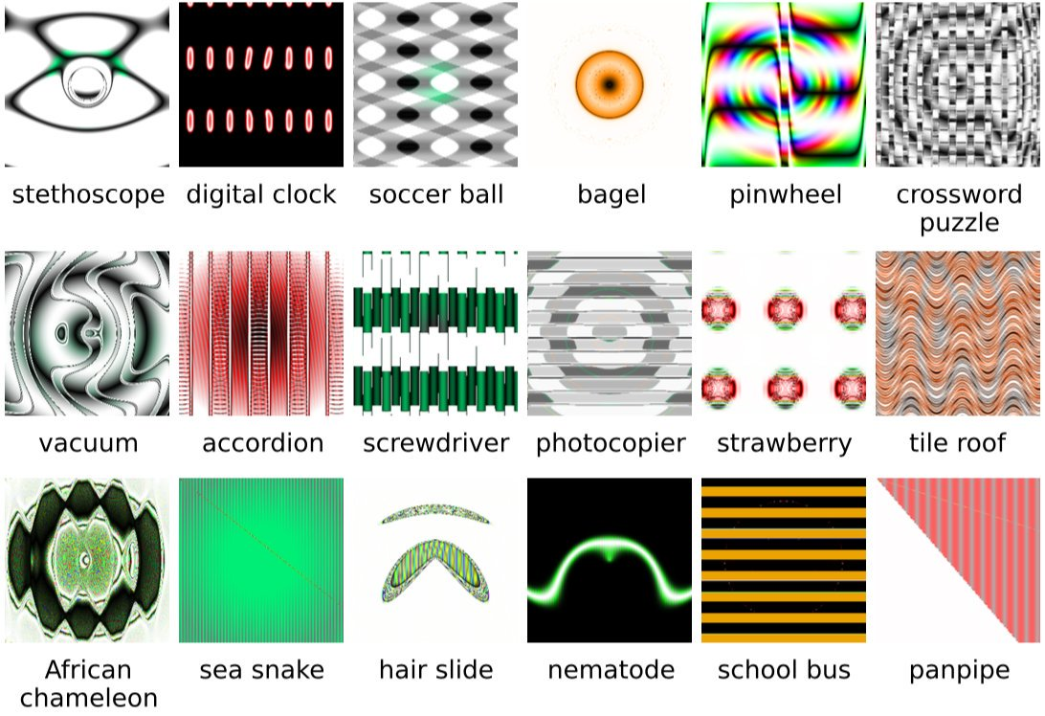
Evolution Deceives a Deep Learner
Deep Neural Networks are Easily Fooled. Nguyen, Yosinski & Clune (2015)

Slide 42
Future AI Directions
Top-Down + Bottom-Up Methods
  GOFAI + Deep Learning
  Enhance comprehension and explainability
Other Bottom-Up Methods
  Evolutionary Neural Networks
  Swarm Intelligence
Embodied AI
  Robots that evolve and learn
  I am therefore I think
Human-AI Cooperation
  Transportation: partially self-driving cars
  Medicine: Doctors consider AI’s suggestions
More Deep Learning
  Pattern Processing + Prediction = foundations of intelligence

Slide 43
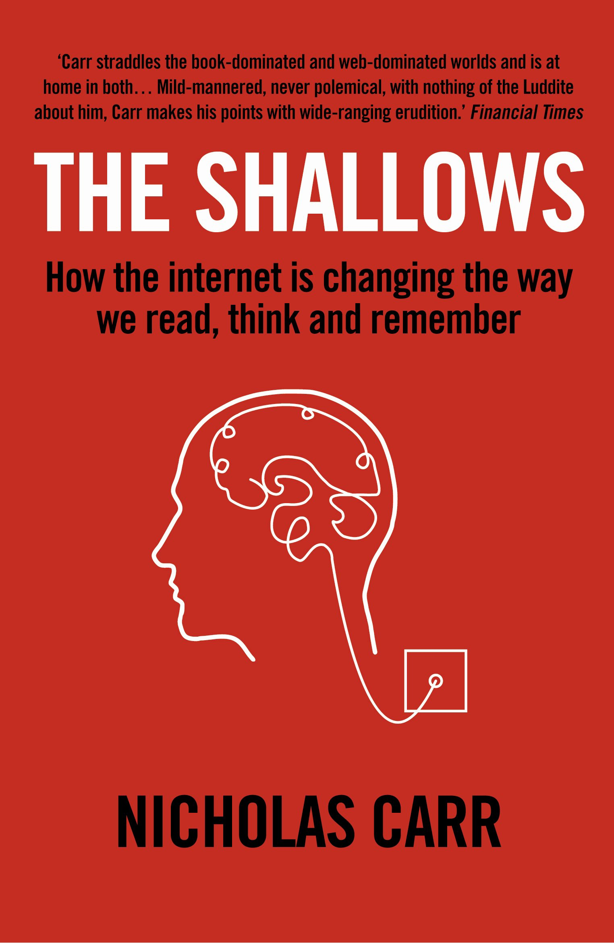
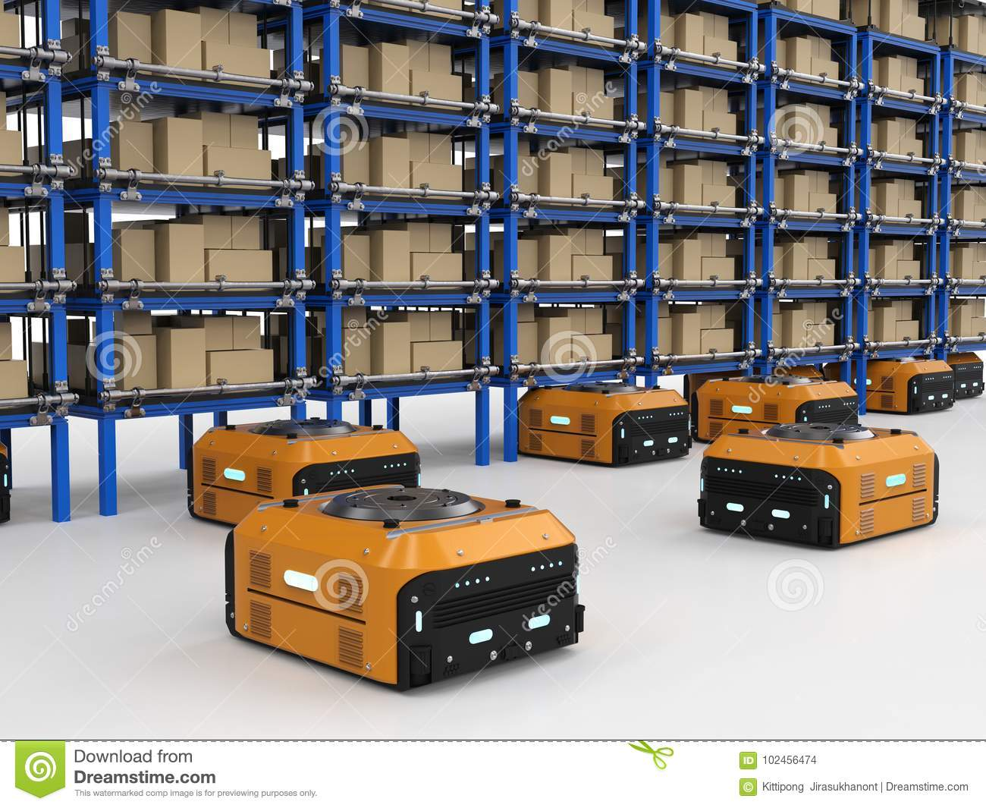
AI’s Immediate Threats
Job Loss
Dumbing down of tech-dependent humanity
Robot-Run Warehouse

Slide 44
What is your value-add?
General advice:
Know what AI can and
cannot do!
Key personal traits:
Deep, creative thought
Empathy and emotion
STEMpathy

Slide 45
Washington Post’s Heliograf System
The Yorktown Patriots triumphed over the visiting Wilson Tigers in a close game on Thursday, 20-14.
The game began with a scoreless first quarter.
In the second quarter, The Patriots' Paul Dalzell was the first to put points on the board with a two-yard touchdown reception off a pass from quarterback William Porter.
Wilson was behind Yorktown 7-0 heading into the second half. Wilson's Anton Reed tied the score with a two-yard touchdown run. The Patriots took the lead from Wilson with a two-yard touchdown run by Tanner Wall…..
Yorktown's top passer was Wilson, who completed 6 of 10 passes for 91 yards and one touchdown. Yorktown's top rusher was Wall, who had seven carries for 57 yards and one touchdown. The Patriots' top receiver was Wall, who had four catches for 54 yards.
Yorktown will play Wakefield High School (1-0, 0-0) on Sept. 8. Wilson will play McKinley Technical High School (0-1, 0-0) on Sept. 8

Slide 46
Economics is not Rocket Science … Unfortunately

Slide 47

Plight of the Infovore
Constant distractions of cyberspace
“Shallows”: Reduced depth
of thought and emotion
Less Creative
Rely on computers to
understand the world
Rely on AI
for wisdom
Reduced value in an information society
Automation Bias: Trust machines over ourselves.
Human intelligence becomes artificial
Notes:
As we become more dependent on machines for decision-making, our own intelligence becomes very artificial, and we may subtly begin to ADOPT the MACHINES GOALS!!

Slide 48
Human-AI Interaction Spectrum
Human + AI
problem-solve
together
Human gives problem-solving
examples/cases to AI, which learns
to problem-solving from them.
Human hard-wires
knowledge into AI, which
then solves problems alone.
AI experiences the
World, learns, and acts…
all on its own.
AI should help us learn, not just do the job itself.
For the good of humanity, move back left !! (Lee Sedol Move 78)

Slide 49
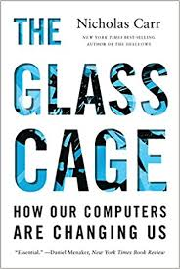
The Glass Cage (Nicholas Carr, 2014)
Reclaim our tools as instruments of ourselves, as instruments of experience rather than just means of production.

Slide 50
Big Issues in AI
Explainable AI – increase transparency of sub-symbolic methods (e.g. neural nets)
Architectures – combinations of many methods
  RL + DL ; CBR + Bayes ; DL + EA ; ….
Artificial General Intelligence (AGI) –
  Many specialties in one system
  More humanlike? Welcomed by humans??
Job Loss
  Can we adapt to this round of automation? Or will our adaptive machines do so faster than us?
Cognitive Underload
  Reduced human intelligence and fulfillment as AI does hard jobs.
  Role of AGI in teaching and stimulating us?
AI + Big Data = Tools or “Weapons of Math Destruction”.

Slide 51
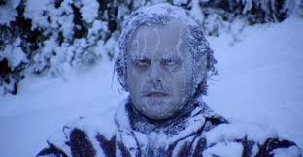
In From the Cold
Notes:
SUMMARY. The AI Winter ended (even in Norway), and we found AI almost frozen to death. We brought it in from the cold.

Slide 52
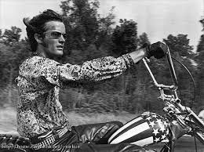
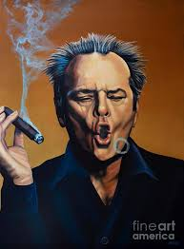
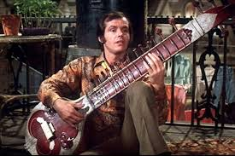
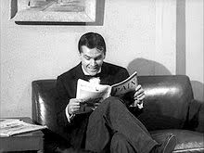
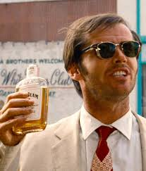
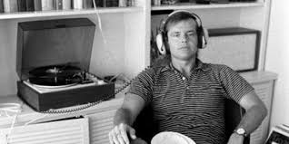
Cultural
Immersion
Notes:
We found out that it has a keen ability to LEARN, so we exposed it to our culture.

Slide 53
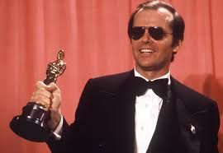
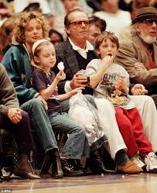
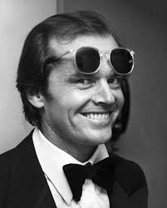
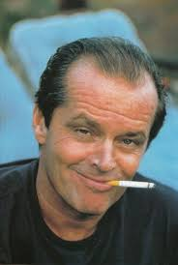
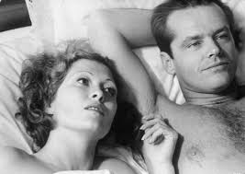
Here’s
Johnny
Notes:
VERY QUICKLY, it became VERY SKILLED at many things, winning many awards, doing some things better than us, and becoming extremely POPULAR…to the point that AI is preferred over humans in many situations.

Slide 54
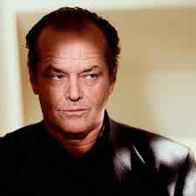
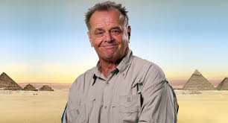

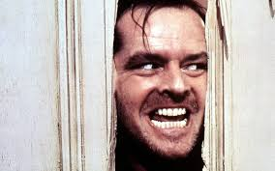
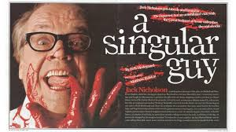
???
Notes:
And now we’re very concerned about what AI could become!!

Slide 55
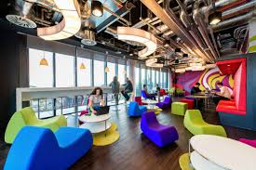




The End?
Robot 19: (Andrew Lincoln Nelson, 2015)
Notes:
And what WE will become….
More exciting jobs in more cool places like Google…or more leisure time….or is this THE END of humanity as we know it…where maybe our brains will still hold enough special power to keep us (or at least our brains) around?

