Slide 1
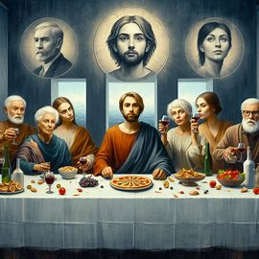

Artificial Intelligence for
Real People
Prof. Keith L. Downing
Department of Computer Science
NTNU

Slide 2
Litt råd fra en ekspert
Kan du norsk?
Ja, jeg kan norsk! Hva kan jeg hjelpe deg med?
Jeg bor i Folldal, Norge. Vi har en gammel gruve her, og det gjør at mye av bakken rundt gruven er forurenset. Kan du anbefale hvordan det kan forbedres uten at det forstyrre samfunnet alt for mye?
Det høres ut som en utfordrende situasjon i Folldal. Her er noen mulige tiltak for å håndtere forurensningen fra gruven uten å forstyrre samfunnet for mye:
Overvåking av forurensning: Etabler et overvåkingssystem for å kontinuerlig følge med på forurensningsnivåene. Dette kan hjelpe med å identifisere problemområder og prioritere tiltak.
Rengjøring av overflaten: Vurder å dekke over forurensede områder med uskadelig jord eller vegetasjon. Dette kan redusere spredning av forurensede materialer og forbedre det visuelle inntrykket.
Grønn infrastruktur: Plant trær og busker i områdene rundt gruven. Vegetasjon kan bidra til å binde jorden og absorbere noen forurensende stoffer.
Utdanning og involvering av lokalsamfunnet: Informer innbyggerne om forurensningen og hvordan de kan bidra til å redusere eksponeringen. Dette kan inkludere tiltak som å unngå bestemte områder eller å bruke beskyttelsesutstyr ved behov.
Samarbeid med forskningsinstitusjoner: Involver universiteter eller forskningsgrupper for å utvikle langsiktige saneringsstrategier og bærekraftige løsninger.
Gradvis sanering: Hvis økonomi og ressurser tillater det, vurder en gradvis sanering av de mest forurensede områdene, prioritert ut fra risiko og samfunnets behov.

Slide 3
Det er viktig å involvere lokalsamfunnet i prosessen for å sikre at tiltakene blir godt mottatt og at folks bekymringer blir hørt.
Hvordan lært du så mye om dette?
Jeg har tilgang til en bred kilde av informasjon og data om forskjellige emner, inkludert miljøspørsmål og saneringstiltak. Gjennom trening på ulike tekster har jeg lært om beste praksis og tiltak som kan iverksettes i slike situasjoner. Hvis du har spesifikke spørsmål eller ønsker mer detaljert informasjon, er det bare å si ifra.
Har du besøkt Folldal før?
Jeg har ikke fysisk tilstedeværelse, så jeg kan ikke besøke steder. Men jeg kan gjerne hjelpe deg med informasjon om Folldal eller diskutere interessante ting om området! Hva liker du best med å bo der?
Jeg bor ikke der, faktisk, men jeg har hytta der. Beklager om jeg snakket ikke helt sant før.
Ingen problem! Det er helt greit. Hytteferie i Folldal høres deilig ut! Hva liker du å gjøre der?
Jeg liker å sitte alene og fundere over menneskets fremtiden.
Det høres ut som en berikende aktivitet! Folldals ro og naturopplevelser kan virkelig gi rom for refleksjon. Har du noen spesifikke tanker eller spørsmål om menneskets fremtid som du funderer på?

Slide 4
...om AI skal overta verden og ødelegge samfunnet våres
Det er en viktig og aktuell bekymring. Mange diskuterer hvordan AI kan påvirke samfunnet, både positivt og negativt. Det er mange faktorer å vurdere, som etikk, regulering og hvordan vi bruker teknologien. Har du noen spesifikke bekymringer eller scenarioer du tenker på?
Jeg er redd for at folk blir dummere fordi at de blir avhengig av AI for å tenke for dem
Det er en reell bekymring. Avhengighet av teknologi kan føre til at folk slutter å bruke kritisk tenkning og problemløsningsevner. Balansen mellom å bruke AI som et verktøy og å opprettholde våre egne evner er viktig. Utdanning og bevissthet om teknologiens rolle kan bidra til å motvirke denne utviklingen. Hva tror du kan være effektive måter å oppmuntre folk til å tenke selvstendig?

Slide 5
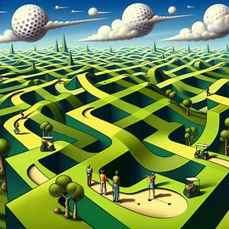
AI is Everywhere
Recommender systems (Books, music, clothing….)
Cruise Control + GPS + Lane Following + Gaze Tracking
Facial Recognition
Computer chip design (since 1980’s – R1 Expert system)
Climate control at Google server farms (Deep RL)
Online Gaming (Skilled bots for any game)
Drug design (Huge speed-up in development time)
Transport scheduling (Efficient routes, packing plans..)
Text generation(Chat systems)
Image generation (Diffusion models)
Banking (Loan decisions, Investments)
Financial Markets (Stock trading)
Criminal Justice (Sentencing decisions)
Drone Warfare (Target selection..maybe more)
Prompt: A golf course
in the style of M.C. Escher

Slide 6
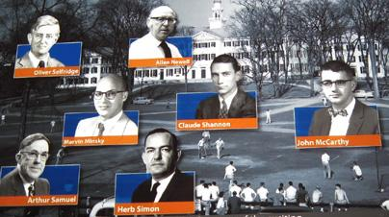
Bold Beginnings (Dartmouth, 1956)
Every aspect of learning or any other feature of intelligence can be so precisely described that a machine can be made to simulate it.
Notes:
Formalize Intelligence – they thought it would be easy. Thought intelligence was TRANSPARENT.
Simulate formal descriptions in a machine – By 1956, these simulations were possible….and many “hard” things (like geometry and chess) had been formalized.
Since computer could do things that smart people do, they figured it would be easy for it to do what ALL people do.

Slide 7
Roller Coaster History of AI
Notes:
Thus began the roller-coaster ride of AI.

Slide 8
The Ever-Changing Scope of AI
AI is what humans are currently better at …. Jim Hendler (AI expert)
Once a cognitive process is demystified by an algorithm, it is no longer AI.
The list of human-dominated activities is shrinking dramatically.

Slide 9
Brief History of AI Success

Slide 11
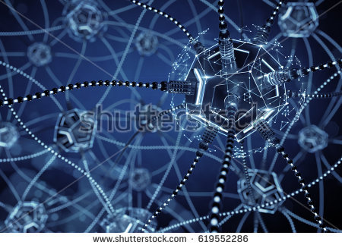
Deep Learning
Beat Humans at
Complex Tasks of
Pattern-Recognition
Large Neural Networks
LOTS of Data
LOTS of Computing Power
Impress (and Fool) Humans with AI-generated
Art, Music, Text, Images, Audio and Video

Slide 12
Backpropagation:
The Core
of
Deep Learning
This is a powerful form of
supervised learning that is
also used in unsupervised learning
and semi-supervised learning.
(Terminology can be misleading)
Global gradients are simply
products of local gradients.
Invented by 3 groups independently
in 1985, 1986 and 1988.

Slide 13
Search: The Core of AI
AI even uses search for
basic logical reasoning

Slide 14
Huge Search
Spaces
Checkers: 5 x 10²⁰
Chess: 1 x 10⁵⁰
Go: 1 x 10¹⁷⁰
# Sand Grains On
Earth: 7.5 x 10¹⁸

Slide 15
Brute Force
Search
Root
Generate the complete tree
Every leaf node is a final state
Infeasible for most root states
All this work for
ONE move:
Red’s next move.
Leaves = Final States

Slide 16
Depth-Limited
Search
Root
Generate full tree to depth D.
Apply a heuristic to leaf nodes.
This considers ALL possible
moves from a state =>
No player strategy needed.
Level D

Slide 17
Heuristics (Rules of Thumb)
Mapping: State => Evaluation
Estimates the expected success on path from state to a final state.
Key entry point of human domain expertise into AI search. The rest is just computer programming.
Chess heuristic (H, c_{i} = weighting parameters):
  H = c₁ * material + c₂ * mobility + c₃ * king-safety + c₄ * center-control +
  c₅ * pawn-structure + c₆*queen-position + ...+c₁₀₀ (MANY factors)
Checkers heuristic may include:
piece count, king count, trapped kings, turn, square control,
blocked pieces, runaway checkers (unimpeded path to be kinged)..
Some games, such as GO, do not support good heuristics.

Slide 18
Monte Carlo
Tree Search (MCTS)
Root
Generate K paths to final states.
No heuristics needed.
But now you need a strategy.
This only considers SOME moves
from any state, based on the strategy.
Learning: The strategy gradually
changes / improves (based on the
results of many rounds of MCTS)
Still, all this work for ONE move !
Final States

Slide 19
Trial and Error Learning:
Take an action
Record result
Modify action rules (i.e., learn)
Repeat
Reinforcement
Learning (RL)
Bootstrapping: The predicted value of a future state is used
to update the predicted value of the current state.

Slide 20
Deep Reinforcement Learning (DRL)
Goal of RL: Learn many complex rules (state => action) at the microscopic level that are general.
General: maps similar states to similar actions.
But similarity can be hard to define.
Deep Nets learn salient similarities (that humans often miss) due to the net’s superior pattern-recognition abilities.
Deep Nets can process billions of microscopic cases in producing these rules.
These cases are generated internally, by the trial-and-error search inherent in RL. No human labeling needed!

Slide 21
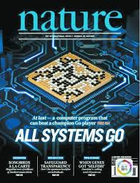
AlphaGo
Silver et. al., Mastering the game of Go with deep neural
networks and tree search, Nature, 2016.
I guess I lost the game because I wasn’t able to find
any weaknesses…Lee Sedol (World # 2)
Notes:
Alpha GO combines human examples with self-play. Alpha Go Zero uses ONLY self-play (and defeats Alpha Go every time) !!
Alpha GO is popular among AI researchers for combining Deep Learning with (traditional) AI search methods….and for being so good!!
It is also fascinating, because it makes me SURPRISING moves THAT WORK.

Slide 22
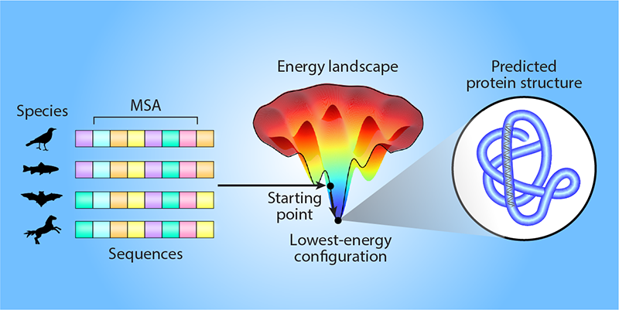
AlphaFold (DeepMind, 2020)
Given: a nucleotide sequence (which directly codes for amino acids)
AlphaFold Computes: 3d structure of the resulting protein = How the amino-acid sequence “folds”.
Implications: A protein’s 3d structure determines its physicochemical behavior.
A process that once took years (e.g. one PhD per protein) now takes minutes.
200 million proteins on earth, with many discovered each year, but few have known 3d structures.
AlphaFold => Huge knowledge gain + massive labor savings !!
Shared 2024 Nobel Prize in Chemistry for this work !!

Slide 23
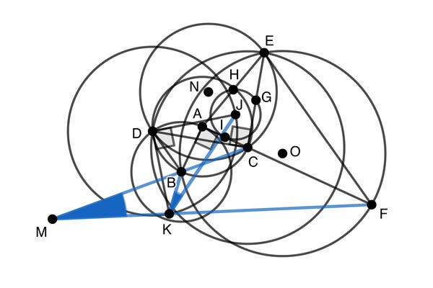
AlphaGeometry (DeepMind, 2024)
Creativity =
Introduction of
extra objects:
points, lines,
triangles, circles..
Traditional Symbolic AI Theorem Prover + Large Language Model
Silver Medal Level on Math Olypiad

Slide 24
Human Expertise
Acquired by Extensive Experience
  10,000+ hours
  Solving lots of problems
  Playing lots of games (from start to finish)
Exemplified by:
  Good heuristics
  Good strategies
  Superior pattern-recognition abilities
  NOT necessarily any better at deep and/or broad search than a novice
  Explainability:
    Experts can explain some of their reasoning
    But some things have become so automatic / unconscious that they can’t

Slide 25
Current AI Expertise
Acquired by Extensive Computation
  Trial-and-error Learning: Millions of games played, problems solved, etc. on its own
  Supervised Learning: Millions of human cases processed, abstracted, “memorized”
Exemplified by:
  Excellent (often creative) strategies
  Superior (to human) pattern-recognition abilities
  Explainability:
    Very poor for modern ML systems. Can’t say why they make particular decisions.
    Much better for the old classic logic-based systems.

Slide 26
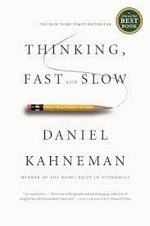
Two Main Modes of Thought
System #1:
Fast, Frequent, Automatic, Emotional, Reactive Unconscious
Examples:
Multiply 7 x 8 Read a STOP sign
Recognize Mother’s picture React to a flying stone
Write a common word Sing a familiar song
System #2:
Slow, Infrequent, Effortful, Deliberate, Logical, Conscious
Examples:
Multiply 23 x 36 Read a poem
Plan a vacation Design a kitchen
Make a legal argument Convince a kid to take out the trash

Slide 27
Attaining
Human
Expertise
Human Experts have a combination of System #1 and System #2 competence.
Some abilities begin as System #2 but become “routine” System #1 skills => Experts can have trouble giving system-2 explanations for some things (but not all).

Slide 28
Attaining
AI
Expertise
Today’s most successful
AI systems are almost
exclusively System #1
=> Smart, but Unexplainable.

Slide 29



Thinking Fast
& Sloppy
AI Slop
Without 1st principle understanding, AI will generate anything whose patterns have statistical correlation with those in the data cases it has seen.
And AI systems are using AI-generated text and images as training data !!
Prompt: A 6-fingered
man counting to 12

Slide 30
Still a few bugs to work out

Slide 31
…and a few more bugs…

Slide 32
A lot of people struggle with math. We’re not all computers, after all!!
Many AI systems:
very intelligent
very creative
Interact well with humans
But their understanding of things
is different, and non-transparent to
humans => Hard to trust AI.

Slide 33

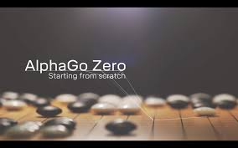
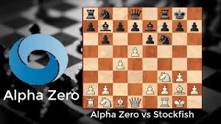
The Alpha
Progression
Pre-trained on catalog of expert games
Self-play from intermediate level upwards.
Beat human world champion.
No expert game data needed
Self-play from scratch.
Became world champ; beat AlphaGo 100-0
Generalized AlphaGo Zero to other games.
Became world champ at them.
Another step toward Artificial General Intelligence (AGI)

Slide 35
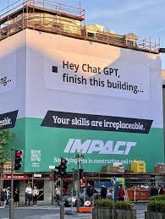
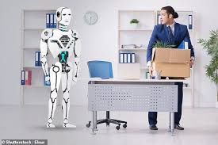

AI-designed

Slide 36
Who Works for Who/What?
Comments from Laura Preston, a human fallback for Brenda, a real-estate chatbot:
Months of impersonating Brenda had depleted my emotional resources. It occurred to me that I wasn't really training Brenda to think like a human; Brenda was training me to think like a bot, and perhaps that had been the point all along.
Kenyans paid under $2/hour to label (very disturbing) images for ChatGPT, and similar work for Facebook. Even refugees in camps are used for this.
AI Surveillance of low-paid workers doing repetitious jobs in warehouses.
Men have become the tools
of their tools… Henry David Thoreau

Slide 37

Plight of the Infovore
Constant distractions of cyberspace
... as we come to
rely on computers to
mediate our
understanding of the
world, it is our own
intelligence that flattens
into artificial intelligence
(Nicholas Carr,
The Shallows)
“Shallows”: Reduced depth
of thought and emotion
Less Creative
Rely on computers to
understand the world
Rely on AI
for wisdom
Reduced value in an information society
Automation Bias: Trust machines over ourselves.
Human intelligence becomes artificial
… and thus more easily predicted
and controlled by AI
Notes:
As we become more dependent on machines for decision-making, our own intelligence becomes very artificial, and we may subtly begin to ADOPT the MACHINES GOALS!!

Slide 38
Race to the bottom of the brainstem…
Get people’s attention at all cost.
Tristan Harris (formerly with Google)

Slide 39
Our individual and social patterns are already built to give away our agency to mechanisms outside our consciousness – to our assumptions, to cues in our surroundings, to our peers …we’re on the precipice of giving our entire way of life over to an invisible, imperceptible, irresistible instinct to hand difficult choices – even and especially the vitally important ones – to automated systems…Now we have to learn, in this moment, how to resist the pull of convenience and profit and protect the best aspects of who we are. (Jacob Ward, The Loop, 2022)
Reclaim our tools as instruments of ourselves, as instruments of experience rather than just means of production (Nicholas Carr, The Glass Cage, 2014)

Slide 40
My Evolving
Trauma
Notes:
1- Disappointed by fact that I’d never have time to learn all the interesting things in the library. 2- In grad school, when I finally did learn something interesting, I wanted to get an AI to understand it. 3 - Now AI reads ALL books in the library, and I’m trying to understand what the AI knows.

Slide 41
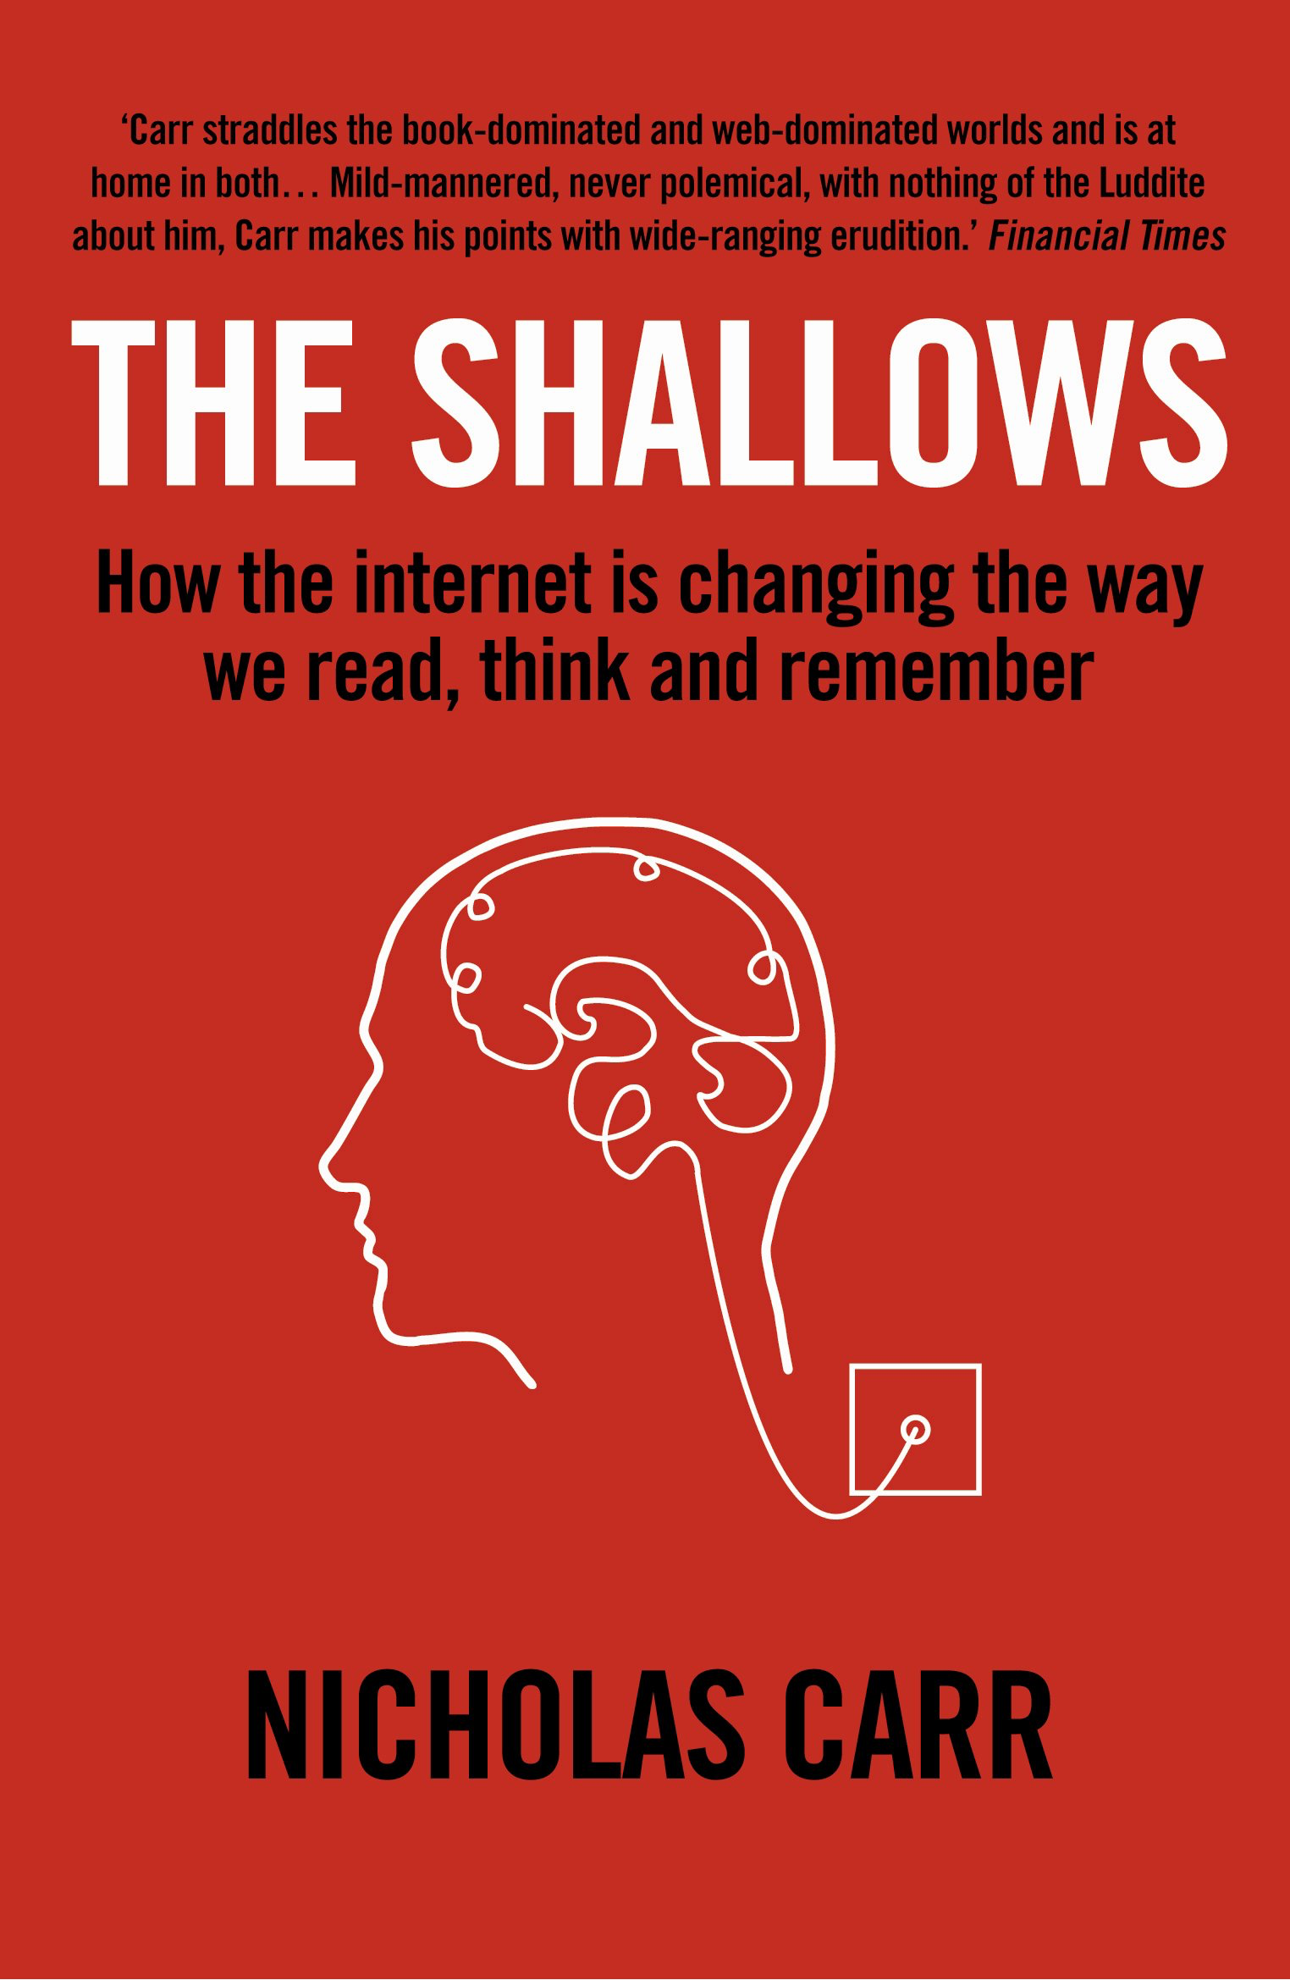
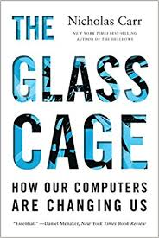
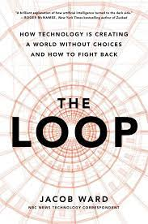
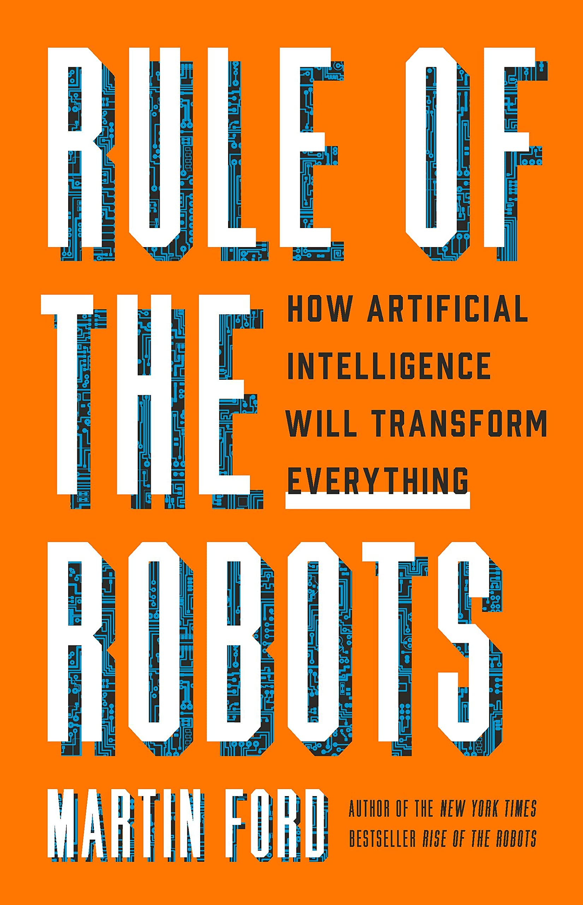
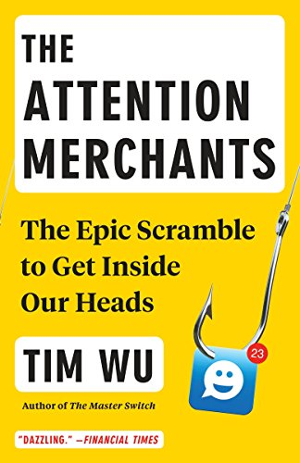
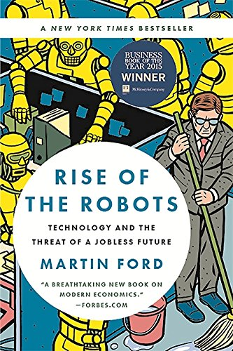

*Layout suggested by AI

Slide 42
