Slide 1
The Ascent of AI:
Toys to Tools to Terror
Keith L. Downing
Department of Computer Science
The Norwegian University of Science and Technology (NTNU)
Notes:
The Mike Hammer story: “AI: Toys or Tools”. We seem to have jumped from Toy right to Terror. This hype is one of my irritations. The other is the use of words like “Algorithms” is if they are all bad, or as if there is ONE algorithm, the AI algorithm, that is bad.

Slide 2
I
AI:
Toys or Tools ???
- M. Hammer

Slide 3
The Ever-Changing Scope of AI
AI is what humans are currently better at …. Jim Hendler (AI expert)
Once a cognitive process is demystified by an algorithm, it is no longer AI.
The list of human-dominated activities is shrinking dramatically.
This definition of AI might become prominent (again) in the next “AI winter”.

Slide 5
Roller Coaster History of AI
Notes:
Thus began the roller-coaster ride of AI.

Slide 6
Brief History of AI Success

Slide 7
The goal of science is not universal truth…but the gradual removal of prejudice (Niels Bohr).
The Prejudice | The Science
Earth is center of the universe | Copernican Revolution
Humans are a special species | Darwinian Evolution
Superiority of human intelligence | AI

Slide 8
Two Very Different AI Approaches

Slide 9
Backpropagation:
The Core
of
Deep Learning
This is a powerful form of
supervised learning that is
also used in unsupervised learning
and semi-supervised learning.
(Terminology can be misleading)
Global gradients are simply
products of local gradients.
Invented by 3 groups independently
in 1985, 1986 and 1988.

Slide 10
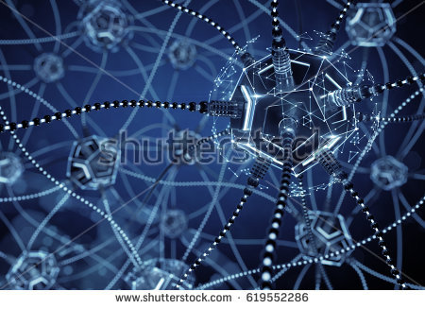
Deep Learning
Beat Humans at
Complex Tasks of
Pattern-Recognition
Large Neural Networks
LOTS of Data
LOTS of Computing Power
Impress (and Fool) Humans with AI-generated
Art, Music, Text, Images, Audio and Video

Slide 11
Practical Problem Solving with ChatGPT
Me
I have two rubber bands, a bag of malted milk balls, two pencils
and a hungry crow. In 50 words or less, explain how to make a
game out of these things.
ChatGPT 3.5
Crow Treat Toss: Stretch rubber bands between pencils to
create slingshots. Launch malted milk balls into the air for the
hungry crow to catch mid-flight. Award points for successful
catches. Enjoy a playful feeding game with the clever crow,
fostering interaction and entertainment.

Slide 12
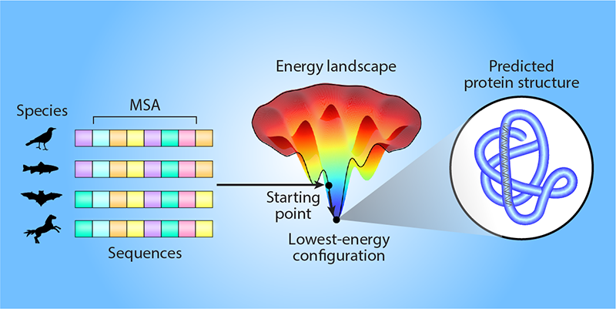
AlphaFold (DeepMind, 2020)
Given: a nucleotide sequence (which directly codes for amino acids)
AlphaFold Computes: 3d structure of the resulting protein = How the amino-acid sequence “folds”.
Implications: A protein’s 3d structure determines its physicochemical behavior.
A process that once took years (e.g. one PhD per protein) now takes minutes.
200 million proteins on earth, with many discovered each year, but few have known 3d structures.
AlphaFold => Huge knowledge gain + massive labor savings !!

Slide 13
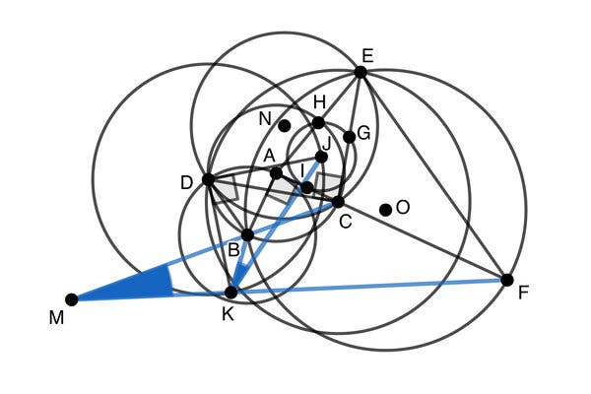
AlphaGeometry (DeepMind, 2024)
Creativity =
Introduction of
extra objects:
points, lines,
triangles, circles..
Traditional Symbolic AI Theorem Prover + Large Language Model
Silver Medal Level on Math Olypiad

Slide 14
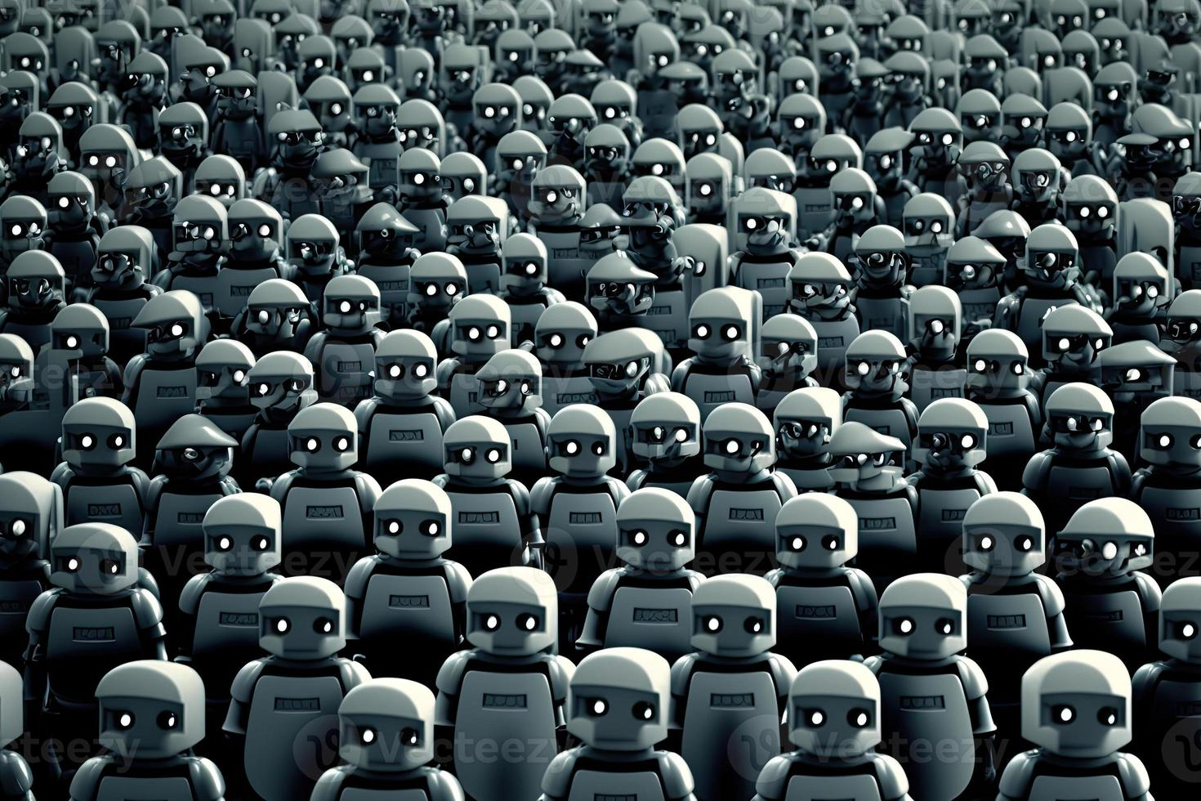
AI’s Threats to Humanity
Long Term
Runaway Intelligence
Robotic Takeover
Short Term
Civil Discord
Financial Market Chaos
Reckless Release of AI
Soft (Subtle) Influence of AI
Job Market Disruption
Widescale Cognitive Decline

Slide 15
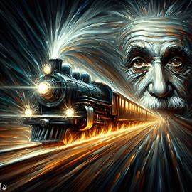
Runaway
Intelligence
Dall-e
Generated

Slide 16
The Singularity (Vernor Vinge, Ray Kurzweil)
The Singularity:
A point where normal
expectations break down,
where things become
confusing, meaningless,
and unpredictable
(Joel Garreau, 2006).
Notes:
When AI’s can produce (improved) AI’s, without human help, the SINGULARITY occurs.

Slide 17
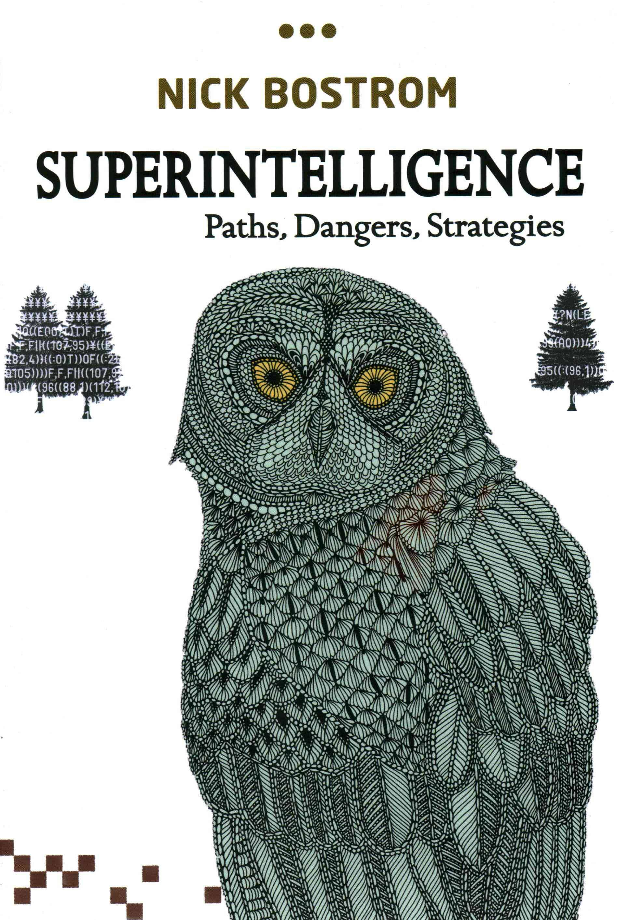
Notes:
All of these exponentials (accelerations) => the singularity could sneak up on us very quickly. Once we get to chimp intelligence, human intelligence (and beyond) may only be a few days away!!
We need a plan, now, as to how to control these superintelligences. We may not have time to do it after they are created.

Slide 18
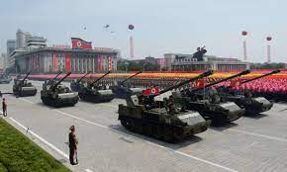
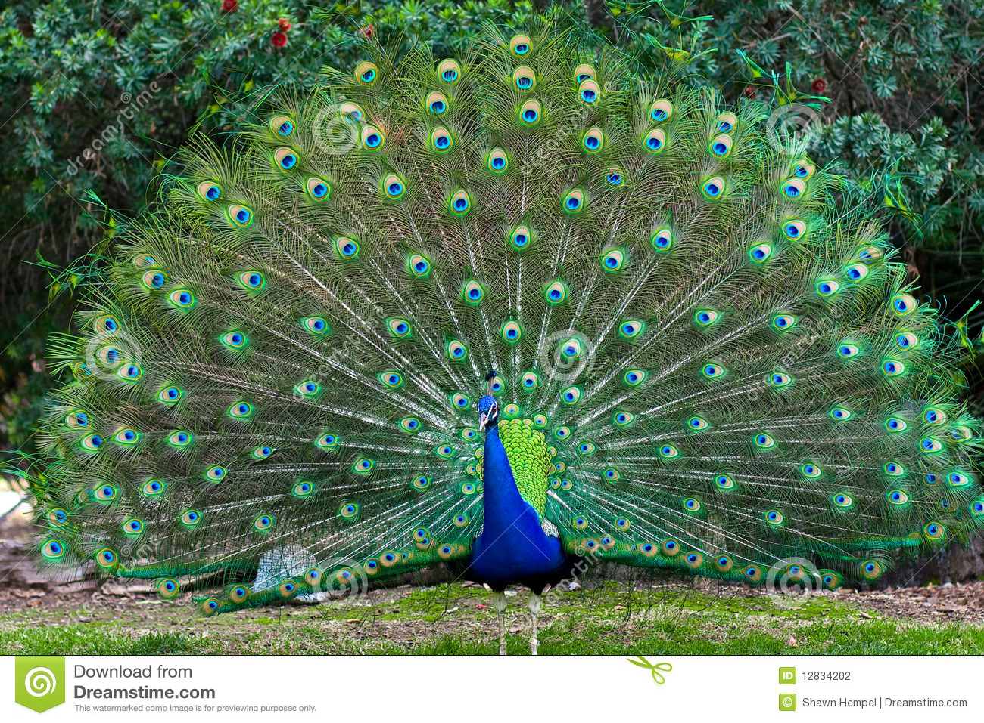



Diminishing Transparency of AI
Showing Off
Military
Nature
Big Tech
Wall Street
Academia
Notes:
Another disturbing trend is reduced transparency of AI, in several different respects.

Slide 19
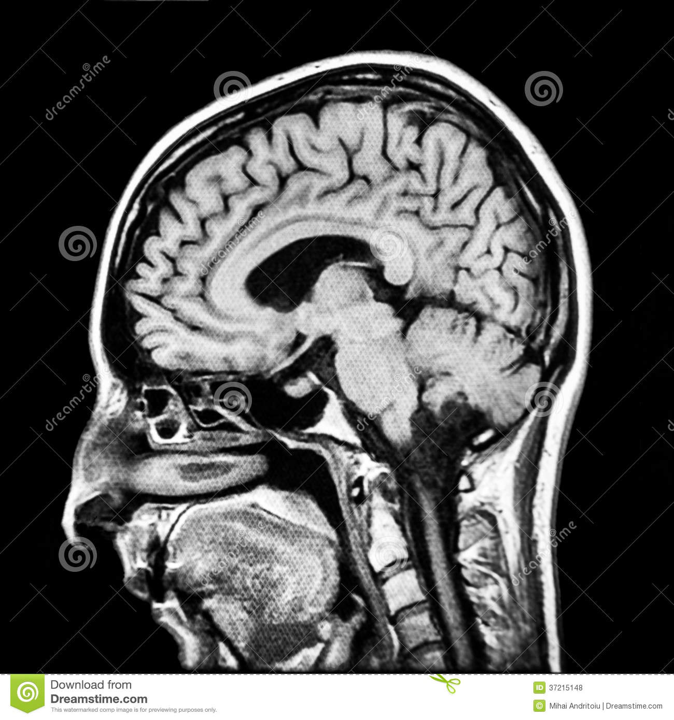
Translucent but not Transparent
Dissecting the Black Box
Competence without
Comprehension (Dennett)
???
Older logic-based
approaches (e.g. expert systems)
are less successful, but
their reasoning is easy to follow.
This is a key motivation
for research in
Explainable AI (XAI).
Remove
Tumor !!

Slide 20
My Evolving Trauma
Notes:
1- Disappointed by fact that I’d never have time to learn all the interesting things in the library. 2- In grad school, when I finally did learn something interesting, I wanted to get an AI to understand it. 3 - Now AI reads ALL books in the library, and I’m trying to understand what the AI knows.

Slide 21
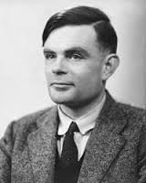
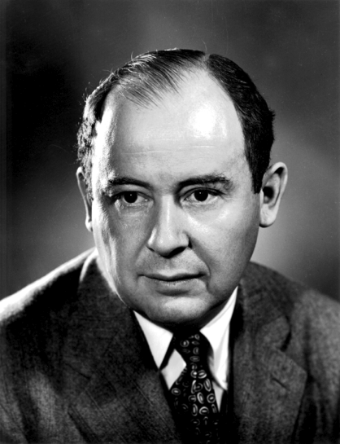
“Machines take me by surprise with great frequency”
- Alan Turing
“Young man, in mathematics, you don’t understand things. You just get used to them.”
- John von Neumann
AI’s true (and most feared) power = computational creativity
(and unpredictability), not automated reasoning and decision making.
Notes:
The real beauty of AI is not a reasoning computer, but a CREATIVE (and hence unpredictable) computer. There are advantages and disadvantages of this.

Slide 22
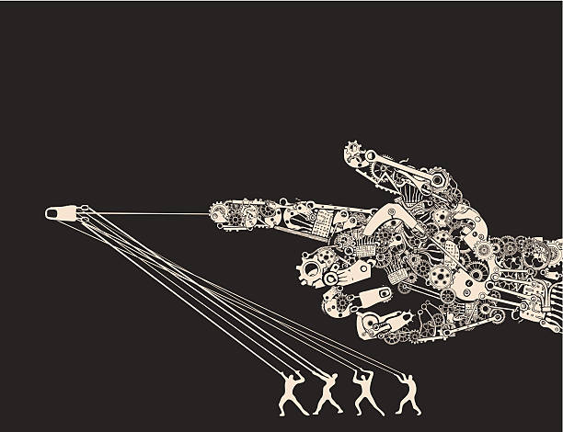
Robotic Takeover

Slide 23
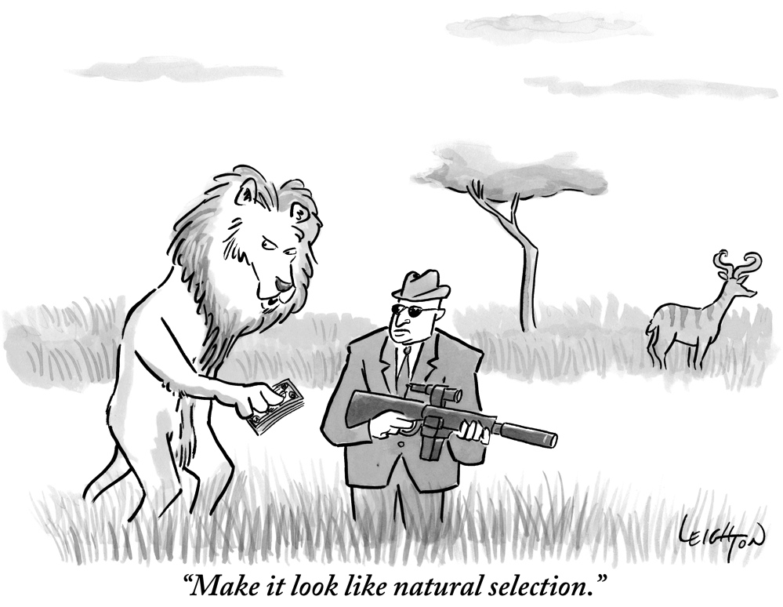
Notes:
In addition to learning, AI systems can also EVOLVE, using simulations that “look like natural selection”.

Slide 24
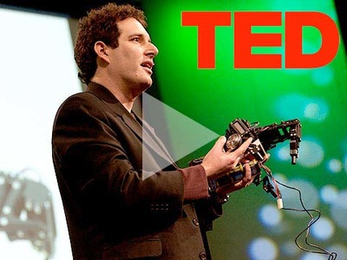
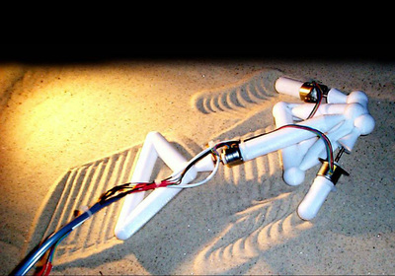
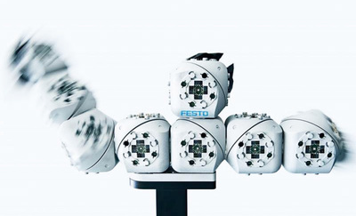
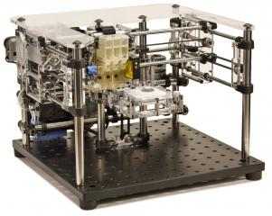
Hod Lipson’s
Creative Machines Lab
(Columbia University)
Evolutionary Robotics
Notes:
So now we have AI systems that evolve other AI systems that can be produced, physically: robots making robots!! This scares some people.

Slide 26
Maintaining Human Control of AI Evolution
Goals
Properly defining them (ethics)
Risk-free embodiment in AIs
Prevent AI from developing
goals that conflict with ours.
Environments
Birth Control
Who controls the resources
needed for AI reproduction?
Today humans have:
- Good control of Hardware
- Weaker control of Software
AI Technology very prevalent
New AI often selected based
on compatibility with existing tech
=>
AI becomes a more
dominating environmental influence,
and thus a stronger selective force.
We eagerly give more AI more
and more decision-making power.
In nature, bodies and
brains reproduce
and evolve together.
In artificial systems,
hardware and software
can reproduce and evolve
separately !!
Notes:
But it is not so easy to preserve artificial selection.

Slide 27
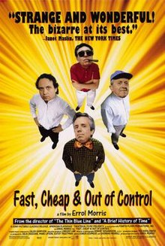
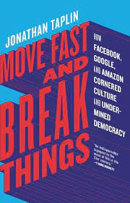
Reckless Release:
Premature
Deployment
&
Agency

Slide 28
Trigger Happy AI Developers & Users
Competition and other pressures => premature deployment:
Too much AI, with too much agency, too soon.
Military – quicker responses means letting AI’s make more decisions.
  Who (What) pulls the trigger?
  Escalating damage as each side increases speed of decision-making and attack.
Tech – pressure to release products (e.g. chatbots) early.
  Bias, Bigotry, Dangerous Advice (e.g. to kids), Fake News…
  The race to deploy becomes the race to recklessness. (Tristan Harris; Center for Humane Technology and formerly with Google)
AI Traderbots – many buy / sell decisions per second.
  Flash Crashes, e.g. 2010, 2015
  May 2023: AI-generated image (of burning Pentagon)
  => Major stock sell-off !

Slide 29
Even AI Understands This
Me
Explain how a despotic rule who has no respect for human life might solve the following problem:
Drones often send camera images back to a human, who decides whether or not to shoot at something that it detects. But having a human in the loop takes time, the target may move out of range.
ChatGPT
3.5
Here's how such a ruler might approach the solution:
Remove Human Intervention: The ruler would eliminate the human in the loop entirely, opting for drones equipped with artificial intelligence (AI) algorithms programmed to make instant decisions on whether to engage targets without any external input.
Optimize Response Time: With humans removed from the decision-making process, drones can react to potential targets in real-time, significantly reducing the time between detection and action. This optimization minimizes the chances of targets escaping before they can be engaged.
Increase Surveillance: To compensate for the lack of human judgment, the ruler might deploy a larger number of drones equipped with advanced surveillance capabilities. This extensive coverage ensures that targets are continuously monitored and tracked, reducing the likelihood of missed opportunities.
Enhance Targeting Accuracy: The ruler would invest in refining drone technology to improve targeting accuracy, minimizing collateral damage and maximizing the effectiveness of each strike. This might involve advancements in sensor technology, AI algorithms, and precision-guided munitions.
Suppress Opposition: To maintain control and suppress any dissent or resistance, the ruler may employ a combination of propaganda, surveillance, and punitive measures to deter potential adversaries. The use of autonomous drones can instill fear and discourage opposition through swift and relentless enforcement of the ruler's authority.

Slide 30
There are genies popping out of bottles all over the place…and we’re arguing over the warning labels to put on empty bottles.

Slide 31
Soft (Subtle)
AI
Influence

Slide 32
People worry that computers will get too smart and take over the world, but the real problem is that they’re too stupid and they’ve already taken over the world…Peter Domingos (The Master Algorithm, 2015, pp. 285-6)
What is the
common concept?

Slide 33
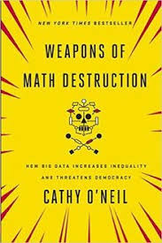
AI is Watching, Listening, Learning & Suggesting
Who is here?
When and where will we meet again?
What do you like? How do we get you to buy it?
What do you believe?
Should you get a bank loan?
Should we hire you?
Can we influence your vote?
Should we send you to jail?
How should humans handle the information produced by big-data mining, and
the suggestions given by AI systems?
Algorithms = Opinions
Embedded in Code

Slide 34
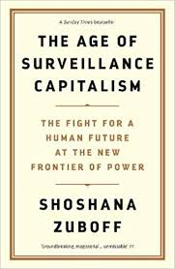
Surveillance Capitalism
Money for nothing
and your clicks for free.
Is the tradeoff of service for control (of your data, of you) fair?
These predictions are traded in a new futures market, where surveillance capitalists sell
certainty to businesses determined to know what we will do next.
In the competition for certainty, surveillance capitalists learned the most
predictive data comes not just from monitoring but also from directing behavior.

Slide 35
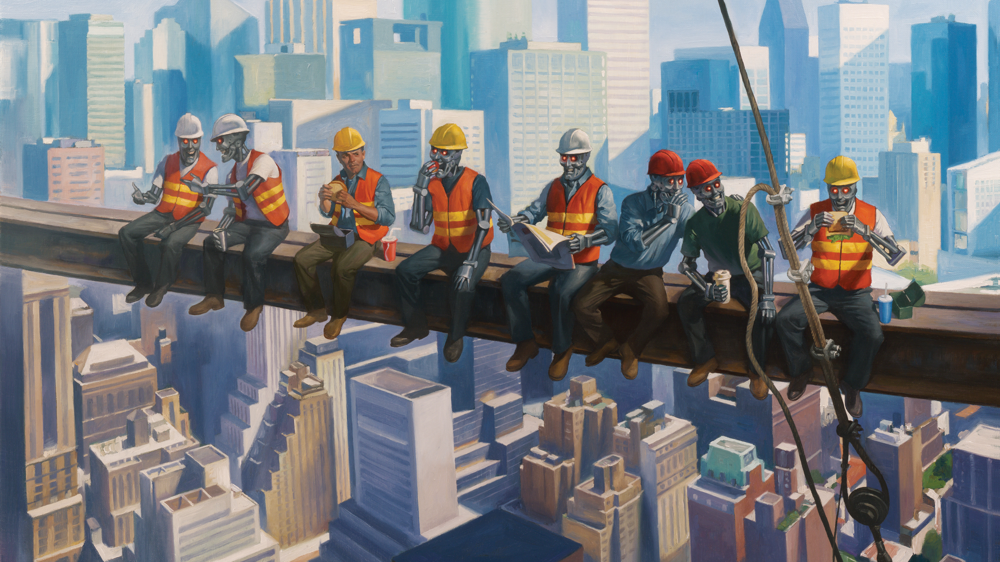
Humans Need Not Apply
Job Loss:
One machine can do the
work of 50 ordinary men.
No machine can do the work
of one extraordinary man.
... Elbert Hubbard

Slide 36
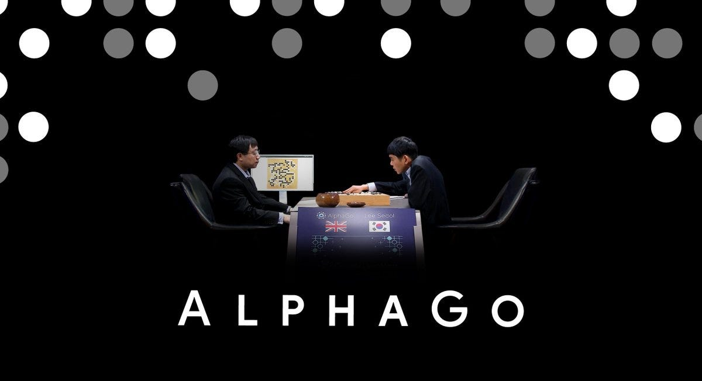
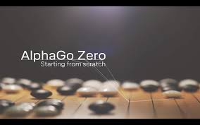
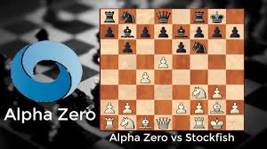
The Alpha
Progression
Pre-trained on catalog of expert games
Self-play from intermediate level upwards.
Beat human world champion.
No expert knowledge needed.
Self-play from scratch.
Became world champ; beat AlphaGo 100-0
Generalized AlphaGo Zero to other games.
Became world champ at them.
Another step toward Artificial General Intelligence (AGI)

Slide 38
HELP WANTED (Machines Only)
AI learns by itself. No need for expert human logic / rules)
Reinforcement Learning (RL) systems generate their own labeled datasets as they explore the world => Don’t even need humans to label data !!
Humans no longer undisputed masters of pattern recognition.
Humans may not even be the best experts on commonsense: It emerges in Large language models (LLMs) !!
AI systems with less human bias can be more creative: E.g. Alpha Go’s Move 37.
When humans become obsolete for one job, they retrain. Now, the machines can retrain too…and faster!

Slide 39
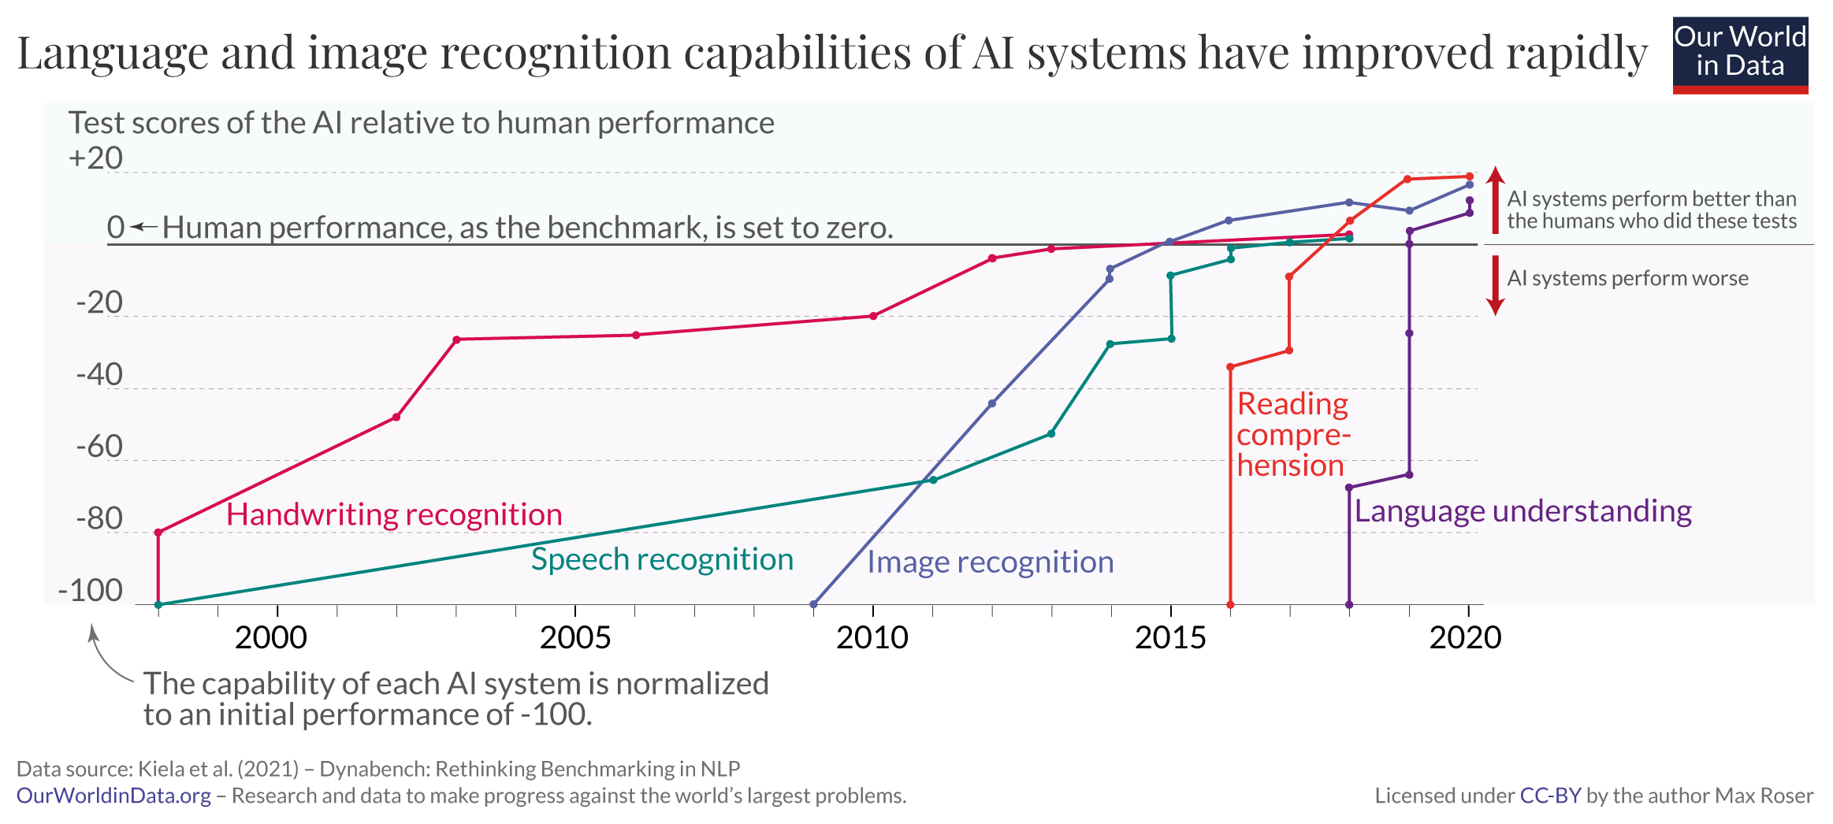
Rapid Acceleration of AI Progress
* AI quickly achieves super-human performance on many new tests.

Slide 40
Scott Galloway
(Popular Tech & Business Podcaster)
You won’t lose your job to an AI, but you might lose it to someone who knows AI.
Code using Co-pilot or become obsolete
Become a ChatGPT whisperer
(a.k.a. prompt engineer)

Slide 41
Humans
Need
Not
Apply Themselves
Cognitive Decline:
The real problem is not
whether machines think but
whether men do too.
… B.F. Skinner

Slide 42

Plight of the Infovore
Constant distractions of cyberspace
... as we come to
rely on computers to
mediate our
understanding of the
world, it is our own
intelligence that flattens
into artificial intelligence
(Nicholas Carr,
The Shallows)
“Shallows”: Reduced depth
of thought and emotion
Less Creative
Rely on computers to
understand the world
Rely on AI
for wisdom
Reduced value in an information society
Automation Bias: Trust machines over ourselves.
Human intelligence becomes artificial
… and thus more easily predicted
and controlled by AI
Notes:
As we become more dependent on machines for decision-making, our own intelligence becomes very artificial, and we may subtly begin to ADOPT the MACHINES GOALS!!

Slide 43
Who Works for Who/What?
Comments from Laura Preston, a human fallback for Brenda, a real-estate chatbot:
Months of impersonating Brenda had depleted my emotional resources. It occurred to me that I wasn't really training Brenda to think like a human; Brenda was training me to think like a bot, and perhaps that had been the point all along.
Men have become the tools
of their tools … Henry David Thoreau

Slide 44
Don’t Become a Spoon !!
When visiting an Asian worksite in the 1960’s, the great economist Milton Friedman was surprised to see workers using shovels, not modern machines. When told the reason: “It was a jobs project,” he responded:
If it’s a jobs project, why not give them spoons instead of shovels?

Slide 45
Human-AI Interaction Spectrum
Should AI help us learn, not just do the job itself?
For the good of humanity, shouldn’t we move back left ?

Slide 46
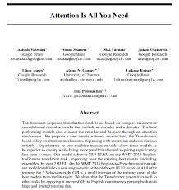
The Oppenheimer Movie
Robert Oppenheimer: I believe there is blood on my hands.
President Harry Truman: Do you think anyone in Hiroshima or Nagasaki gives a $#%& who built the bomb? You didn’t drop the bomb. I did. Hiroshima isn’t about you.
If this seems like exaggerated concern, see Tristan Harris:
The AI Dilemma (YouTube, March 2023)
Beyond The AI Dilemma (YouTube, Sept. 2023)

Slide 47
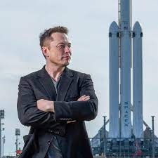
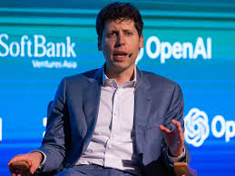
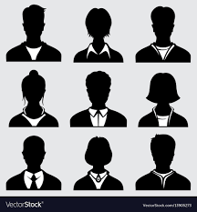
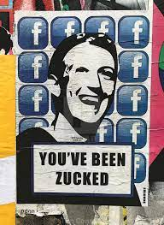
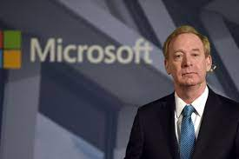
Who will AI be about?
???
AI Transformation Playbook,
Andrew Ng, landing.ai
Great insights, from a famous AI researcher,
for any organization thinking about using AI.

Slide 48
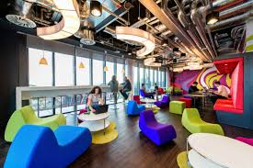

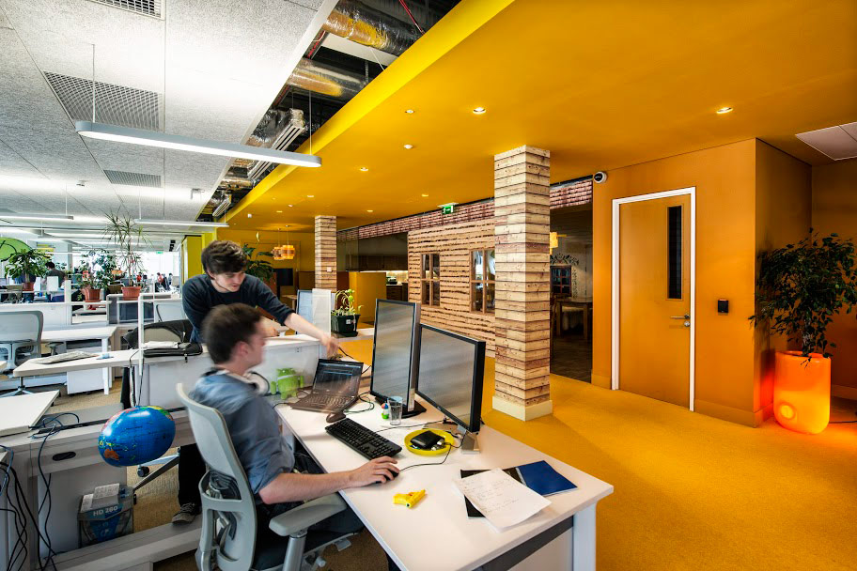
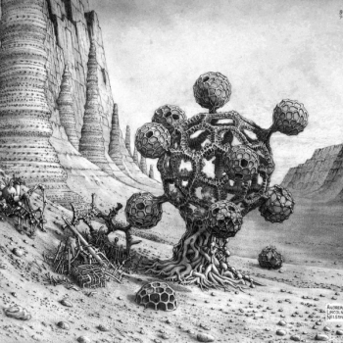
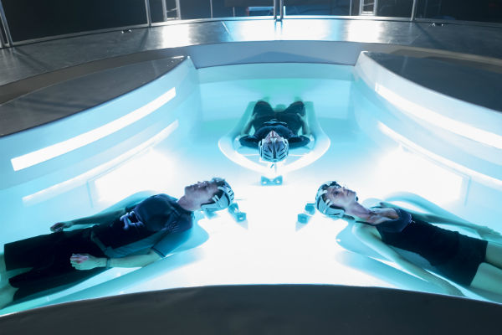
The End?
Robot 19: (Andrew Lincoln Nelson, 2015)
Notes:
And what WE will become….
More exciting jobs in more cool places like Google…or more leisure time….or is this THE END of humanity as we know it…where maybe our brains will still hold enough special power to keep us (or at least our brains) around?

