Slide 1

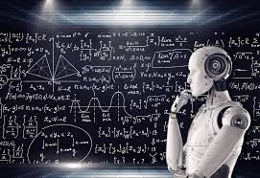
The Data and Artificial Intelligence Group (DART)
Autumn 2023
Big Data
AI
Notes:
Merger of DB and AI....perfect combination.

Slide 2
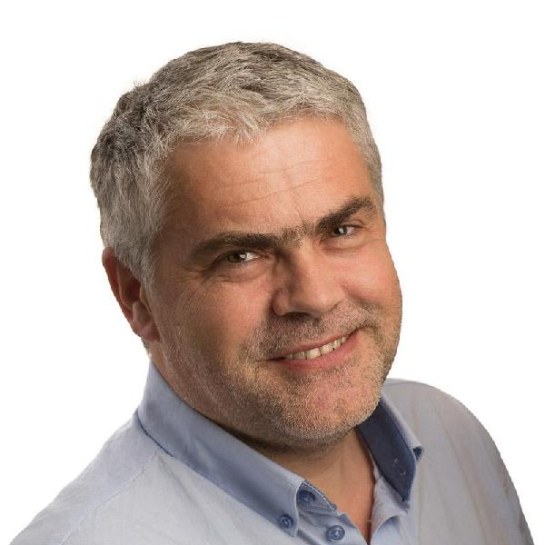
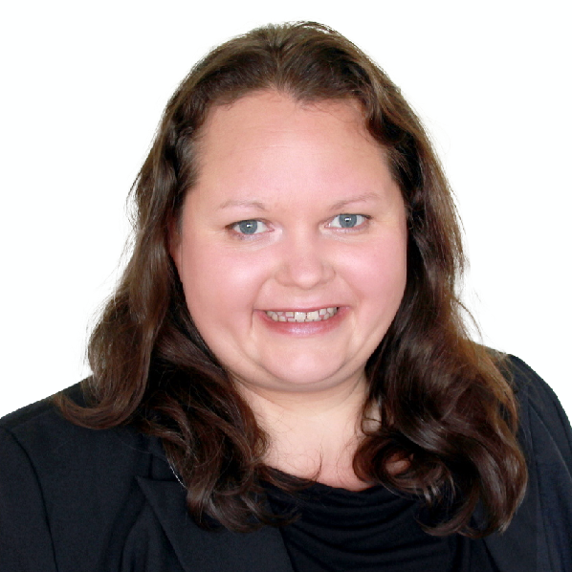
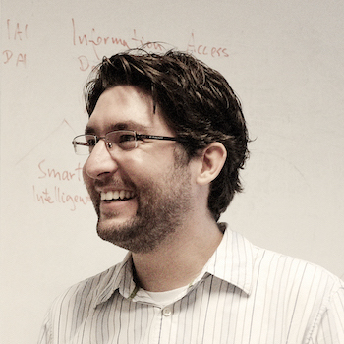
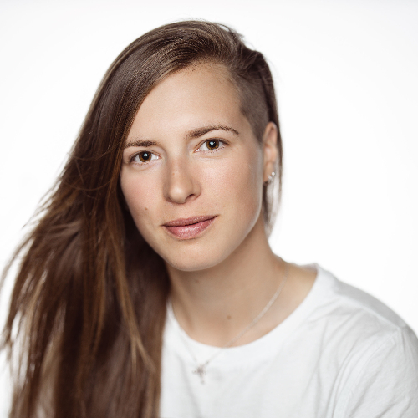
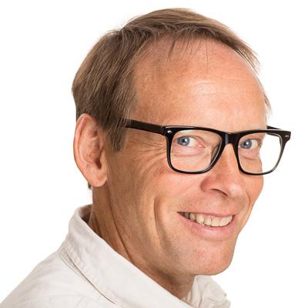


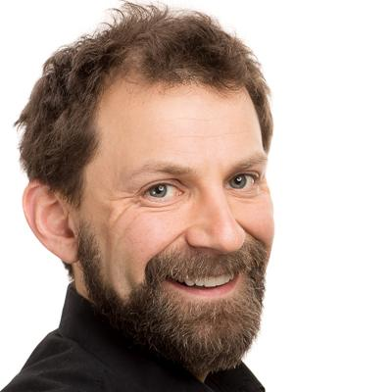
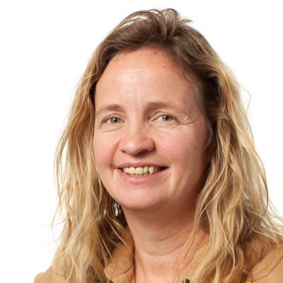
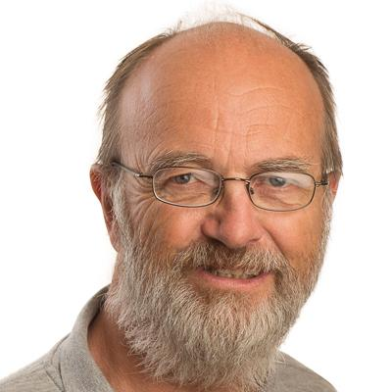
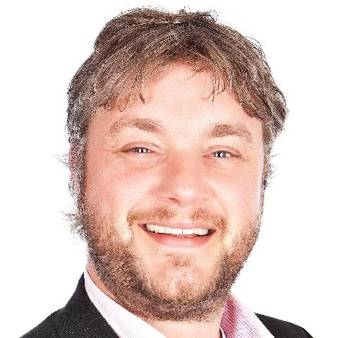
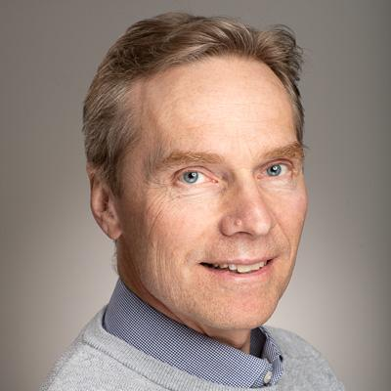

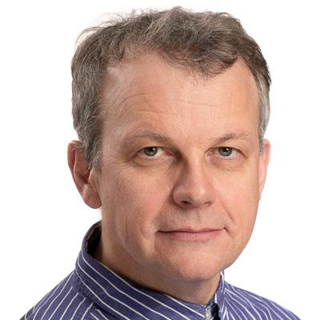
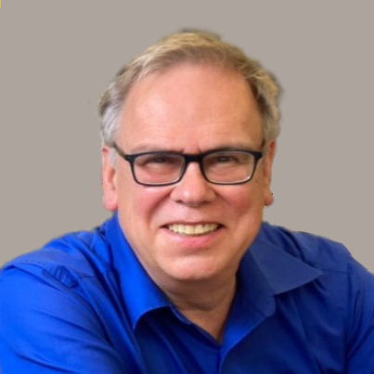
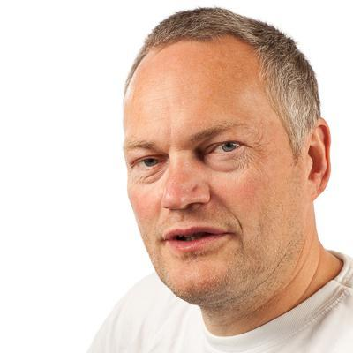
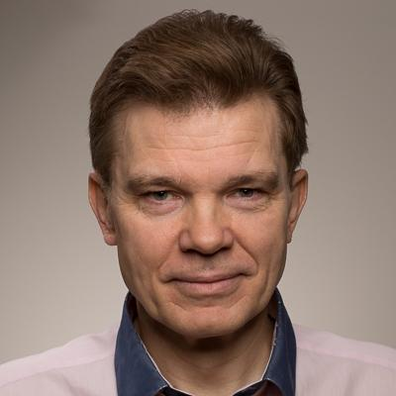


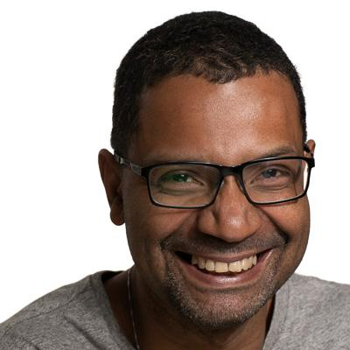
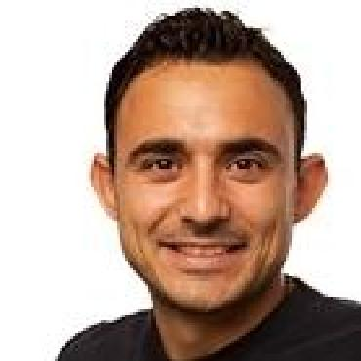
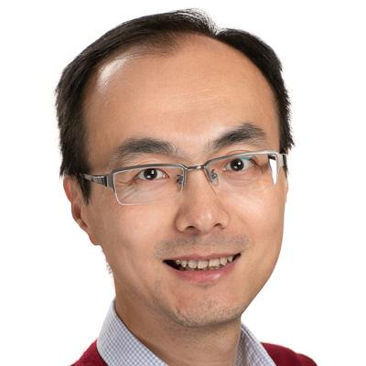
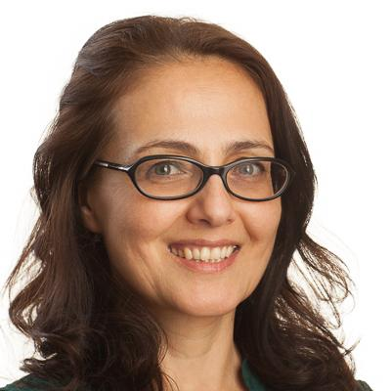
DART Teachers

Slide 3



Three-pronged Focus of DART
Research
Education
Innovation

Slide 4
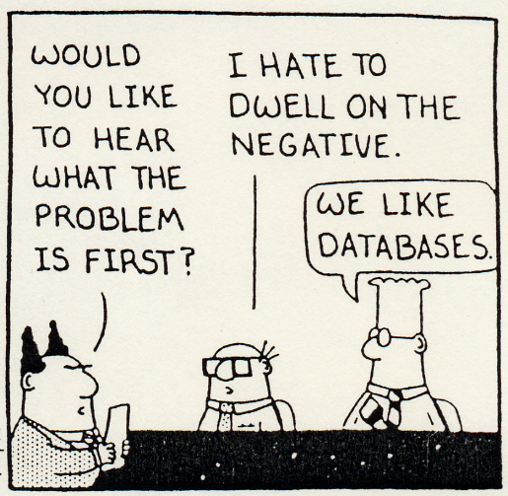
Databases and Search
Databases
Algorithms for multicore and GPUs
In-memory databases
Handling complex datatypes: trajectories, graphs, etc.
Parallel and distributed DB systems.
NoSQL/NewSQL DBs
Big Data Frameworks (Hadoop, Spark…)
Text / Web Mining
Finding useful info in a large data corpus.
Social media mining – increasing the value of user-generated data by:
  Finding relationships between users
  Opinion mining
  Community detection
Linking open data to structured knowledge bases (DBPedia etc.)
Search
Text-,person-,product-search
Combining text and time
Machine Learning for search
Natural-Language Processing (NLP)
Large Language Models (GPTs)
Notes:
Long history of internationally-renowned DB work at IDI. 2005 - Hosted Very Large Database Conference (VLDB).
Best known for work on parallel and distributed DBs.

Slide 5
Previous Projects and Master’s Theses
Determining creation time of documents based on contents
Handling big spatial data
DB tracking on remote processors and GPUs
Automatic scaling and maintenance of a NoSQL database
In-memory databases
Spatio-textual trajectory mining
Analyzing bank transactions
Text mining on Twitter data
Mining dynamic graphs
Personalised, intelligent object search and recommendation
Scalable search in knowledge bases
Machine learning in cache replacement algorithms
Online upgrade in NoSQL databases
Detection of fake news
Notes:
DB – Structuring, Searching and Analyzing Data / Information
AI – Abstracting / Generalizing from Data + (recently) Generating Data

Slide 6
DataBase Research:
Structuring, Searching + Analyzing Data + …
AI Research:
Abstracting + Generating Data + …

Slide 7
Transformer
What is all this??
Attention
Embedding

Slide 8
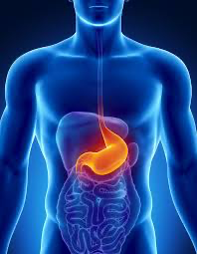
Answer:
The guts of
ChatGPT
(as best
we know)

Slide 9
Me: Compose a 4-line poem that introduces VERY smart people to our Database and AI group.
ChatGPT (3.5):
  In realms of wisdom, where brilliance does reside,
  Very smart minds, our AI group's pride,
  With knowledge vast and intellect ablaze,
  They join our database in myriad ways.
Me: Could you make it a little more dystopian?
ChatGPT (3.5):
In a world of shadows, where brilliance is concealed,
The very smart we gather, their knowledge sealed,
Within our database, their potential held tight,
In this grim reality, their insights out of sight.

Slide 10
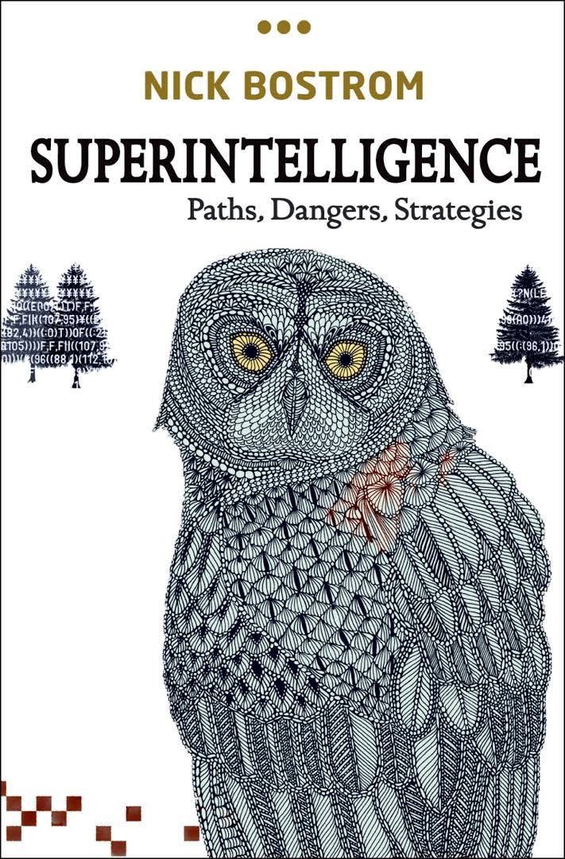
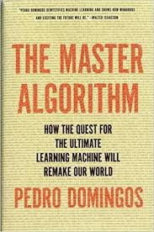
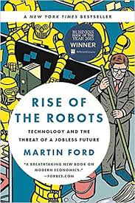
Words from The Masters
“… there is currently a war for the scarce AI talent…”
+ “AI is the new electricity.”
– Andrew Ng, Professor at Stanford
“The rise of powerful AI will be either the best or the worst thing ever to happen to humanity. We do not know which.” – Stephen Hawking, famous physicist.
“If you don’t learn AI, you’re going to be a dinosaur within three years.” – Mark Cuban, famous US businessman.
“You won’t lose your job to an AI, but you might lose it to someone who knows AI.” - Scott Galloway (popular tech podcaster)
The big tech companies now compete to build
THE AI platform (Chatbot?) of the future.

Slide 11
Popular AI Topics at IDI
Deep Learning (Neural Networks)
Natural Language Processing / Text Analytics
Bayesian Decision-Making
Case-Based Reasoning
Evolutionary Algorithms
Multi-Agent Systems / Swarm Intelligence
What’s in your toolkit?
Today, AI is everywhere, and anyone can use it, but you
need special competence to understand + develop it.

Slide 12
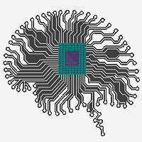
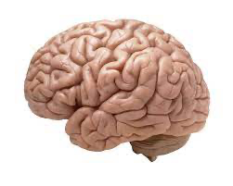
AI Research Goals
NTNU
IE
IDI
DART
AI
Technological
  Develop smart computer systems: those that behave intelligently (often in narrow domains), and which learn from experience.
Scientific
  Increased understanding of intelligence in both natural and artificial systems by designing computational models of sensing, reacting, reasoning and learning.

Slide 13
20+ ongoing externally-funded projects

Slide 14
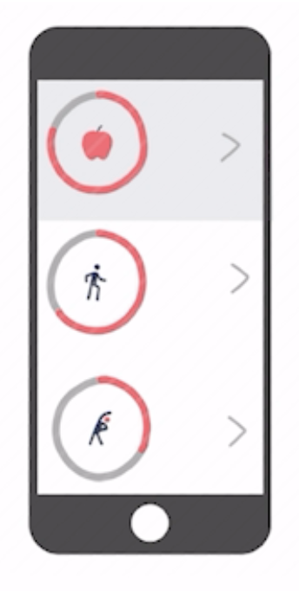
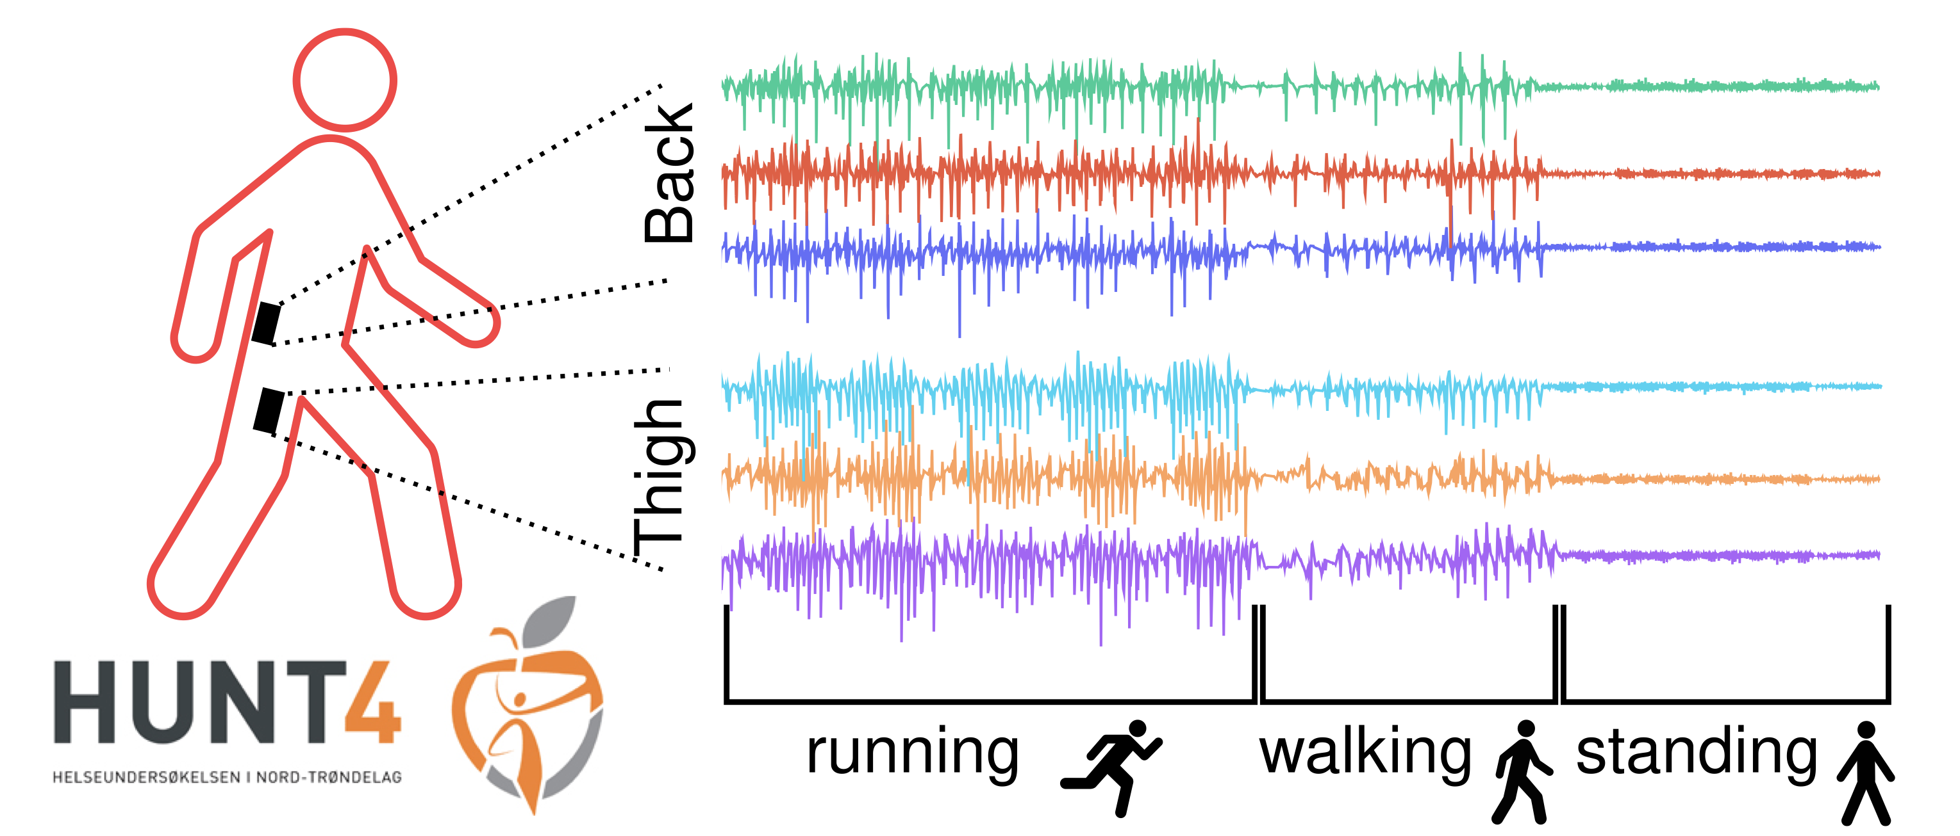
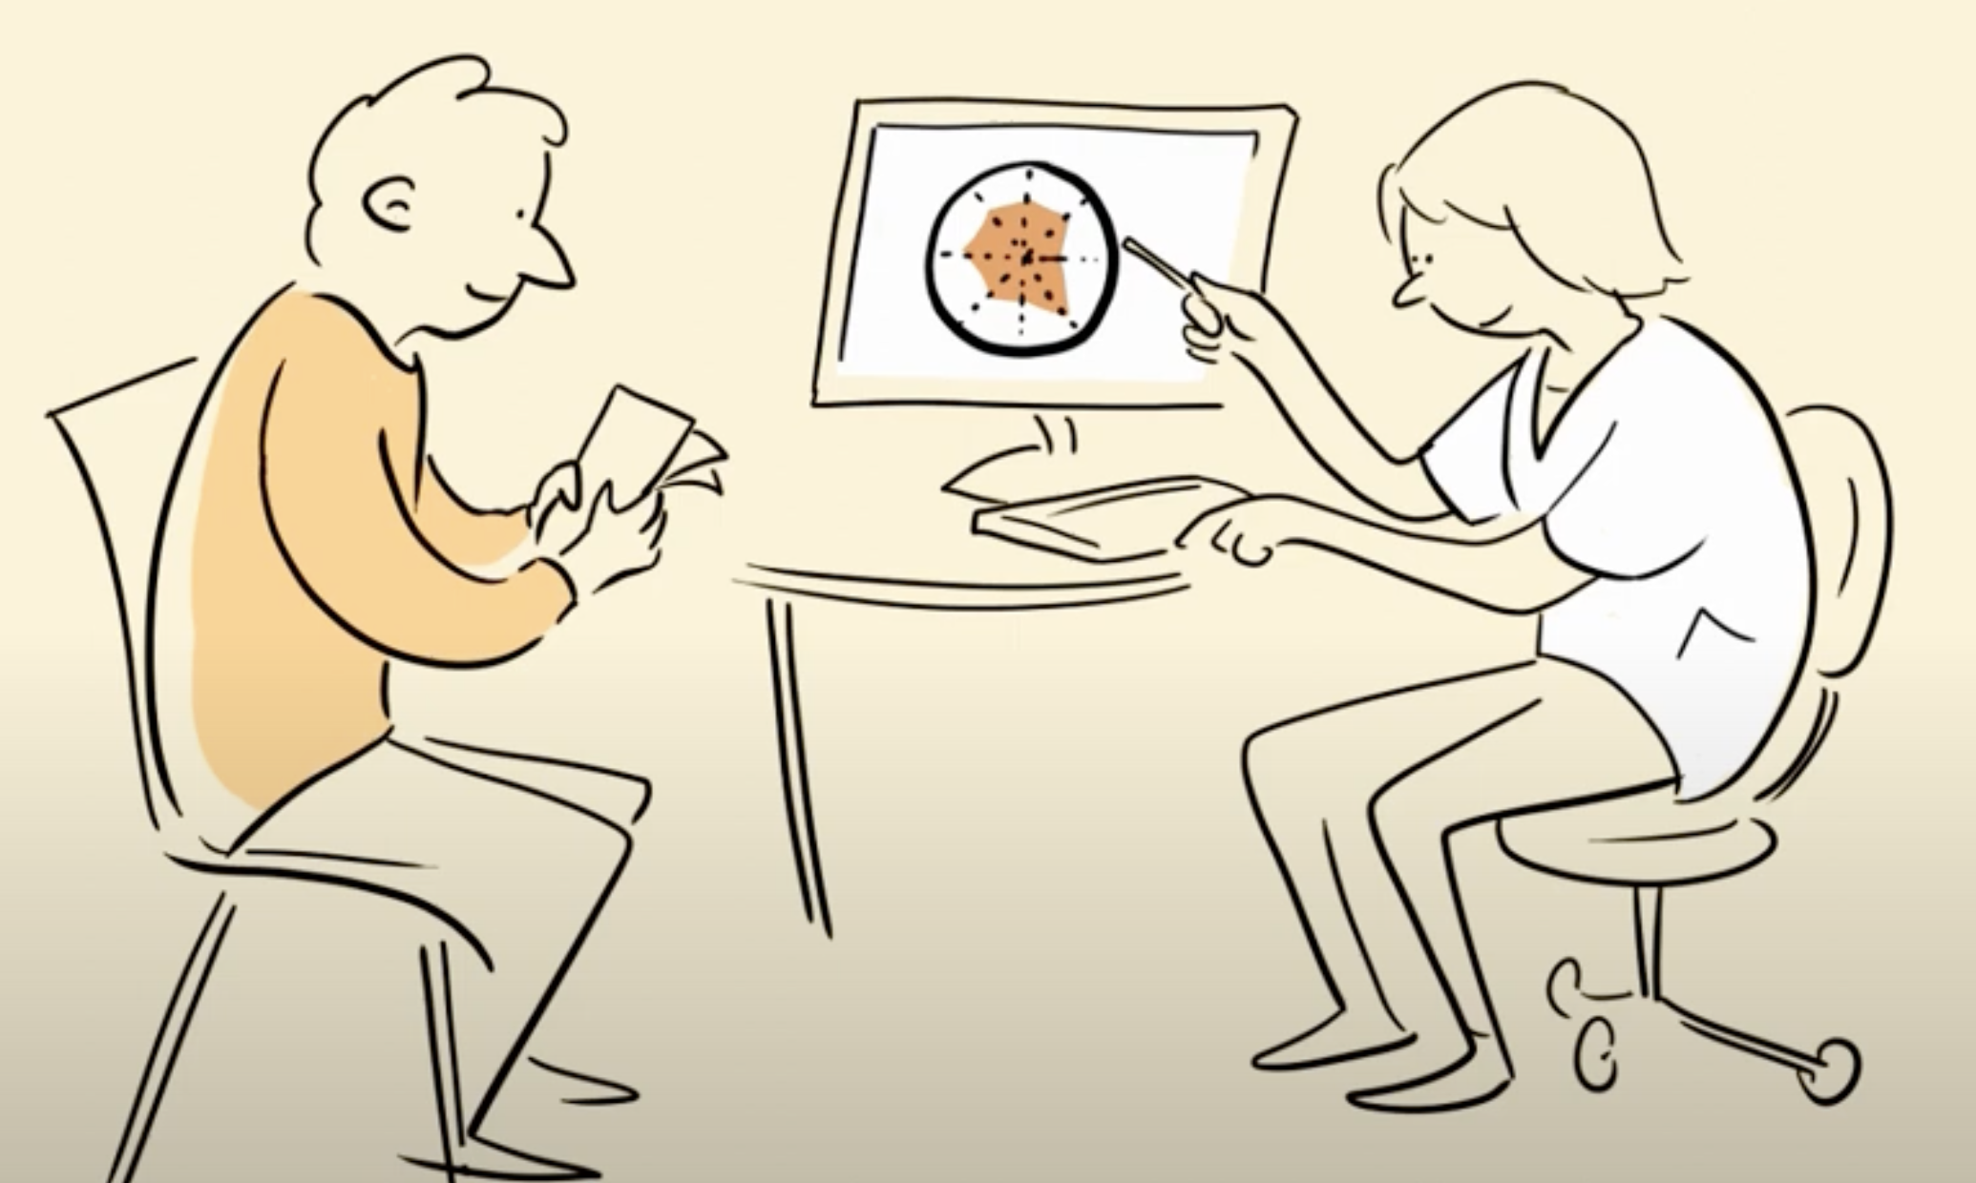
Artificial Intelligence in Healthcare
Decision Support for Patients and Clinicians
Developing AI-driven (CBR) applications for patients
Developing co-decision making systems for GPs and Physiotherapists
Time Series Data
Human Activity Recognition from sensor data
Classification models for real-time healthcare datasets
Understanding Health Trajectories
Role of sleep for Physical activity behaviour and mental health
Analysis and prediction models of clinical interventions
Notes:
We work on several aspects using AI in HC
Decision Support for Patients and Clinicians: We use Case-Based Reasoning, an AI method that reuses previous experiences to solve new problems, and develop applications for patients providing personalized self-management plans to facilitate physical activity and educational content to cope with non-specific low back pain. Further, we are also exploring treatment recommendation in primary care. In those projects we work with GPs and physiotherapists helping them implementing latest clinical guidelines
Time Series Data: We are working with HUNT data. HUNT is one of the largest population-based study that is conducted since 1980s in Trøndelag. We build prediction models for physical activity from sensor data. Further, we create
Understanding Health Trajectories: We work on researching the interplay between physical activity and sleep using machine learning methods. Further, we investigate the results of randomized controlled trials (RCTs) and build prediction models that determine whether a treatment is beneficial. Compared to tranditional statistical models, we use XAI methods to identify and decribe different patient groups.

Slide 15
BIAS: Mitigating Diversity Biases of AI in the Labor Market
(EU-Horizon, Pinar Ozturk, 2022-26)
Company context
Law/legal issues
Social/Philosophical issues
Business goals
Hiring policy
rules
Anti-discrimination law
Employee rights
…
Justice
Social-welfare
…
..
. . . . . . . ?
Knowledge base
Similar applications
with decisions made
New job applications
CBR
Case base of
previous recruitments
How similar - similarity score?
Decision: interview/not ?
Reason?
Decision making by finding
similar applications
application
decision
“similar individuals should be treated similarly”
Notes:
Student recently complained that we still teach CBR. Here’s why !!!

Slide 16
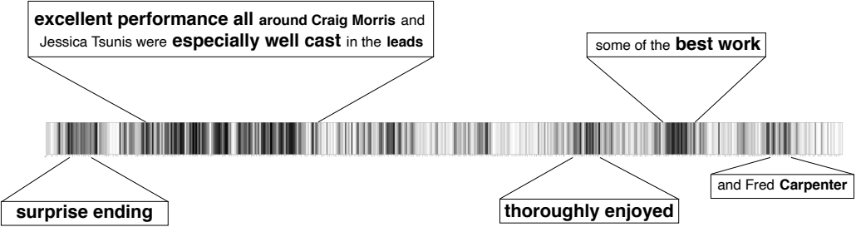
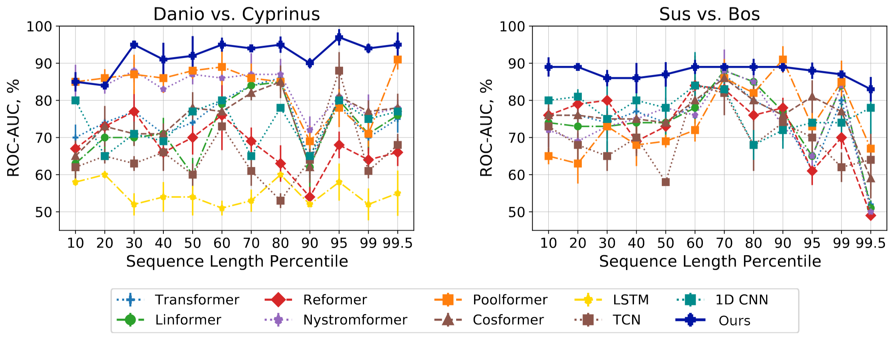
ShuttleNet: Scalable Neural Models for Long Sequential Data
Norwegian Research Council project 287284
Research group: Zhirong Yang, Lei Cheng, Ruslan Khalitov, and Tong Yu
Achievements
Works accurately for sequence length 1,500,000 on a single machine (submitted to ICLR2022)
Defeats all X-Formers in all Long Rang Arena benchmark tasks (published in Neural Networks)
Surpasses DeepMind’s Enformer by 15% in accuracy for genetic variant classification (submitted to Bioinformatics)
Wins in long DNA-based taxonomy classification (submitted to ICLR2022)
Yields good attention maps (published in CVPR2022)
Leads in long time series classification (accepted in Neurocomputing)
Attention vector visualization of a positive review in Text Classification.
Notes:
This an NFR project led by Professor Zhirong Yang and his three PhD students. The project delivers wide neural networks for self-attention backbone. It takes long sequences as input and returns their enhanced representation. These good feature will help various downstream tasks such as classification, regression, generation, retrieval, etc. If you have heard about Transformer in deep neural networks, the work here is to replace Transformers with a better self-attention architecture.
The Transformer’s input is only a few hundreds, but our method can accurately handle up to 1.5 million elements on a single machine. In the public benchmark called Long Range Arena, we have defeated Transformer and all its variants. Long range interactions are common in genomes. Our method has defeated the SOTA, DeepMind’s Enformer by 15%. We give the most accurate taxonomy classification using long DNA sequences only. Our methods also work well for long time series classification. Our network can also give good attention maps for interpretation.

Slide 17
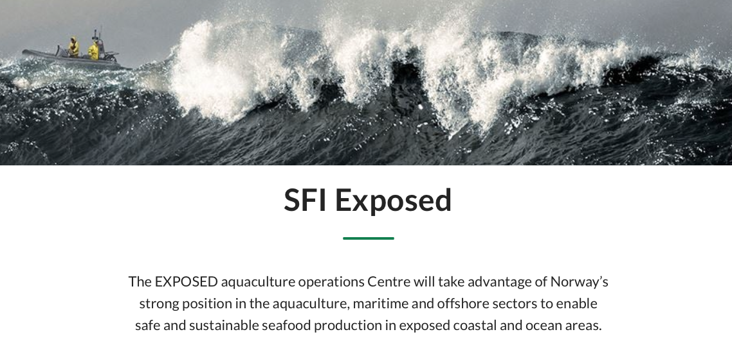
Exposed SFI (NFR)
Coordinated by Sintef Ocean, ending 2023
PI at IDI: Helge Langseth, collaboration across NTNU, Sintef, ++
PhD student (IDI): Håkon Måløy, Sverre Herland
Postdoc (IDI): Bjørn Magnus Mathisen
Objective:
  Develop knowledge and technologies for exposed aquaculture operations
  enabling a sustainable expansion of the fish farming industry
https://www.sintef.no/en/ocean/initiatives/sfi-exposed/

Slide 18
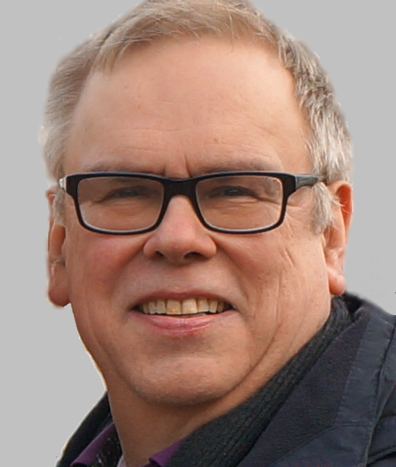
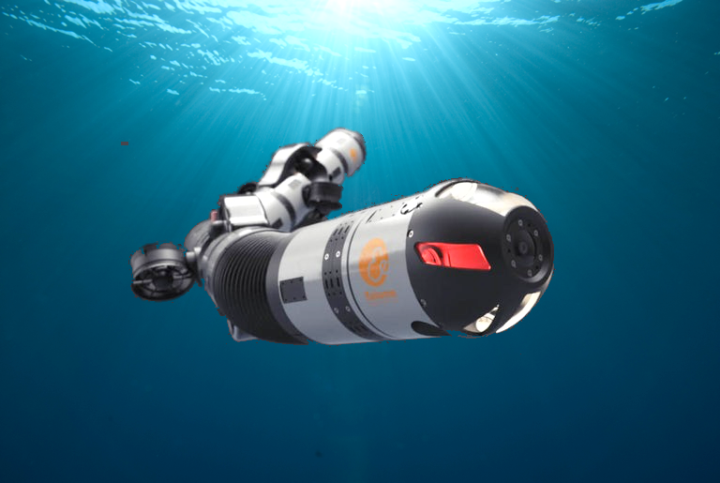
AROS (NFR-funded project, 2020-2023)
Project goal: Perception, control and energy efficient operation
of underwater snake robots
Contributors: K.Y.Pettersen, (lead),
A. Stahl, T. Gravdahl (all ITK), M. Greco (IMT),
R. Mester (IDI)
Work group Mester:
visual perception and egomotion estimation
Machine learning-based processing of (visual) sensor data from difficult viewing conditions

Slide 19
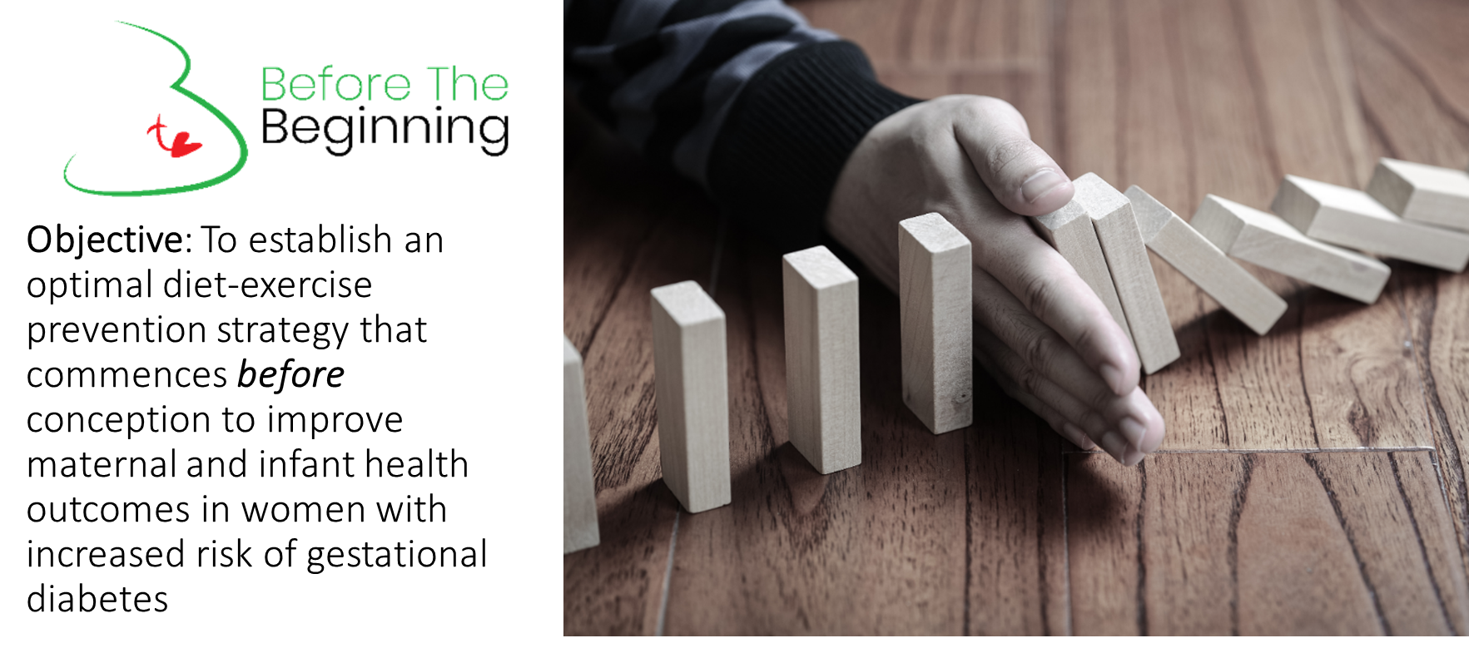
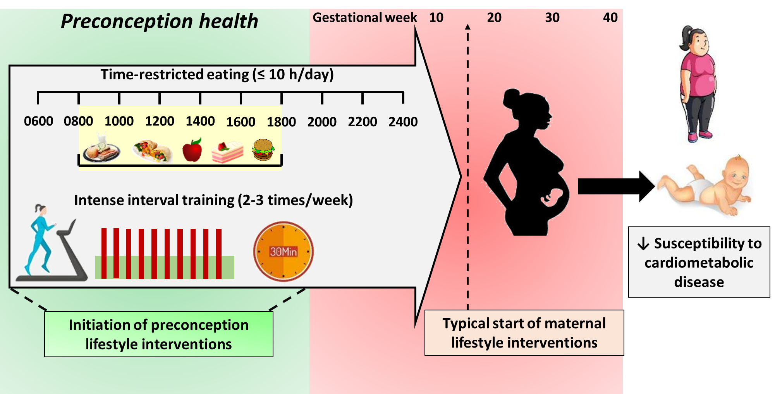
Explainable Machine Learning for Management of Diabetes
Objectives of project are to:
identify, develop, and experiment with explainable AI techniques, focus on machine learning using causal Bayesian networks applied to diabetes data;
complement an on-going randomised controlled trial at the Dept. of Circulation and Medical Imaging, Before The Beginning (BTB);
improve and develop explainable causal ML-models for prediction of diabetes and its progression of comorbidities in order to provide patient-tailored treatment plans; and
discover correlation and causation in bio-data, including clinical outcomes, from women with increased risk of GDM and possible comorbidities based on collected data fom BTB.
Ph.D. candidate: N.N.
Advisors: Ole Jakob Mengshoel and Trine Moholdt (Department of Circulation and Medical Imaging)
Time line: Fall 2023 – Fall 2026 or Fall 2027
Application deadline: 15.1.2023, check jobbnorge.no
Funding: NTNU

Slide 21
Large Language Models (LLMs)
Probability Distributions over Sequences of Tokens
Existing Models:
ChatGPT (OpenAI), Bard (Google), LLAMA (Meta), BLOOM, …
Team
Resources
Outcome
1 Professor
3 PostDocs
12 Research Assistants
4+ External Collaborators
IDUN (28 NVIDIA A100 80 GB GPUs)
500 GB Text
85% Norwegian (+SWE, DAN, GER, ENG)
NCC (NB), Websites, News Articles, Social Media
23B GPT (summarization)
23B GPT (generation)
3B GPT (summarization)
3B GPT (generation)
3B LLAMA
Motivation
Reduce Reliance on Big Tech
Reflect Norwegian Culture
Facilitate Data Ownership
Contact
Jon Atle Gulla
Benjamin Kille

Slide 22












Norwegian Open AI Lab
OUR PARTNERS
A center for research, innovation and education within Artificial Intelligence
Established in 2017, as Telenor-NTNU AI Lab with SINTEF
Ensures collaboration between academia, industry and public sector
Hosted by the Department of Computer Science, NTNU
Strong NTNU research team, with a core team of 12 professors, 21 associated professors & 75+ PhD students

Slide 23















Center for Research-based Innovation
NorwAI
Enhance technology transfer, internationalization and researcher training through long-term research conducted in close collaboration between research-performing companies and prominent research groups.
2020 - 2028
Notes:
NorwAI
260 MNOK over 8 years (2020 – 2028)
Host: NTNU
Finance, Media and Industry 4.0
Consortium:
NTNU, Oslo University, University of Stavanger
SINTEF, NR
Cognite, Digital Norway, DNB, DNV, Kongsberg Digital, NRK, Retriever, Schibsted, Sparebank1 SMN, Telenor, TrønderEnergi

Slide 24
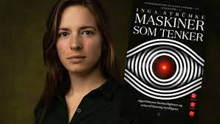
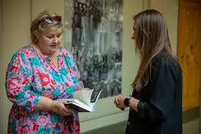

Slide 25
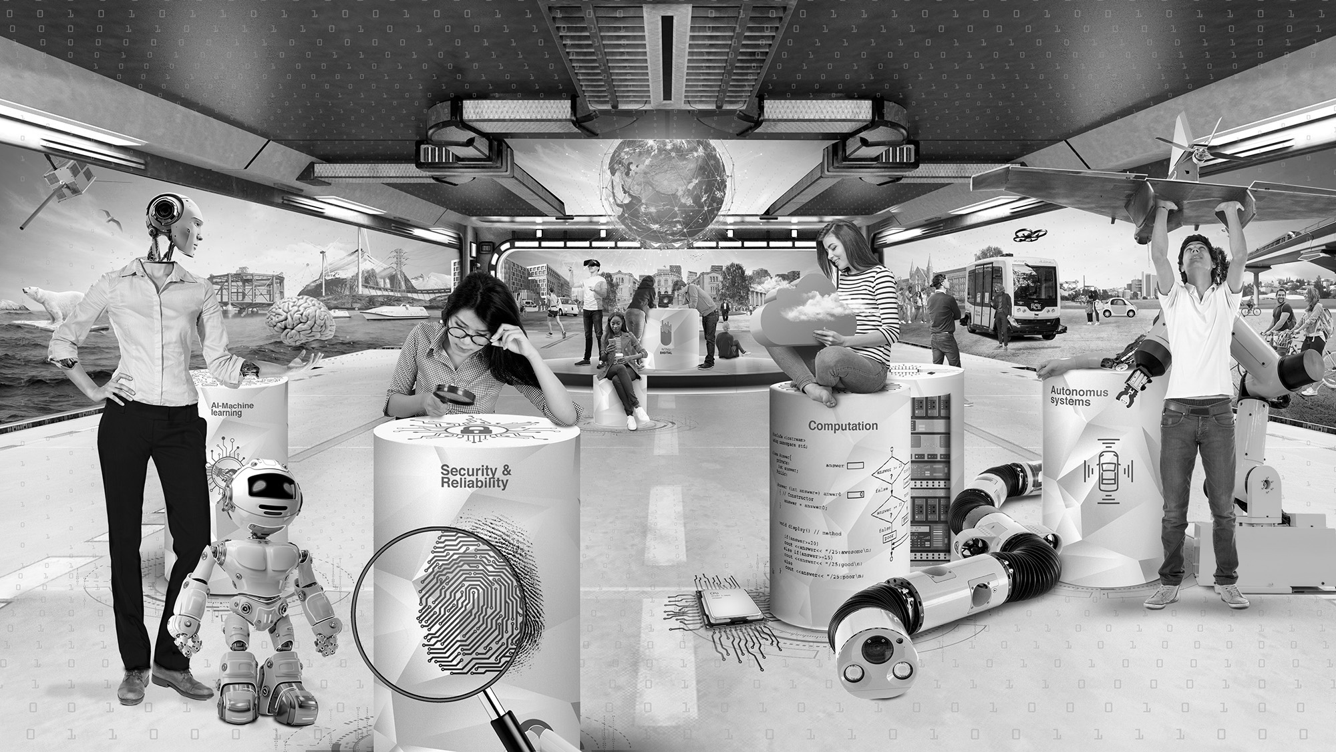
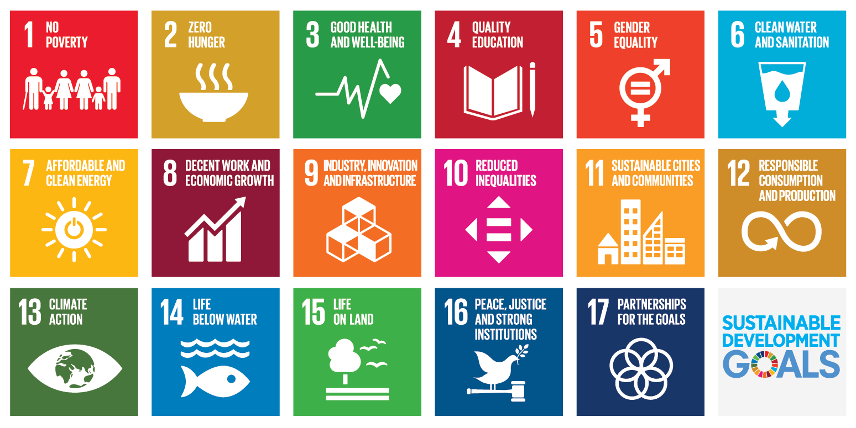
AI and UN’s Sustainability Goals
Notes:
Helse: H

Slide 26
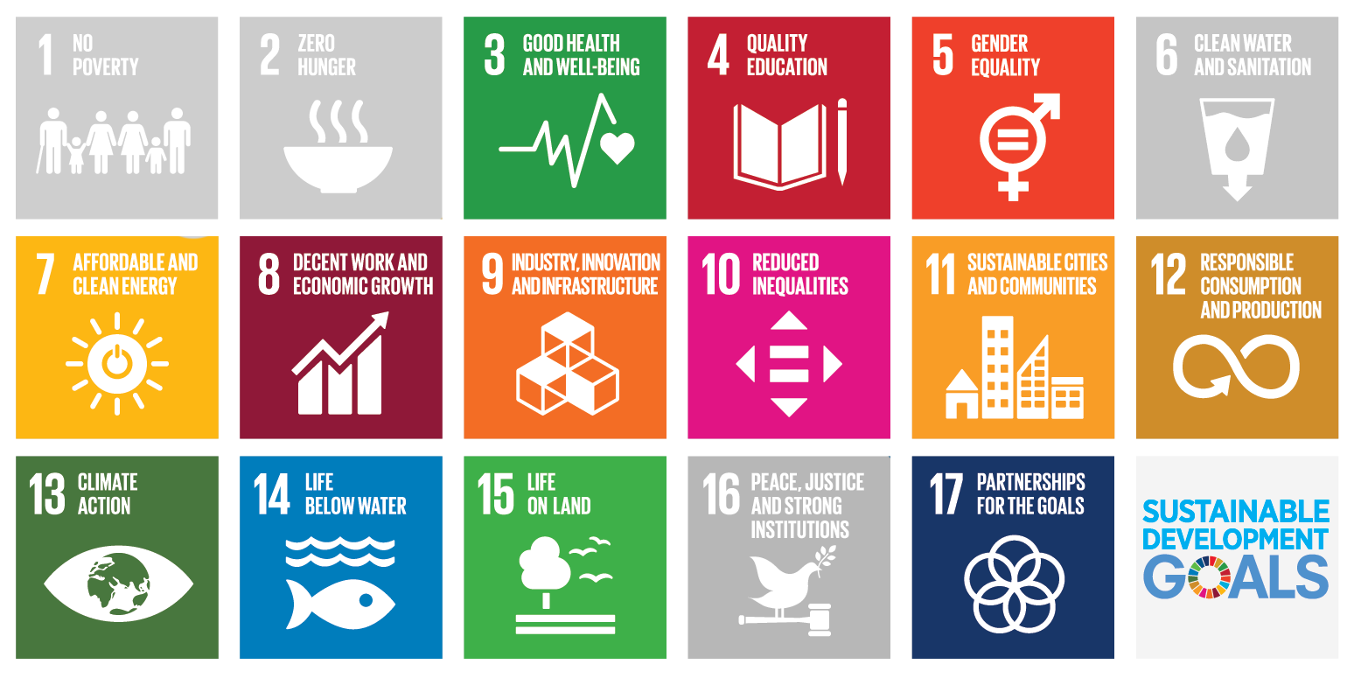
AI and UN’s Sustainability Goals
Notes:
Helse: H

Slide 27
The goal of science is not universal truth…but the gradual removal of prejudice (Niels Bohr).
The Prejudice | The Science
Earth is center of the universe | Copernican Revolution
Humans are a special species | Darwinian Evolution
Superiority of human intelligence | AI

