Slide 1
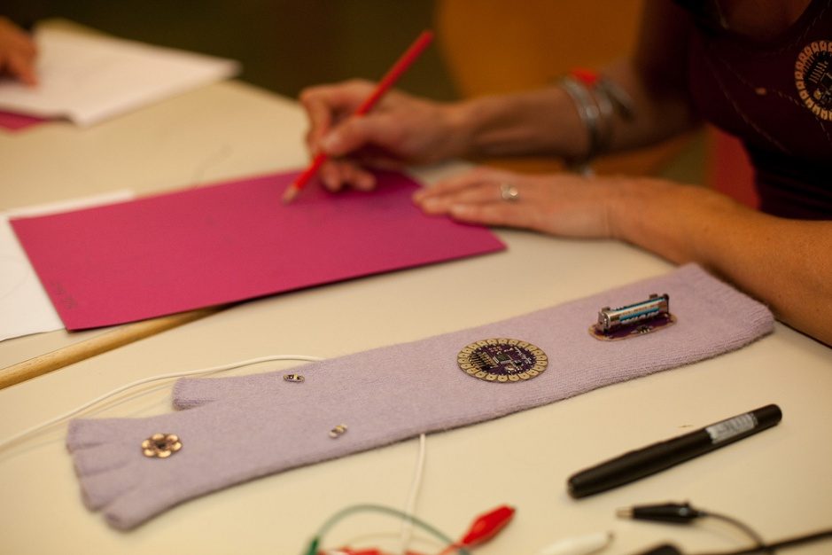
ArTe Open Source Software
Tools for creativity
  Letizia Jaccheri
  www.letiziajaccheri.com
  Torino May 2010

Slide 2
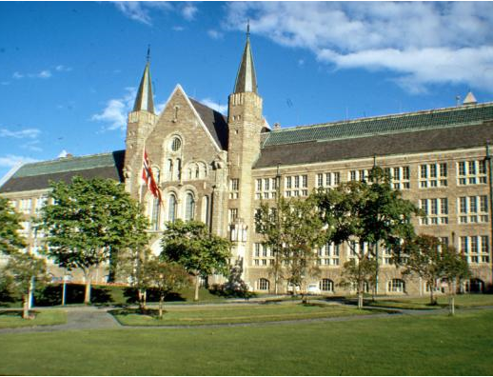
Norwegian University of Science and Technology
NTNU
4200 staff members
budget 4.2 bNOK
20,000 students
Trondheim 140.000 persons‏

Slide 3
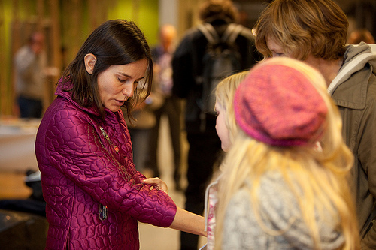
Vision
The vision of ArTe is disseminating IT issues to teen-agers, their teachers, and decision makers in the society, with focus on creativity, cooperation, and openness of processes and content. ArTe makes IT visible by help of art.

Slide 5
How
ArTe encourages people to work in meaningful cooperative projects with the goal of producing novel forms of new media art. The ArTe project is focused on the relationships between new media art and openness, organized around three topics: the relation between the author and the audience, the media of the artwork, and the tools used to realize the artwork.
Notes:
Technology or tool?

Slide 6
This presentation
This presentation will focus on open source tools evaluated according to the ArTe goals, with emphasis on Arduino, Scratch, and processing.
URL: http://www.artentnu.com

Slide 7
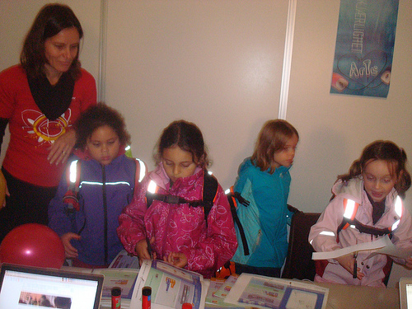
Testing the audience
dissemination - research
new media art - OSS
artentnu.com

Slide 8
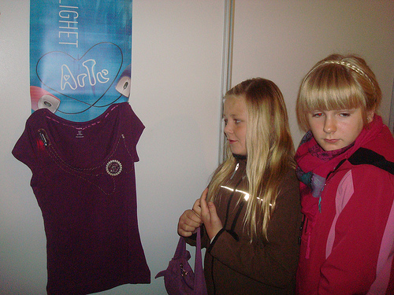
Norwegian Research Council – PROREAL 2009-2010
Increase interest in science, focus on recruitment
  Computer science
  Girls
  13-15 (Norwegian Ungdom school)

Slide 9
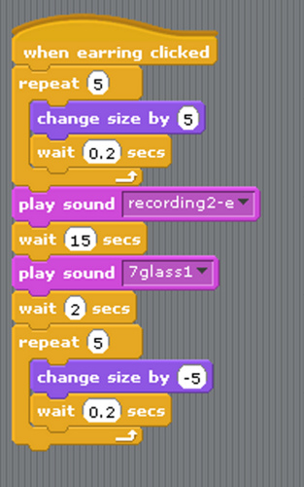
The ArTe vision
The vision of ArTe is disseminating IT issues to Norwegian and International teen-agers (13-15) with focus on creativity, cooperation, and openness of processes and content.

Slide 10
Choices
Web site artentnu.com 12,343 visits, pictures, videos, new media art, open source tools
Competition
  call, jury ++, first deadline 31 October
Book: physical – digital
Disseminating events: Researcher Days, Night, ITovation, visits to schools
In the media, chat.no, caplex.no, tekna, network

Slide 11
Arte Goals/Criteria
1. Openness
2. Support for teenagers
3. New media art
4. Cooperation and sharing
5. Information Technology
  does this tool make its users aware of IT issues, such as programming?”.

Slide 12
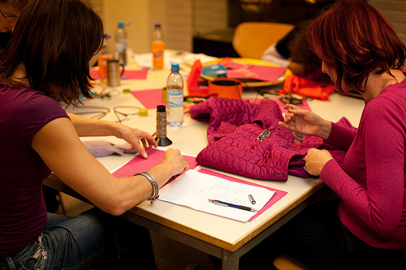
Tool - Arduino

Slide 13
Arduino beautiful and tangible
void loop()
{
//Turn on the output //signal for pin 10
digitalWrite(pin, HIGH);
delay(d);
//Turn off the ouput //signal for pin 10
digitalWrite(pin, LOW);
delay(d);
}

Slide 14
Tool: Audacity
Audacity supports sound recording, editing, and saving in different formats. It is simple to use with its tape-style layout which offers rewind, fast forward, play, and record functions.
Notes:
Desktop audacity

Slide 15
Tool: GIMP
GIMP supports picture manipulation and retouching. The program comes with several languages in addition to English. It supports the majority of picture file formats, such as jpeg, png, gif, xcf (which is the native format of GIMP) and the native format of photoshop, PSD.

Slide 16
Tool: Processing
Processing is a text programming language designed to generate and modify images, animation, and interaction. Beginners are able to write their own programs after only a few minutes of instruction.
www.processing.org
http://www.openprocessing.org

Slide 17
Tool: Scratch
Scratch is a programming language which makes it easy for pupils from the age of 8 to create their own interactive stories, animations, games, music, and art — and to share their creations on the web. Scratch is developed by the Lifelong Kindergarten Group, at MIT Media Lab.
http://scratch.mit.edu/
Notes:
Artentnu2009
Letizia1965
Show video from artentnu about scratch

Slide 18
Tool: Inkscape
Inkscape is a graphics editor using vectors. The main difference between a file created with a vector based editor compared to a filecreated with pixel based editors (like GIMP), is that images can be scaled up more easily. Inkscape uses the W3C standard Scalable Vector Graphics (SVG) file format, although it is possible to save in other formats as well.

Slide 19
Tool: Tuxpaint
Tux Paint is a free drawing program for children ages 3 to 12, which combines an easy-to-use interface with fun sound effects. It is ideal for those who want a basic drawing tool with which one can be creative from the first minute.

Slide 20
Criteria: Openness
The source code of all tools is open and available for inspection. All of the tools except Scratch are developed according to a process that is open to newcomers. GIMP, Audacity, Inkspace, OpenOffice.org, and Tux Paint support open formats. Arduino and Processing are programming languages which operate on text files. Scratch saves files in its own proprietary format sb.
Sharing of content and software

Slide 21
Criteria: Support for teenagers
Scratch is specifically designed for children from the age 8 and for teenagers. Tux Paint is designed for children between the ages of 3 to 12. All the other tools are not specifically designed for teenagers.

Slide 22
Criteria: New media art
Arduino can be used to develop and program installations. Processing has been developed by artists to be used by artists who wants to program artistic pictures and animations. Audacity is designed to manage music files. GIMP, Inkspace, and Tux Paint are picture manipulation programs. Scratch is designed for digital storytelling, while OpenOffice.org enables the user to develop powerpoint-style animations and text files.

Slide 23
Criteria: Cooperation and sharing
All tools come equipped with a web sites that provides manuals, examples, and forums for discussion. Scratch and Tuxpaint provides mechanisms for sharing and remixing media. Scratch has more than 300.000 (2009) 1M (May 2010) projects available created by 50.000 contributors.

Slide 24
Criteria: Information Technology
Arduino and Processing are based on programming. Scratch has been designed with the specific goal of making programming attractive to teenagers and children. The other tools do not require programming.

Slide 25
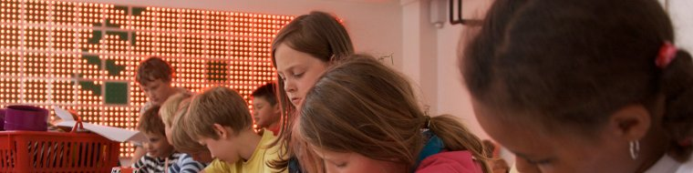
Research
SArt software art
SArt http://prosjekt.idi.ntnu.no/sart‏
Literature review
Participation to 3 artistic projects

Slide 26
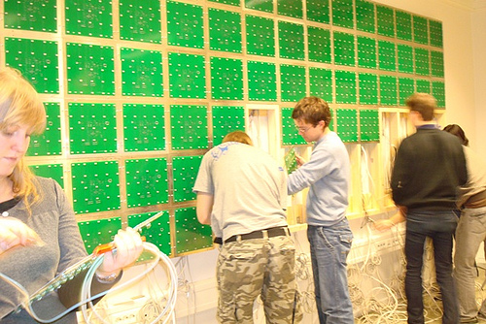
The open wall

Slide 27
Literature review
Who: artist, IT engineer, researcher, curator, gallery, audience
Why:
  Learning about cooperation, Innovation of products and interfaces, Aesthetics in computing, Develop and exhibit IT based artworks, Reflection on IT societal issues through art, Dissemination
What: tools, technology‏
Where: museum, open space, lab‏

Slide 28
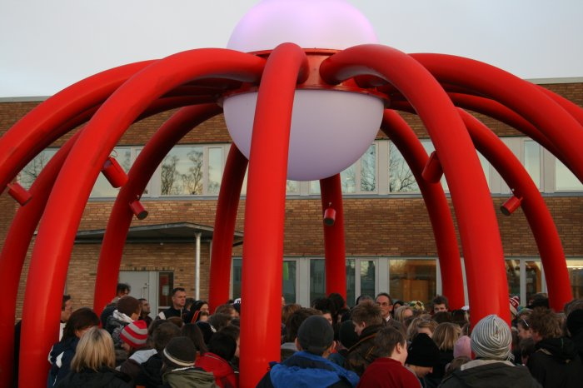
Research questions in SArt
How can we improve the development process of software dependent artworks and projects, in terms of software development, maintenance, upgrade and usability of the artwork?
Artist Samir M'kdami
PhD st. Salah U. Ahmed

Slide 29
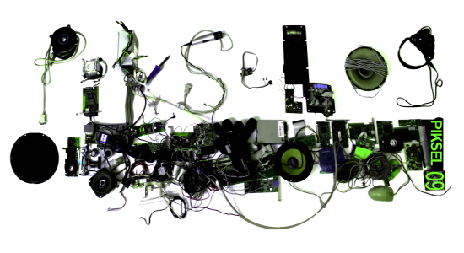
Relations
author
content
tools
format
licenses
audience
Notes:
There are many relations and we want to say something about these relations.

Slide 30
RQ1 Which are the main OSS tools for ACP?
RQ2 How do we characterize the OSS tools for (ACP)?
RQ3 Which authors use OSS tools for ACP?
RQ4 Why do authors use OSS tools for ACP?
RQ5 How do authors choose OSS tools for ACP?
RQ6 How do authors use OSS tools for ACP?
RQ7 Who are the tools developers (inventors)? Is the artist the developer?
RQ9 Which is the relation between artwork and tools?
RQ10 Is the tool an artwork itself?
RQ11 To what degree is the audience aware of the OSS tools? Is it possible for the audience to engage not only with the artwork but also with the tools?
Notes:
11 And if that is the case, in which ways and to what degree? Does the audience contribute to the creation of the artwork by accessing its code and changing it? Is this a case of ‘collaborative/distributed creativity’?
RQ7 (authors – tools) In which way do authors participate to the software developing process of the tools?

Slide 31
Why do we human beings need new technology?
to make our work more effective. Think about the plow, invented several millenniums B.C, or our beloved computer invented half century ago
to make our life go faster, think about the train, airplane, telephone, and internet
to make our life lighter and enjoyable. Think about cinema, radio, television, electronic games, and I-Pod

Slide 32
In ArTe
In the ArTe project we see technology as a possibility to introduce in our life more creativity, cooperation, and openness
Sewing as a way of seeing

Slide 33
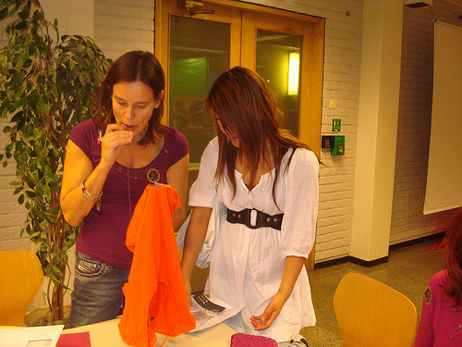

Slide 34
the lillac gown
The LED on the lillac gown displays a beautiful yellow color to symbolize day light. The LED switches to a deep blue night color and again to yellow. Day after day. By moving my arms, jumping, walking, falling down I alter this cycle. The more I stress the less I am able to observe the cycle of life. I cannot really observe myself. I need somebody else to tell what they see on my gown LED. Beautiful or less beautiful patterns can arise while I busy myself. These patterns do not always match the lilac color of my gown.

Slide 35
the lillac gown (cont.)
I understand more and more the programs that govern my gown but I do not fully understand the relationships between my movements and its effects. I needed the help of both my student Hallgeir to write the code and my friend, fashion design Urd, to find my unique lilac Lilypad gown, and I need Daniela who believes in science, to observe my gown and its program to find the motivation to change. I do not fully understand the details of acceleration but I am aware I will. I know that the beautiful cycle of yellow and deep blue will come again and again.

Slide 37
Future
Teaching
  Experts in Team, Fourth year course taken by 1800 students at NTNU, 3 weeks full time 30 students
  Art and software since 2004, 30 students per year
Research/practice
  PhD positions NTNU
  Art projects participation
  ArTe 2.0 by Culture Council of Norway

