Slide 1
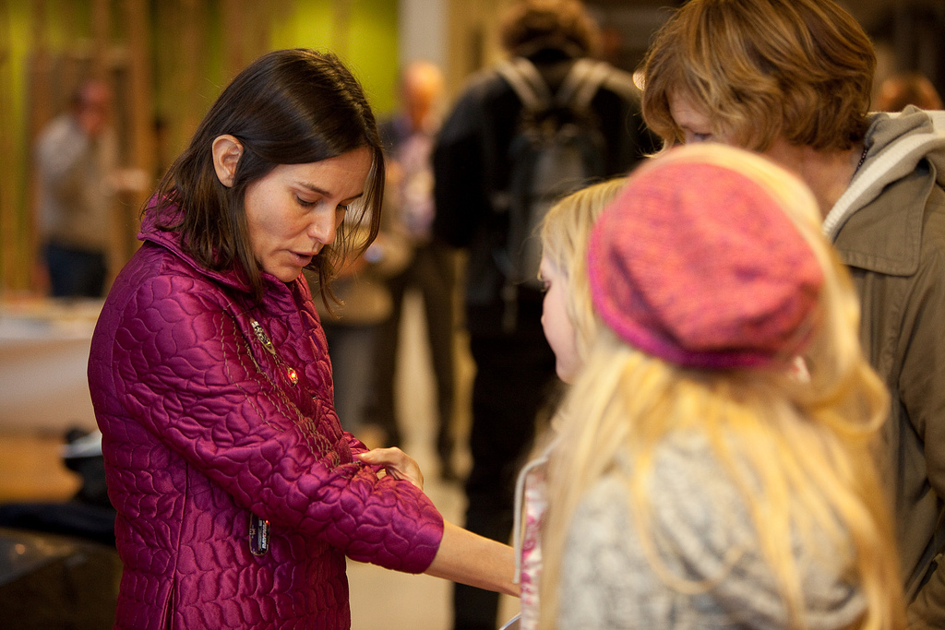
Letizia Jaccheri
Norwegian University
of Science and Technology
Electronic art chair XP2010
www.artentnu.com

Slide 2
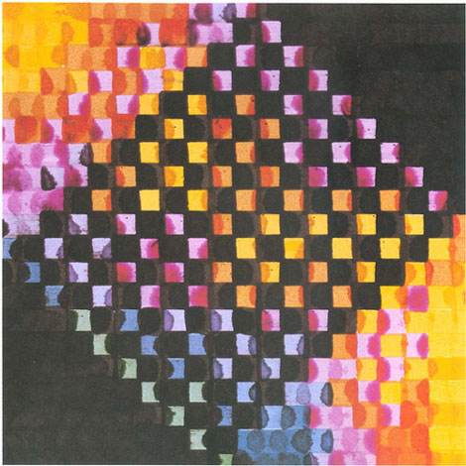
The first electronic art
Exhibition was held in New York
In 1965
Picture Frieder Nake: Multiplication Series 31, detail, China ink on papers, 50 x 50 cm, 1967

Slide 3
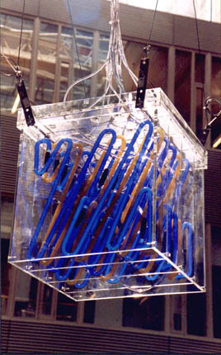
Electronic Art or Digital art all forms of art that exploit information technology, like digital images, videos, music, games, digital stories, poems, interactive installations.
Gilde is a cooperation project between two artists working with sound (Nordheim) and light (Nesjar), and IT engineers (Soundscape). Gilde is installed at Realfagbygget NTNU, Gløshaugen, 2001

Slide 4
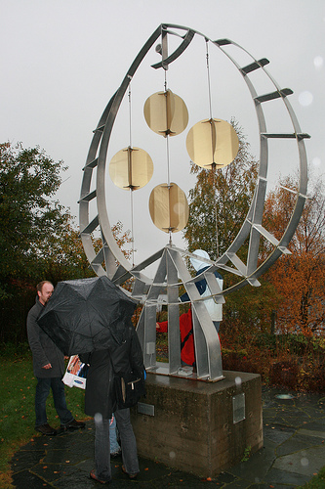
Øyvind Brandsegg
will play again Thursday 3rd June at 815
Brandsegg, Flyndre at Inderøy, Norway, 2006-2016.

Slide 5
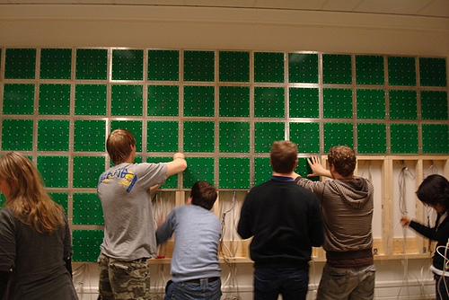
The artist is the inventor
The Open Wall, who is the author? 2008, Gløshaugen NTNU Trondheim

Slide 6
Letizia Jaccheri
Norwegian University
of Science and Technology
Electronic art chair XP2010
www.artentnu.com

