Slide 1
www.artentnu.com
for MKI-students
kl. 13.30 Room D133,
seminarrom i Bygg 11, nivå 4
Letizia Jaccheri
Department of Computer and Information Science
‏Norwegian University of Science and Technology
Notes:
12 minutes totally
1

Slide 2
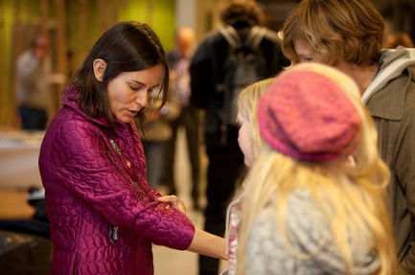
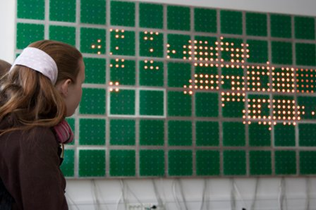
2 master descriptions
1) Computer enabled creativity
2) The open wall

Slide 3
Computer enabled creativity (1)
The research goal is to increase knowledge on the interdisciplinary area between digital art and software technology. The research questions explore the digital art projects made by the interplay between technologists, artists, and audience. The principal domain of study is outlined by “Maker” events, both physical and virtual. Maker events are centered on enabling software technology for creativity and art (like Arduino and Microsoft .NET Gadgeteer), and aim at enabling a broad audience to become makers of digital artistic expressions.

Slide 4
Computer enabled creativity (2)
The Master student will use qualitative research methods (like the case study methodology) to explore the creation process and the quality of makers’ events. In particular, the data generation method consists of the artefacts that already exist prior or at the time of the research. Analysis will be qualitative enhanced by esthetic evaluation. The results of this research will consist of guidelines/theories about how to best develop, compare, and evaluate digital art projects.

Slide 5
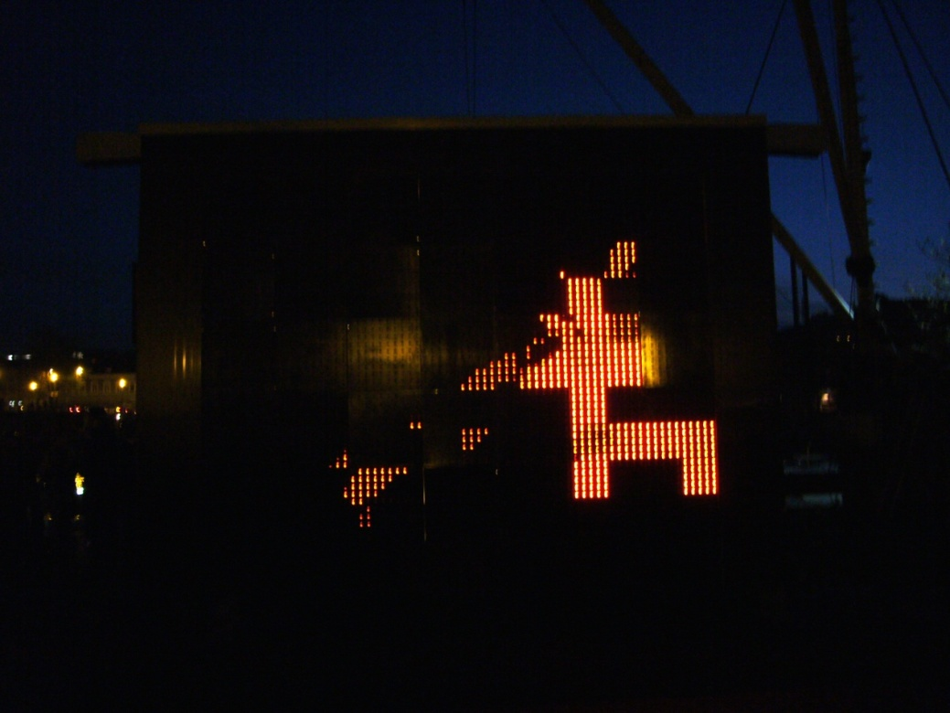
The open wall - When
2005 architect Åsmund Gamlesæter initiates the project as he wants to build a LED facade for an experimental house
2007, the Open Wall software goes open source with BSD license
2008, 3 groups of students re-build the installation during a 3 weeks intensive course

Slide 6
The open wall What?
480 cm long and 180 cm high
96 circuits boards (16 x 6 boards 25 LED each) containing 2400 orange LED lights with 5 cm distance to the next light
light with 99 possible intensities
Each board: microprocessor, power connection, and Ethernet
Connection through a set of switches or hubs
http://sart.svn.sourceforge.net
Notes:
Add a picture
6

Slide 7
The competition process
Itovation 4 June 2008, Espen G. announces the competition
Deadline 15th September
The prize award will take place at this year’s festival for art and technology in Trondheim, Trondheim Matchmaking, the 17th - 18th of October.
The contest is divided in two prize categories:
- The Open Wall open contest.
1st prize 2000 €, 2nd prize 1500 €, 3rd prize 1000 €.
- The Open Wall student contest. 2000 NOK each

Slide 8
The jury
Stacey Spiegel, Artist, President, Parallel World Labs Inc
Trine Eidsmo, Artist, Trondheim Electronic Arts Centre
Per Platou, Artist, Coordinator, The Production Network of Electronic Arts Norway
Bjørn Alterhaug, professor, Department for Music, NTNU
Letizia Jaccheri, professor, Department of Computer and Information Science, NTNU

Slide 9
The participants
19 contributions: from Norway (6), Germany (3), Thailand (1), Sweden (1), USA (6), Italy (2)

Slide 10
Those who did not win
Technology based, rather than inspired by an estetic, poetic idea. Should go together with some artists.
Too little elaborated.

Slide 11
Anne Marthe Dyvi - GLIMT
The building where “The Wall” is located is “ populated” with students and staff. Two main ingredients in a school. No students - no school, no staff - no school.
I want the artpiece to be a documentation of the activity in the building. And a documentation of that every person does equally effect their surroundings. Visually expressed through a light-glimps.
The pattern is created by the collection of movement by every user of the building.
Motivation: it is driven by an estetic idea which invites us to reflect about students and teachers, their patterns of activities and relations.

Slide 12
a) Practices: Wall art in the world - similar projects b) Theories: which theories can help to understand wall art projects and their participation processes?
http://medialab-prado.es/article/26000_pixeles_presentacion_final

