Slide 1
ArTe New Media Art
Letizia Jaccheri
www.letiziajaccheri.com
Pisa February 2010

Slide 2
New media art
In project ArTe, we use the term “new media art” to describe artworks involving digital images, animations, digital music, computer games, digital poetry and literature, computer based installations, and robots
The relation between the author and the audience and the media of the artwork and its technology support

Slide 3
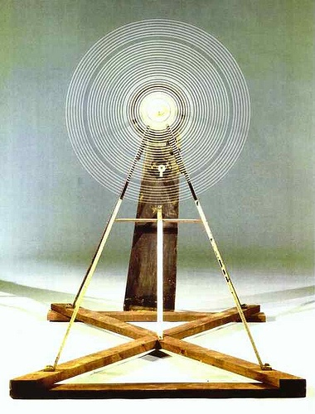
Rotary Glass Plates,
Precision Optics, a motorized sculpture,
built by Marcel Ducham in 1921,
with help from Man Ray.

Slide 4
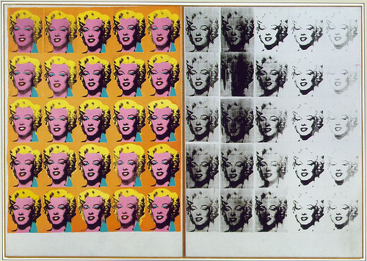
Warhol’s Marilyn Monroe Diptych, 1962

Slide 5
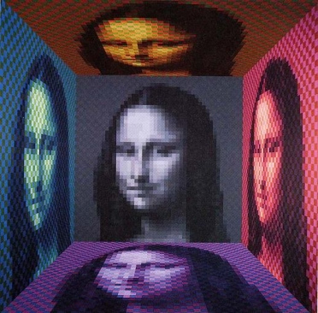
Picture of Yvaral’s Mona Lisa, 1989.

Slide 6
Arne Nordheim is a Norwegian composer who’s international
breakthrough came in the late 1950s.Ode to Light was installed
in cooperation with the acoustics department at NTH (NTNU) in 1968.

Slide 7
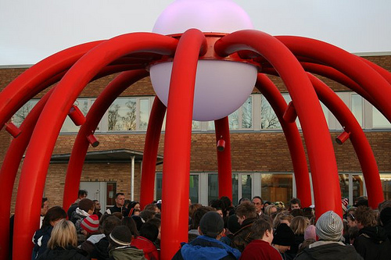
Samir M’kadmi is both a curator and an artist working with video and sounds.
M’kadmi is the artist behind Sonic Onyx, an Interactive Art Installation
Project commissioned by Trondheim Municipality and located at Blussvold
school in Trondheim, 2007

Slide 8
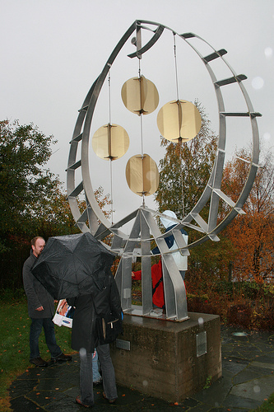
http://flyndresang.no/

Slide 9
The open wall: who is the author?
who is the responsible?

Slide 10
Conclusions New Media Art
Author – audience – media – technology/tool

