Slide 1
About Openness
Letizia Jaccheri
www.letiziajaccheri.com
Pisa 26.02.2010

Slide 2
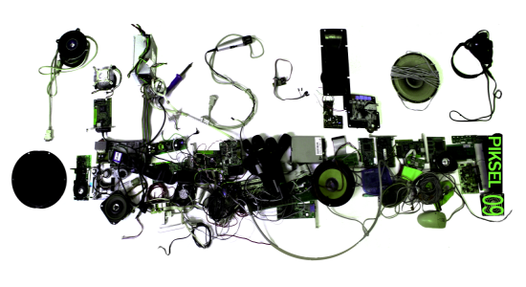
Open source software
author
format
content
tools
licenses
audience

Slide 3
Author – audience (Licenses)
Who can use and make copies of a cultural object?
Notes:
A license places limits on who can use and make copies of a cultural objects. An important license is the GPL (Gnu Public License). GPL introduces an important cultural change as the term copyright is replaced with the idea of copyleft. Copyleft licensing gives all recipients of a file the right to use, copy, modify, and distribute it, while forbidding them from imposing further restrictions on any copies they distribute. This means everyone can use, while no one can own. While GPL was conceived for software, Creative commons provides a family of licenses that enables an author to specify the constraint he or she wants on the cultural objects he or she produces. The license that governs the content of the site Artentnu.com and its submissions is part of the creative commons family. Organizations wanting to build business models around OSS have developed licenses of their own, like for example the Apache licenses, which are less restrictive than GPL with respect to commercialization.

Slide 4
GPL (Gnu Public License)
copyright is replaced with copyleft
copyleft licensing gives all recipients of an object the right to use, copy, modify, and distribute it, while forbidding them from imposing further restrictions on any copies they distribute. This means everyone can use, while no one can own

Slide 5
Creative commons
CC provides a family of licenses that enables an author to specify the constraint she wants on the cultural objects she produces
The license that governs the content of the site Artentnu.com and its submissions is part of the creative commons family.

Slide 6
Licenses and commercialization
to build business models around OSS, organizations have developed licenses of their own, like for example the Apache licenses, which are less restrictive than GPL with respect to commercialization.

Slide 7
Media Formats
Open formats are standardized by International standardization bodies such as ISO (The International Organization for Standardization).
Proprietary formats are developed and owned by single organizations or groups of organizations.

Slide 8
Media formats
Sound
Open: ?
Proprietary: ?
Pictures
Open: ?
Proprietary: ?
Video
Open: ?
Proprietary: ?
Document
Open: ?
Proprietary: ?

Slide 9
Media formats
Sound
Open: ogg FLAC, ogg Vorbis, ogg Speex
Proprietary: mp3, mp4, m4a, wav (Microsoft), aiff (Mac)
Pictures
Open: xcf, png, svg, tiff
Proprietary: jpeg, gif
Video
Open: ogg Theora
Proprietary: mov, wmv, avi, mpg
Document
Open: odf, pdf, html, xhtml, xml, css z
Proprietary: doc, ppt

Slide 10
Media formats
The tool you use will sometimes decide the format of your multimedia files. When working with digital media files, it is important to take time to think and discuss about which format to use, in order to make the right choices.
Notes:
Right choices mean reflected choices

Slide 11
Process
Open: new comers can contribute
Close : new comers cannot contribute back their modifications

Slide 12
OSS Tools
OSS tools: computer programs which can be used freely and whose source code is available for modification.
run on Linux, Mac OS and/or Windows
Free versions of commercial tools, ex. GIMP
Unique tools, ex. Scratch
Notes:
Some tools, like Scratch, are not free versions of an existing commercial tool, but new unique tools developed with the goal of enhancing learning and creativity of children or teenagers.

Slide 13
Conclusions - Openness
Computers can be exploited as machine to create and share culture, as well as calculate. By culture we mean cultural objects like books, music, video, games, as well as the software itself. In ArTe, we focus on three important openness issues, namely licenses, formats, and tools

